Slide 1




Management Response to the Report of
the Board of Auditors
for the year ended 31 December 2018
Lene Jespersen, Director, a.i.
Strategy, Planning, Resources and Effectiveness Division

Slide 2





Overview of 2018 UNBoA audit of UN-Women
12 Recommendations Issued
Headquarters - NY
8th
Unqualified Audit Opinion
Mexico Country Office
Panama Regional Office
UN-Women Offices Audited

Slide 3

2018 Audit Recommendation Implementation Status as of Jan 2020
Issued in 2018
1 In- Progress, 8%
Status of 12 new recommendations issued:
4 Completed Actions (UN-Women), 33%
7 Assessed Implemented (UNBoA), 59%
Actions completed for 92% (11 of 12) of 2018 audit recommendations
UNBoA assessed implemented 7 of 11 audit recommendations, 4 pending assessment
Note: dotted areas represent recommendations with High priority

Slide 4


Five Key Findings and Recommendations Issued in 2018
Recommendation:
Develop dashboard to monitor procurement planning compliance
Action:
Corporate Procurement Plan monitoring dashboard launched
Key Finding #1:
Non-Compliance on Procurement Plan
UNBoA Assessed Implemented

Slide 5
Five Key Findings and Recommendations Issued in 2018
Recommendation:
Improve project procurement planning
Action:
Procurement Plan template to be included in Project Appraisal Committee checklist
Key Finding #2:
Inconsistent Procurement Planning for Projects
UN-Women Action In-progress

Slide 6
Five Key Findings and Recommendations Issued in 2018
Recommendation:
Standardize project expenditure sampling and documentation
Action:
Standardized project expenditure liquidation review process included in the revised Cash Advances and Transfer Policy
Key Finding #3:
Inconsistent project expenditure sampling documentation
UN-Women Actions Completed

Slide 7
Five Key Findings and Recommendations Issued in 2018
Recommendation:
Review and record project expenditures on time
Action:
Recorded partner project expenditures on time
Key Finding #4:
Untimely project expenditure recording
UNBoA Assessed Implemented

Slide 8
Five Key Findings and Recommendations Issued in 2018
Recommendation:
Provide training on implementing partners’ project expenditure liquidation
Action:
Trained implementing partners on expenditure liquidation
Key Finding #5:
Enhancements required in Implementing Partners’ capacity
UNBoA Assessed Implemented

Slide 9
Prior Years’ Audit Recommendation Implementation Status as of Jan 2020
Issued in 2016 and 2017
Actions taken in 2019 on remaining 10 recommendations:
3 Assessed Implemented (UNBoA), 30%
4 In-Progress, 40%
Actions completed for 60% (6 of 10) of 2016, 2017 audit recommendations
3 Completed actions (UN-Women), 30%
UNBoA assessed implemented 3 of 6 audit recommendations, 3 pending assessment
Note: dotted areas represent recommendations with High priority

Slide 10
Prior Years’ Audit Recommendation Implementation Status as of Jan 2020
Issued in 2016 and 2017
UNBoA Assessed as Implemented (30%)
UN-Women Actions Completed (30%)
Fraud risk assessments conducted
Small Grants Policy launched
Global consultant monitoring system upgraded
5) Procedure for implementing partners selection updated (2 recs)
Monitoring of findings from project partner audits strengthened
UN-Women Actions In-Progress (40%)
Enhance capacity of Audit Coordination Unit
Improve linkage between Results Management System and Atlas
Establish policies for project management and accounting for prior years’ ineligible expenditure
Finalize guidelines for programme and field presences (country typology)

Slide 11






Executive Board Decision 2019/3
Status of 5 main audit recommendations issued in 2017
Implemented
Implemented
Action completed
Action completed
In-Progress

Slide 12
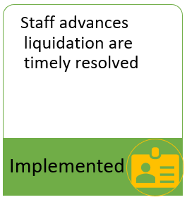
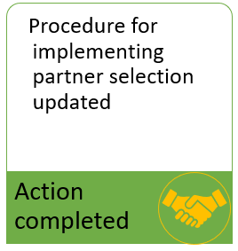
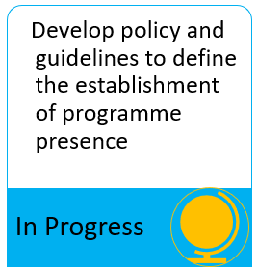
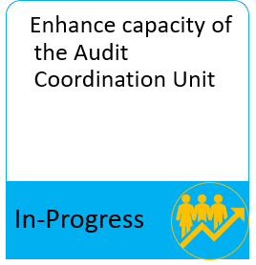

Executive Board Decision 2019/3
Status of 4 remaining audit recommendations issued in 2016

Slide 13
Thank you for your Attention!
Q & A

