Slide 1


Independent Evaluation and Audit Services (IEAS)
Independent Evaluation Service (IES)
What can we learn from UN Women evaluations?
A META-SYNTHESIS OF EVALUATIONS MANAGED BY UN WOMEN IN 2018
2019

Slide 2
2019 META-SYNTHESIS
SCOPE
39 evaluations
Programmes
implemented in 2014-2018
80 countries - all
regions represented
PURPOSE
METHODOLOGY
Qualitative and quantitative analysis
Enablers and drivers of performance
5 selected criteria:
relevance, effectiveness, efficiency,
results culture & sustainability
• Evidence-based insights through aggregation and synthesis of evaluation findings
Contribute to knowledge generation and organizational learning
•Inform the mid-term review of the Strategic Plan, and other corporate and country level strategies and processes

Slide 3
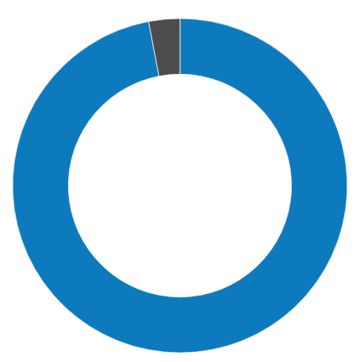
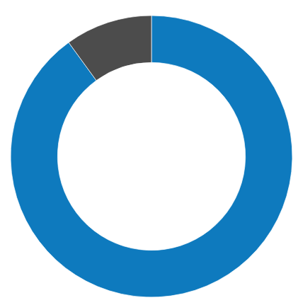
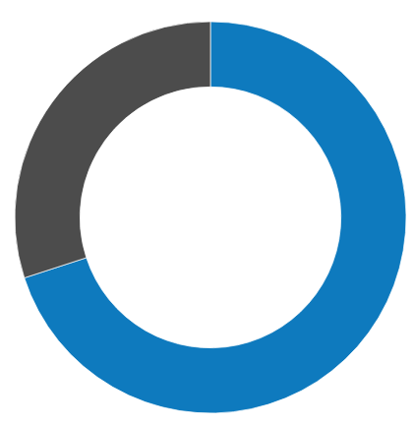
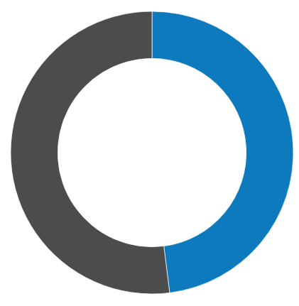

INSIGHT
UN Women has achieved and
sustained its strategic positioning
across its integrated mandate.
However, it is critical for UN Women’s to protect and sustain policy gains, and establish clear and robust policy and practice
linkages.
OPPORTUNITY
Strengthen the strategic
positioning of UN-Women and its participation in broader system- wide initiatives and deepen the
focus on social norm change more coherently.
RESULTS OF THE META-SYNTHESIS
Overarching Conclusion
PERFORMANCE OF DEVELOPMENT EFFECTIVENESS CRITERIA
97%
90%
70%
48%
87%
Relevance
Effectiveness
Efficiency
Results’ culture
Sustainability

Slide 4
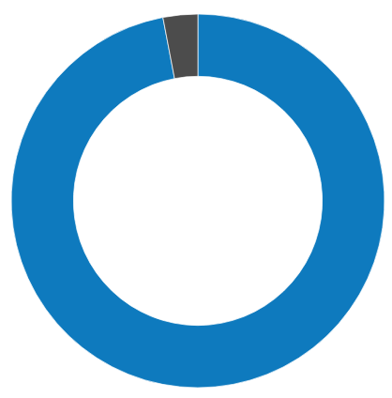
RELEVANCE
97%
INSIGHT
UN Women supported interventions are suited to the needs of target
groups and are aligned with national priorities. Effective partnerships led to strategically positioning gender issues in national agenda.
OPPORTUNITY
There is scope for a more systematic
needs assessment, mapping and gender analysis for better-targeted assistance
to fulfilling the commitment to the
“leave no one behind” principle.

Slide 5
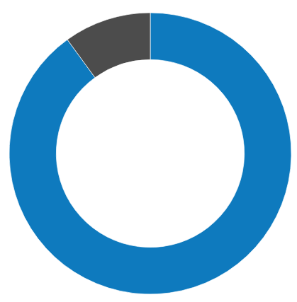
EFFECTIVENESS
90%
INSIGHT
UN Women interventions have been effective in achieving most of their objectives. Small-
scale interventions, limited human and
financial resources, weak partner capacity and monitoring systems have at times
affected performance.
OPPORTUNITY
Boost the achievement of results through
multi-pronged advocacy, capacity building and strategic and diverse partnerships, including
through the United Nations Sustainable Development Cooperation Framework
(UNSDCF)

Slide 6
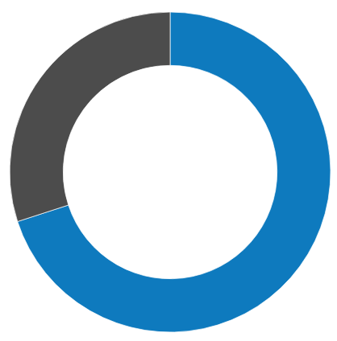
EFFICIENCY
70%
INSIGHT
UN Women has reportedly improved its programme and management
efficiency, but its success largely hinges on its ability to operate with limited
resources and to leverage partners’ resources.
OPPORTUNITY
Strengthening programme design and monitoring systems to better track
and monitor costs, and having viable strategies for assuring needed human and financial resources.

Slide 7
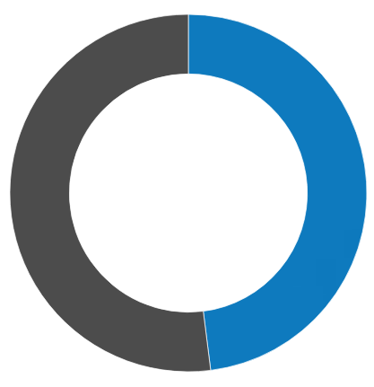
RESULTS-BASED MANAGEMENT CULTURE
48%
INSIGHT
Despite gradual improvements over the years, capacity varies and constraints
exist in ensuring functional results-based management practices at the programme implementation level.
OPPORTUNITY
Results culture needs to be further
improved through explicit theories of change and knowledge management, including capturing and reporting
longer-term results and lessons learned.

Slide 8
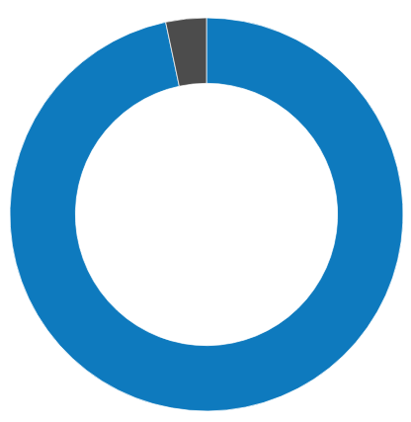
SUSTAINABILITY
87%
INSIGHT
Sustainability of UN Women supported programmes and results are mixed
and highly influenced by the different contexts and complex situations in
which UN Women operates.
OPPORTUNITY
Enhance the sustainability of UN Women’s interventions through exit strategies
and sustainability plans as well as more strategic and meaningful engagement of men and boys.

Slide 9
Ability to operate with limited resources
and leverage funds
Committed personnel willing to over-stretch
Strategic partnerships with CSOs and women’s groups/networks
Joint programming and UNCT coordination
Synergistic and holistic approaches
Multi-pronged advocacy and innovative approaches
Challenging political environments and security situations
Deep-rooted cultural/social norms
Limitations in core resources and the unpredictability of non-core resources
Highly stretched human resources
Shifting priorities and limited capacity of partners
Inadequate monitoring/RBM practices and
inadequate data on outcomes
Small scale interventions and short duration of projects
ENABLING FACTORS
HINDERING FACTORS
DRIVERS OF CHANGE

Slide 10












Independent Evaluation and Audit Services (IEAS)
Independent Evaluation Service (IES)
THANK YOU
Find all corporate evaluations at:
http://www.unwomen.org/en/about-us/accountability/evaluation/corporate-evaluations
CORPORATE THEMATIC EVALUATION OF UN WOMEN’S CONTRIBUTION TO
GOVERNANCE AND NATIONAL PLANNING
Final Report
CORPORATE THEMATIC EVALUATION OF UN WOMEN’S CONTRIBUTION TO
GOVERNANCE AND NATIONAL PLANNING
Final Report
CORPORATE THEMATIC EVALUATION OF UN WOMEN’S CONTRIBUTION TO
GOVERNANCE AND NATIONAL PLANNING
Final Report
CORPORATE THEMATIC EVALUATION OF UN WOMEN’S CONTRIBUTION TO
GOVERNANCE AND NATIONAL PLANNING
Final Report
Find us on Twitter
@unwomenEval

