Slide 1

Dr. Tara Patricia Cookson
Research Fellow, University of British Columbia
Director, Ladysmith
Notes:
SHARE WEBCAM / UNMUTE
[1] I’m here to talk about a qualitative - ethnographic - research perspective, I love qualitative research, and I’m really excited to be here. In particular I’m going to talk about findings in a book I’m publishing with University of California Press about CCTs out in May, which started with my PhD research at the University of Cambridge, and then share some ways that at Ladysmith we incorporate feminist ethnographic methods in our practical policy research. NEXT SLIDE.

Slide 2
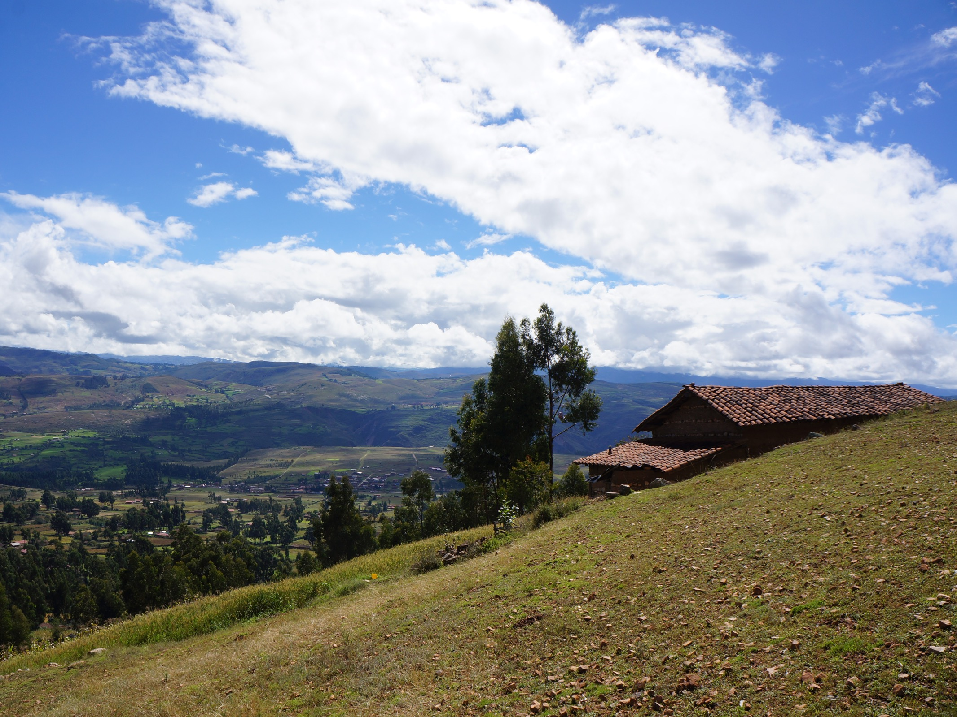
Yesenia’s story
Notes:
SHARE WEBCAM / UNMUTE
[1] I’m here to talk about a qualitative - ethnographic - research perspective, I love qualitative research, and I’m really excited to be here. In particular I’m going to talk about findings in a book I’m publishing with University of California Press about CCTs out in May, which started with my PhD research at the University of Cambridge, and then share some ways that at Ladysmith we incorporate feminist ethnographic methods in our practical policy research. NEXT SLIDE.

Slide 3
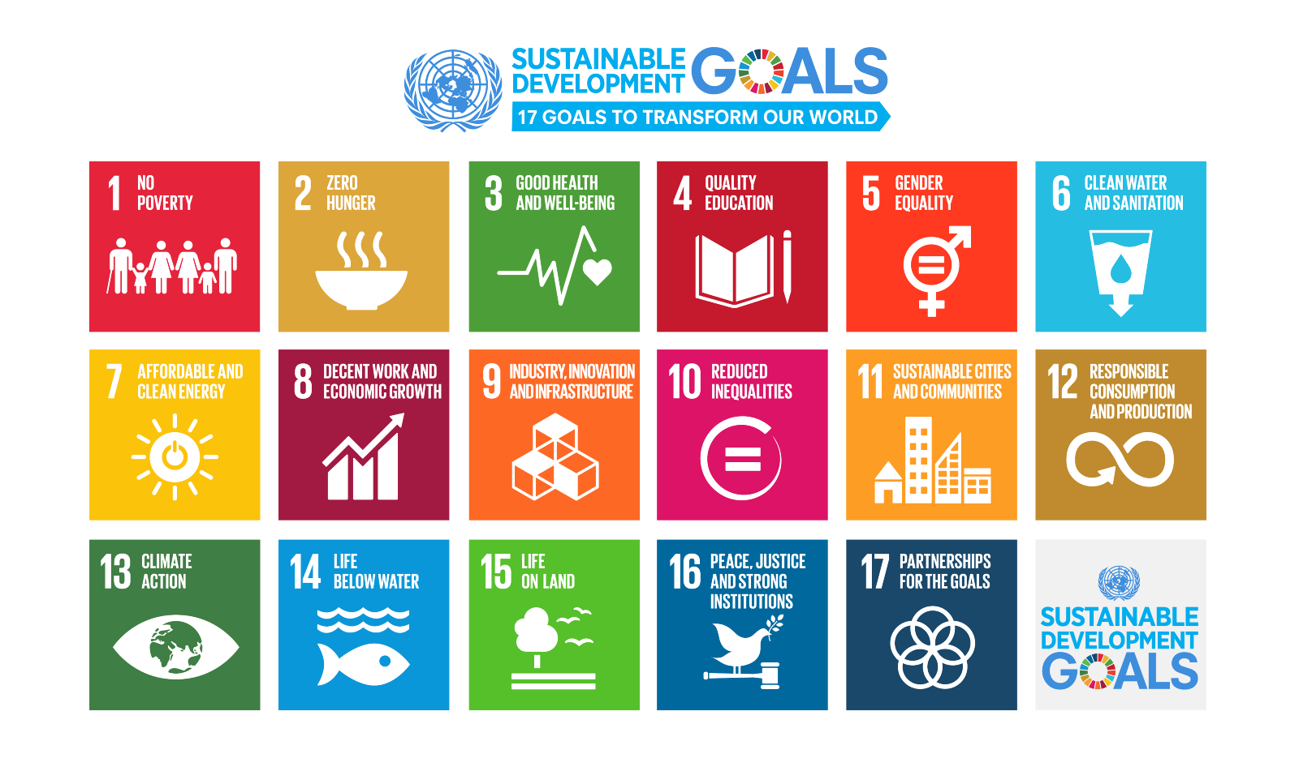

Slide 4
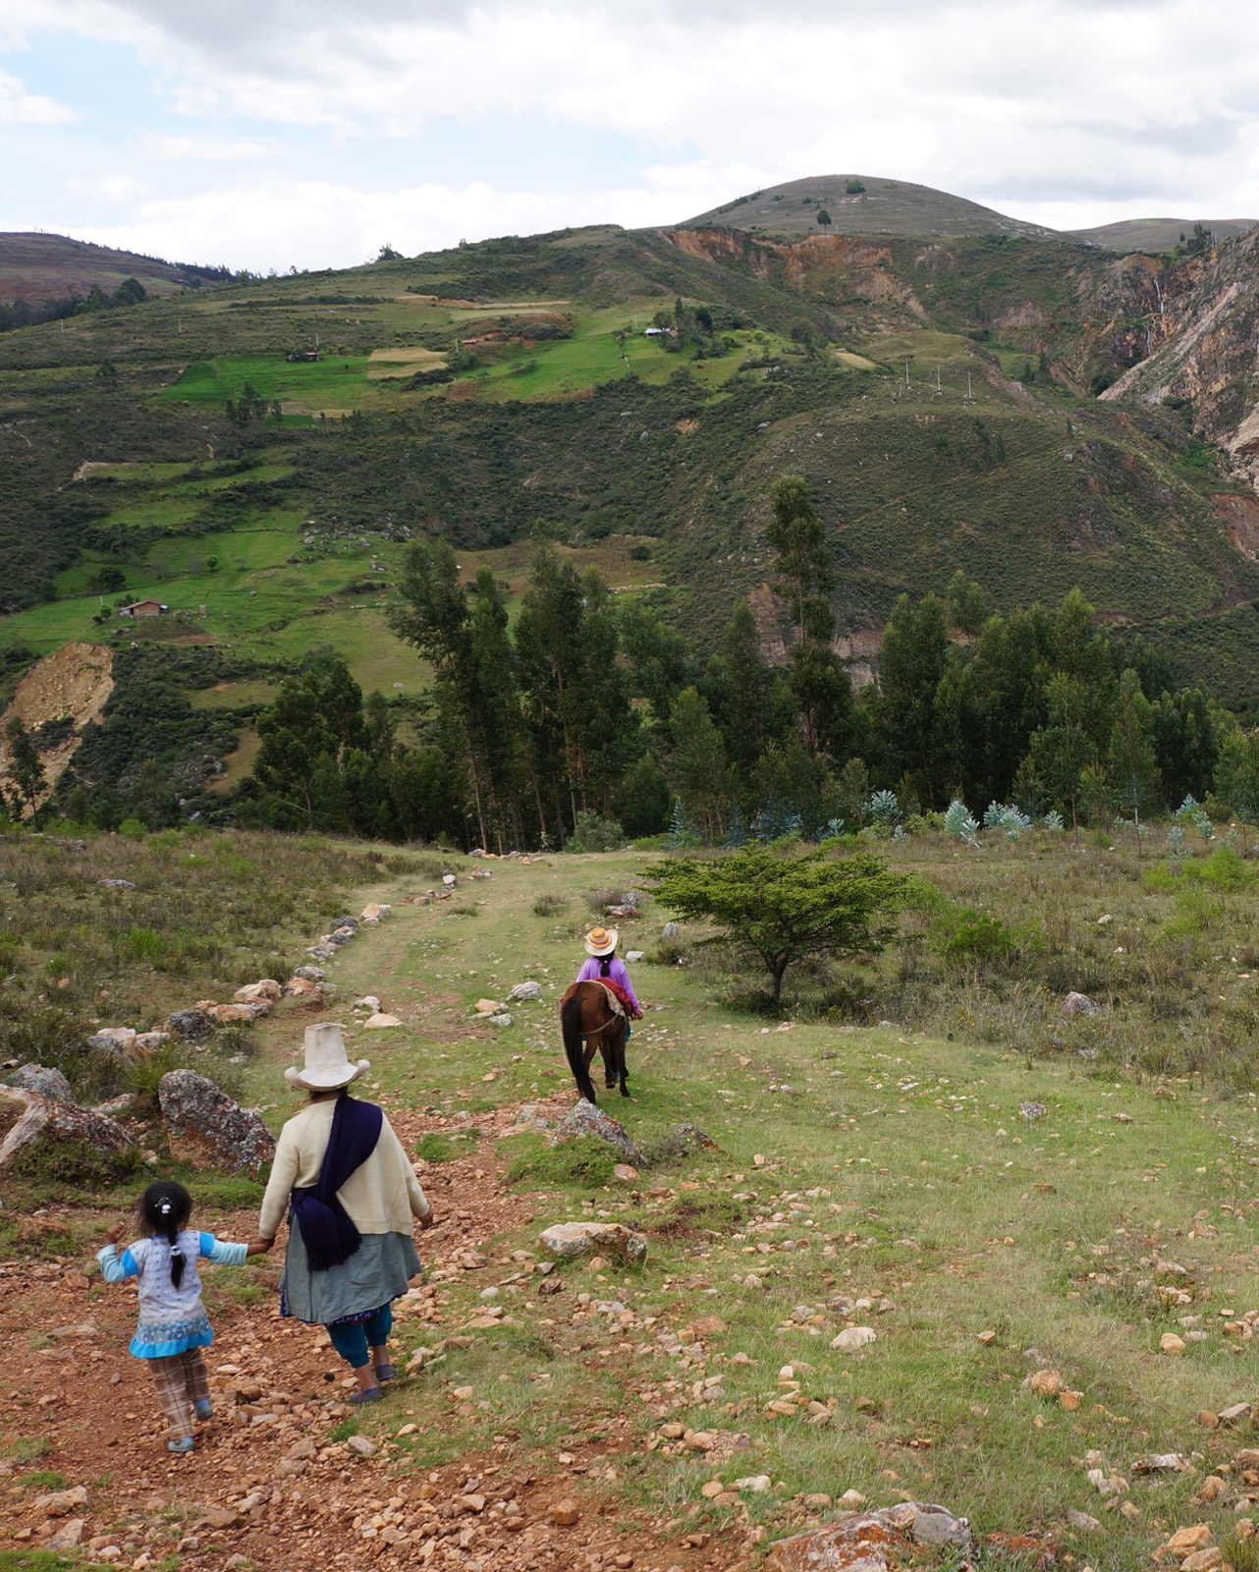
Conditionalities
mask poor
service quality

Slide 5
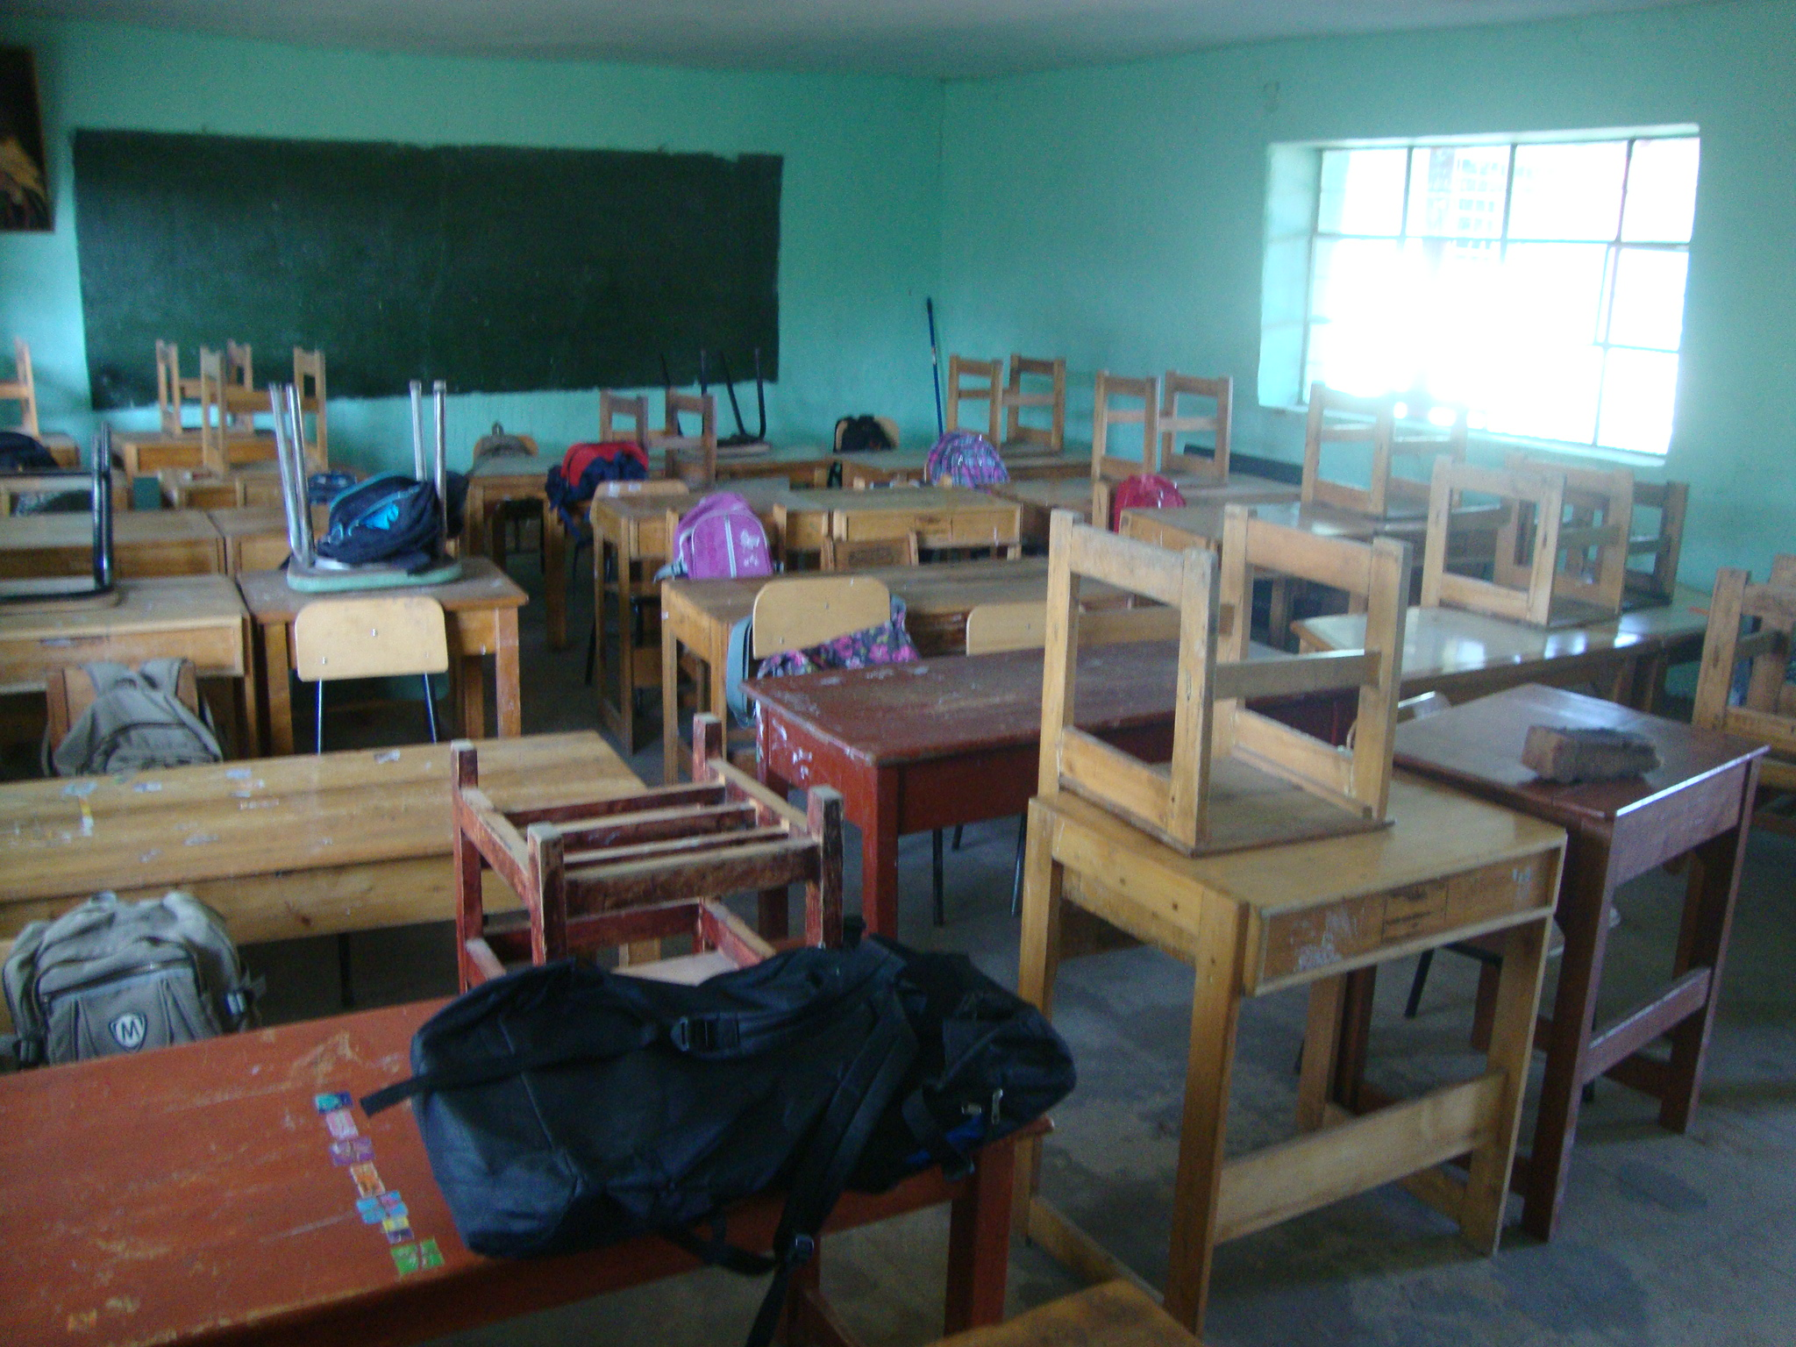

Slide 6
Conditionalities create opportunities for coercion
Marching in parades
Painting the CCT program flag on one’s house
Participating in a political re-election campaign
Cooking (unpaid) for the school lunch program
Paying for school parties
Participating in micro-enterprise
Cooking for a regional fair
Giving birth in a registered facility
Contributing to medical costs of a neighbor’s broken leg
Taking Zumba (exercise) classes
Cleaning public spaces
Keeping a tidy house
Growing a vegetable garden
Keeping hygiene instruments organized
Build and use ecological refrigerators
Have separate bedrooms for parents and children
Using a smokeless stove
Purchasing “appropriate” food items
Attending meetings
Having a latrine
Attending literacy classes
“Doing whatever the local manager tells me to”

Slide 7
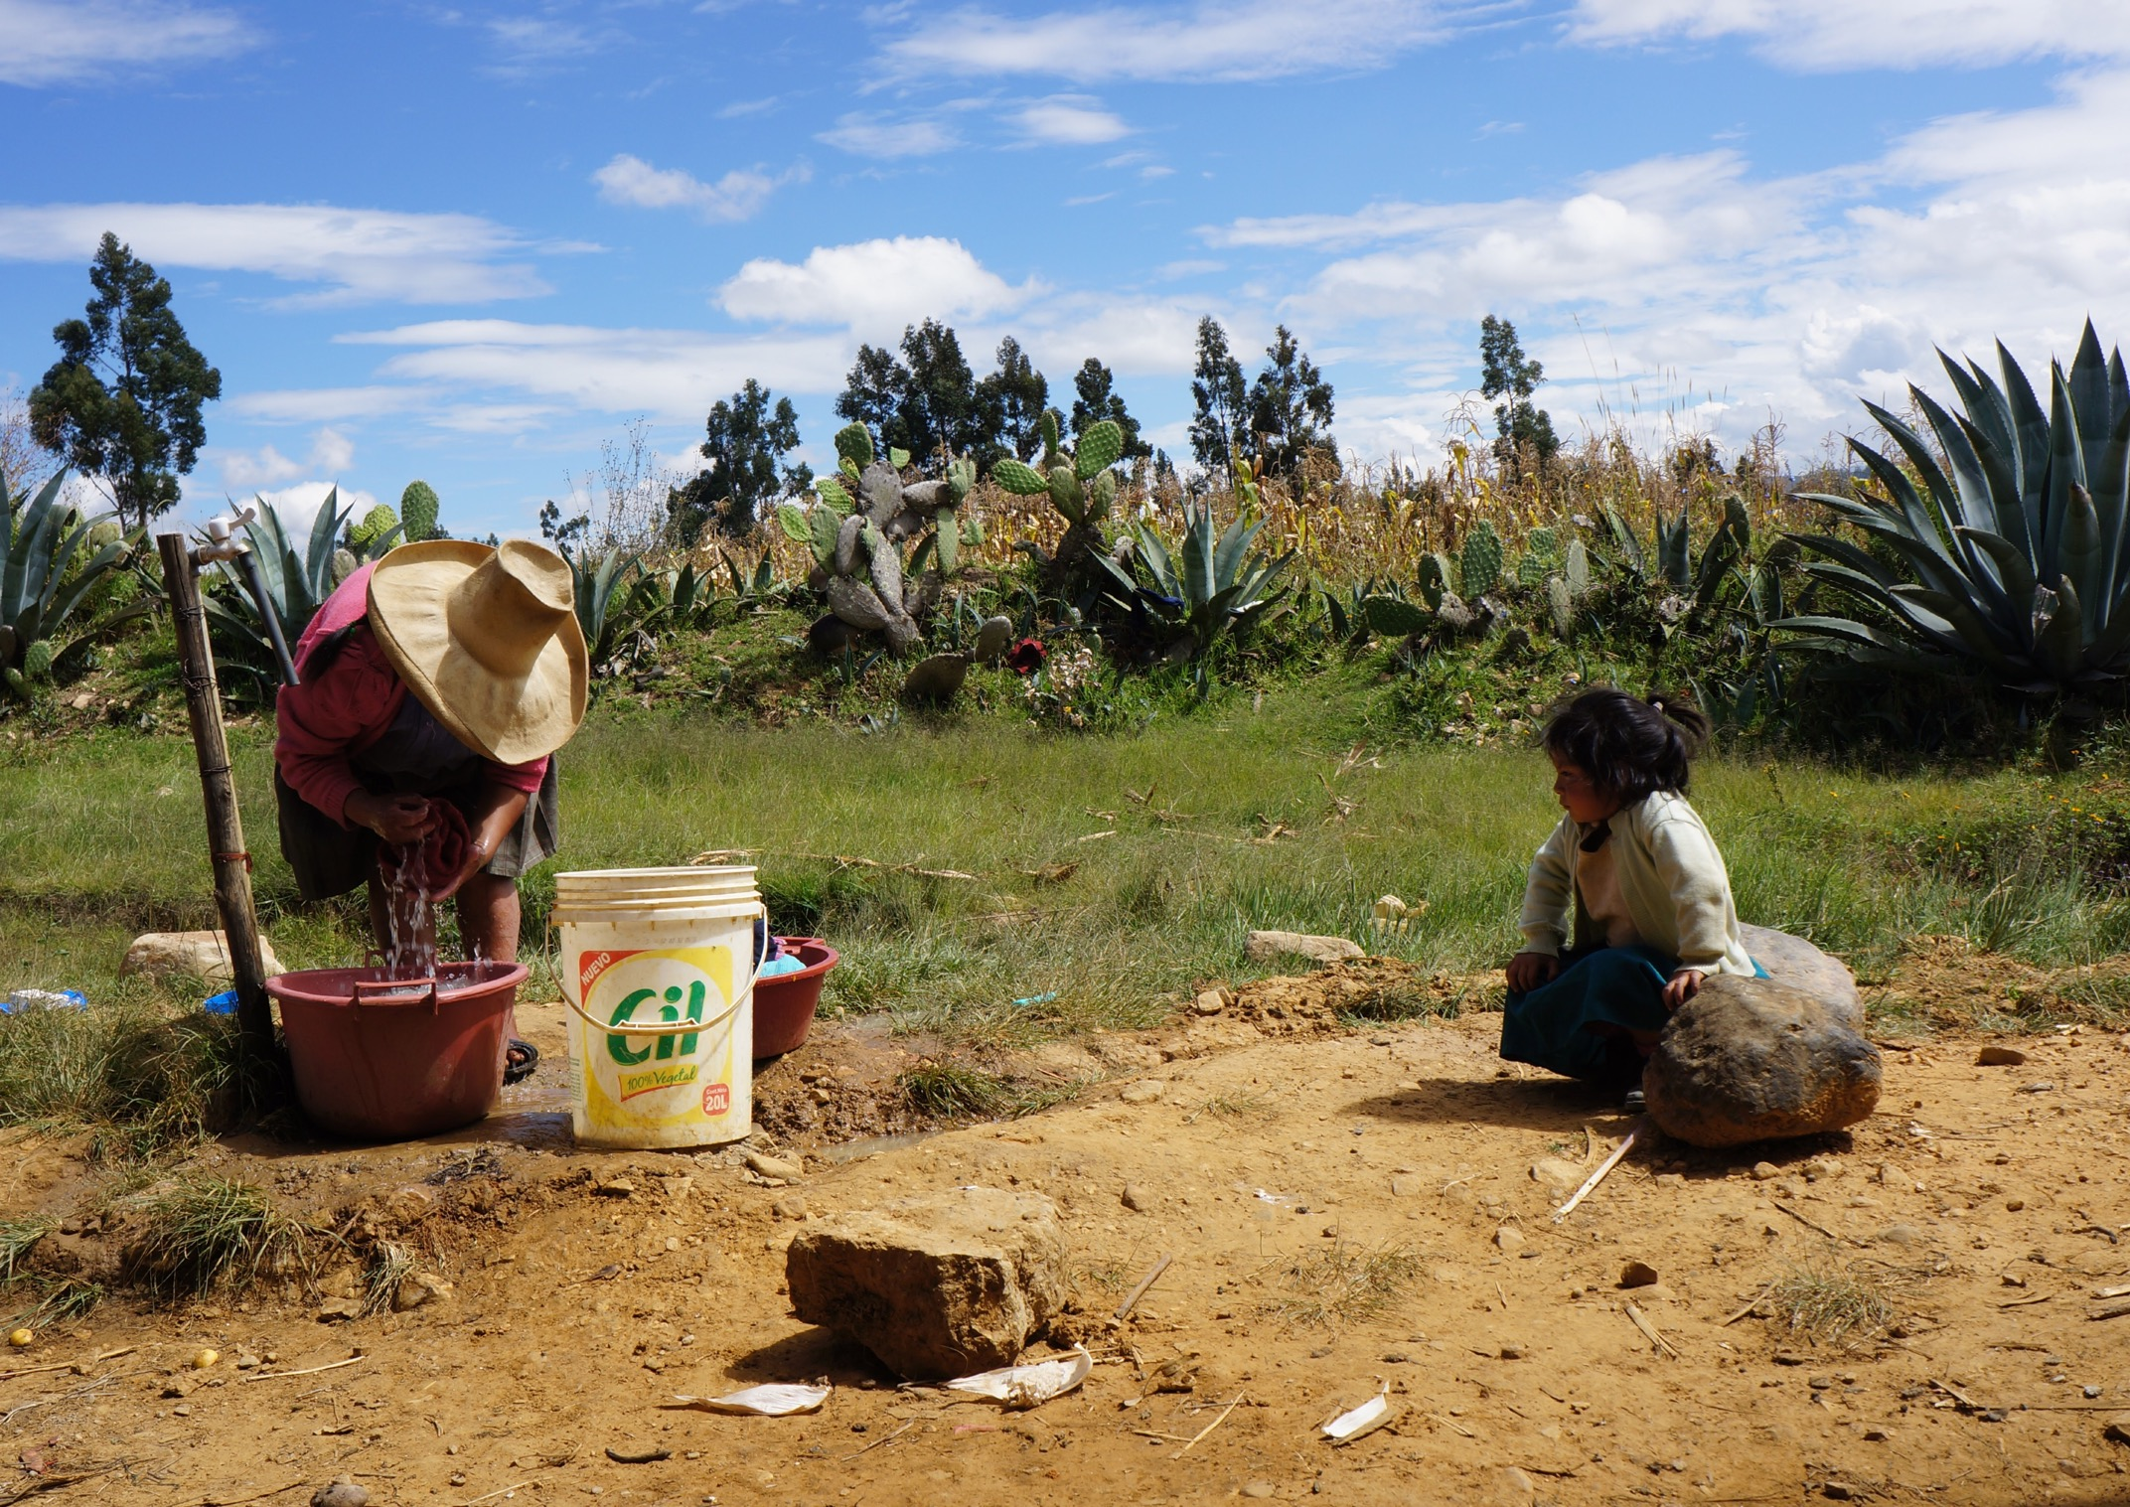
Conditionalities take the ‘protection’ out of social protection, and the ‘safety’ out of safety net

Slide 8
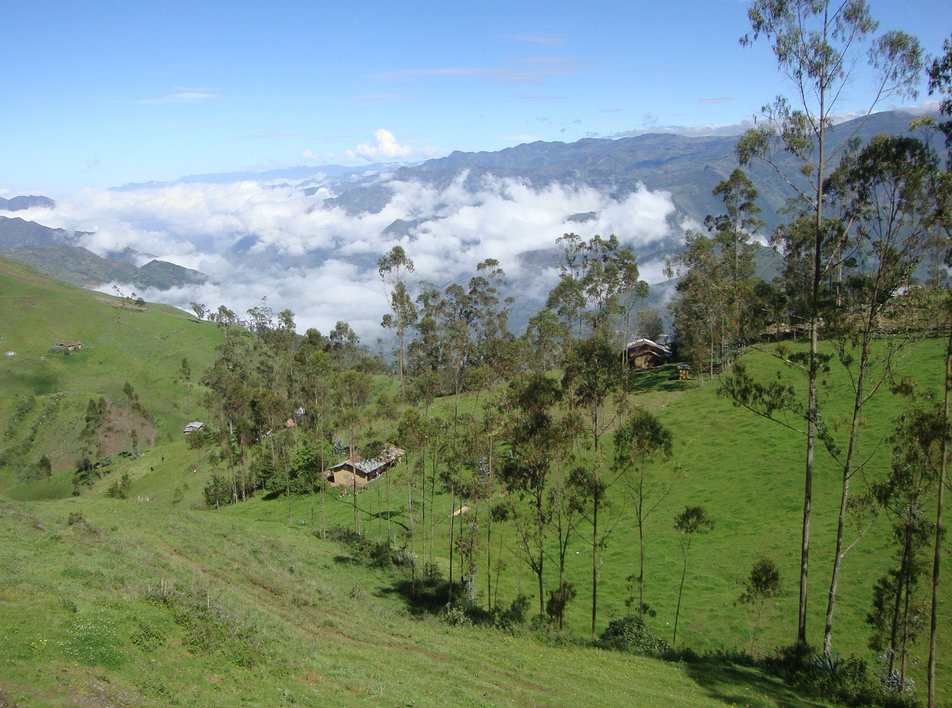
Make social protection unconditional
Invest in the quality and accessibility of public services and infrastructure
Design social protection with women’s everyday lives at the centre

