Slide 1
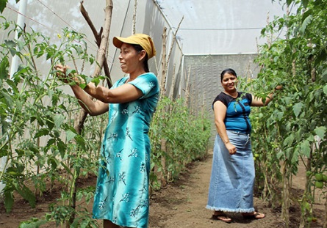
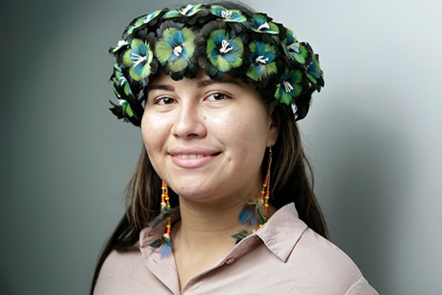




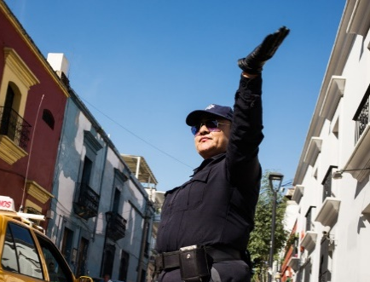
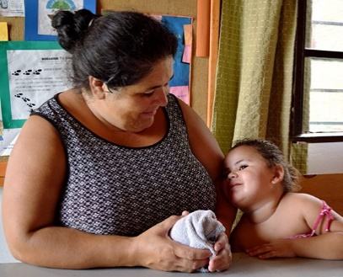
Social protection systems, access to public services and sustainable infrastructure for gender equality and the empowerment of women and girls

Slide 2
With current trends SDG 10 will be hard to achieve:

Slide 3
In a BAU scenario, or worse in a US scenario trends in inequality will risk achieving SDG 1

Slide 4
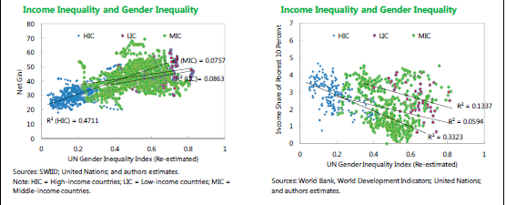
Gender inequality and Income and wealth inequality are related

Slide 5
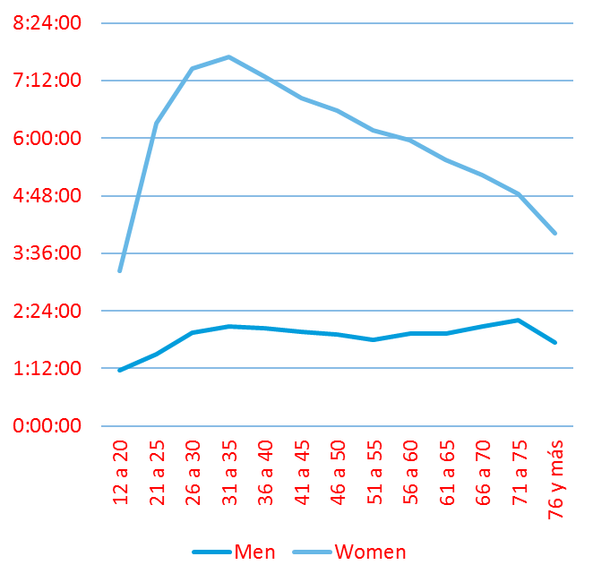
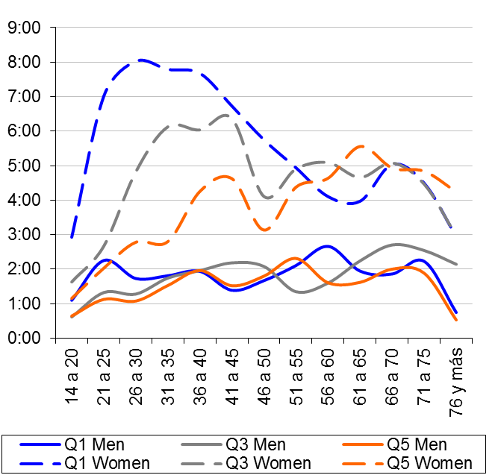
CLASS, GENDER AND THE SEXUAL DIVISION OF LABOR
Unpaid work Women with lower incomes bear an even heavier workload Men/Women
Notes:
La mayor carga de trabajo que asumen las mujeres, especialmente las mujeres con menores ingresos, está directamente relacionada con menores oportunidades de acceso al mercado laboral formal, lo que tiene un impacto en su acceso y cobertura de los sistemas de protección social.
Los cuidados, en particular, es un problema no resuelto por la Sociedad en su conjunto cuya solución facilitan las mujeres de manera gratuita y con gran perjuicio para sus oportunidades de desarrollo professional.

Slide 7
Reinforce gender roles
Transform gender roles
Recognize gender inequalities
Does not recognize gender inequality
Combat Income and wealth inequality
Reinforces Income and Wealth Inequality

Slide 8
Social policies and social protection: Gender bias and structural limitations
Contributive model
Based on formal labor market on a contributory basis This model only recognizes formal work and its contributions as generators of insurance rights for accidents, maternity, unemployment, etc.
Targetted non contributive model
This model solves some of the issues of the contributory model but it creates others (coverage gaps, stigma, limited take up, low value, lack of political support)
Universal non contributive model
Little or no implementation in LDC and emerging countries. When available taxation and quality issues.
Historically excluded and invisible sectors

Slide 9
Services: Education, Health and Care have deficits in coverage, quality and sustainability
Education
Coverage deficits Quality deficits Part-time model based on the model of the man worker and woman caregiver
Health
If based on contributive models, limited access If based on targeted model, quality issues
Basic access to sexual and reproductive health
Co-payments and lack of infrastructure limit public access
Rationing logic by waiting / time
Care
Development still weak in most LDC and emerging countries. Limits regarding infrastructure, taxation and human resources Challenges concerning quality, relevance and coverage.

Slide 10
Services: Energy, Water, Transport Men designs, womens use
Energy
Countries at different points of the curve or access function: connection, power, cost, electrical household appliances
Key given that women carry out domestic work dependent on energy and rural women can develop microenterprise strategies with adequate energy provision
Water
Access at home, distance from nearest source
Quality
Transport
Biased provision of services based on a model for male mobility and middle and upper classes.
Low investment in pedestrian mobility, bike lanes and quality public transport
Cost

Slide 11
Infrastructure: physical, human, fiscal
Physical
Thinking that it is gender neutral is a mistake (City and mobility)
Fiscal
Weaker in protection and services that address gender inequality or women's welfare
Human
Low pay and training deficits in services "thought of as feminine" Well paid and masculinized in infrastructure and "hard" services.

Slide 12
The world shows wide variations in fiscal effort and progressivity of tax burden
GDP per-capita and tax revenue as a % of GDP
GDP per-capita and percentage of tax revenue from income, capital and profits

Slide 13
The fiscal challenge: a political equation, rather than a technical impossibility
The fallacy of the lack of fiscal space:
There are countries that present significant margin to increase the fiscal burden
There are countries where incurring in moderate debt to invest in infrastructure is viable
In all countries there is the possibility and need to curtail expenditures producing no results in terms of efficiency and quality (for example, corporate-based privilege wages paid by the state), and increase investments fostering efficiency and equity (for example, gender-sensitive spending on early childhood).
In all sectors considered, it is possible to improve the intersectoral allocation of funding and the quality of expenditures
Most developing countries can continue to improve the progressivity in their tax burden

Slide 14
Again it is not technical, it is political
Gender sensitive intra-fiscal space
Social protection
Lower subsidies for privileged pension groups, invest in gender sensitive family friendly policies (family allowances, basic targetted or universal noncontributory pensions, leaves,)
Public services
Get rid of fiscal credits for private access to human capital services (education, health) and invest in expansion of gender sensitive policies (ECEC Services, free of charge basic sexual an reproductive services, school food services)
Labor Market Policies Get rid of subsidies to Formal and Public Sector Jobs and invest in gender sensitive active labor market policies and credit systems for women entrepreneur's
Infrastructures and basic utilities
Lower investments in highways and increase it in walking lanes and bike lanes. Surpress carbon based fuel subsidies and invest in public transportation. Limit fiscal credit for big capital energy projects and invest in mini grids and last connections from grid to home.

