Slide 1




“Women’s empowerment and the link to sustainable development” 63rd Session of Commission on the Status on Women 13 March 2019, UN, New York
Alliance for Protection against Gender Based Violence
Bulgarian Gender Research Foundation
Association Demetra

Slide 2
GENERAL POINTS
- Gender Equality, Protection against Discrimination and Violence are guaranteed by the law in Bulgaria;
- Bulgaria has the highest share of women and girls ICT specialists - 27,7 % (the average share for EU is 16%) according to Eurostat;
- In Bulgaria women are represented in the current parliament with 26,25% (63 women among 240 MPs);

Slide 3
GENERAL POINTS
The risk of poverty and social exclusion in Bulgaria is high - 45.9% of people over 65 years face such risk (2016 EU). 52.3% of them are women and 36.5 % are men. For the people over the age of 75 the risk is 53.1%, the risk for men is 40.5% and for women - 60.4%;
37 cases of femicides in Bulgaria for 2018 and 34 femicides for 2017 according to official data of the Bulgarian Ministry of Interior;
There is no official statistics about victims of GBV in Bulgaria but every 4th woman has been a victim of violence (FRA, 2014);

Slide 4
GENERAL POINTS
Bulgarian NGOs played a key role in initiating and drafting of legislation on protection against GBV.
The Bulgarian Law on Protection against Domestic Violence was adopted in 2005;
Criminalization of GBV (physical, sexual or psychological violence by current or former spouses or co-habiting people and forced marriage) was adopted in 2019.

Slide 5

Goal 5: Achieve gender equality and empower all women and girls
The principles, goals, mission and experience of the Alliance for Protection against Gender Based Violence, Association Demetra and Bulgarian Gender Research Foundation are in agreement with Sustainable Development Goal 5 for achieving gender equality and empowering all women and girls.
Our efforts, activities and tasks in cooperation with the national authorities aim to ensure:
Consistent measures to overcome the gender pay gap, fighting poverty and social exclusion affecting all social groups;
Women's protection from all forms of gender-based violence;
The recent adoption of the amendments to the Penal Code for stricter punishment of domestic violence and other forms of violence affecting women more is undoubtedly an achievement;
Better protection for children who are witnesses of violence.

Slide 6
Good practices from Bulgaria – GBV focus with work with refugees and asylum seekers
PROJECT “REACHING OUT AND LEAVING NO WOMAN, CHILD AND MAN BEHIND AND AT RISK OF VIOLENCE” supported by UNICEF Bulgaria 2018 – 2019
The project was implemented by the Alliance for Protection against Gender Based Violence, funded by the US Department of State, Bureau of Population, Refugees and Migration" through UNICEF Bulgaria between April - September 2018 and was extended until July 2019
- Development of gender-sensitive approach toward men, women and children - refugees, migrants and asylum seekers among frontline servants (social workers, lawyers and police officers);
- Specialized training into seven sessions was conducted for specialists working directly with refugees, migrants and asylum seekers - 75 people were trained - representatives of state institutions and NGOs working with women and children refugees.

Slide 7
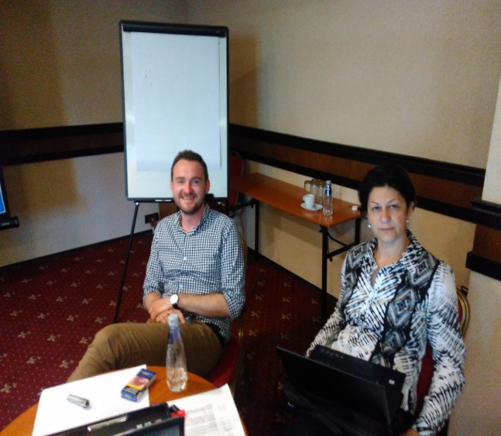
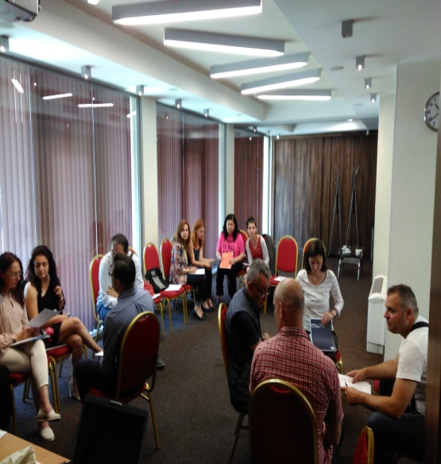
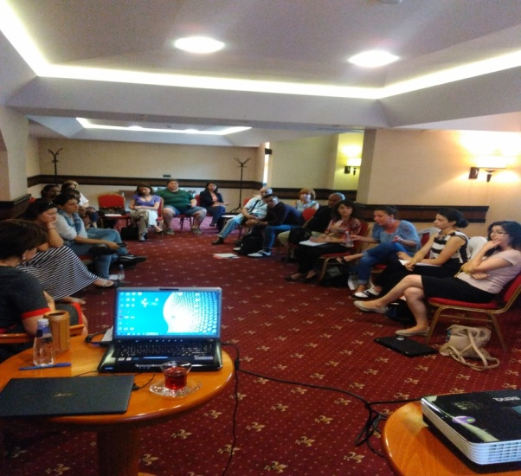
Good practices from Bulgaria – GBV focus with work with refugees and asylum seekers

Slide 8
Good practices from Bulgaria – prevention of Domestic Violence
Project „Domestic Violence as an Issue of the Family and Society“ implemented by the Alliance for Protection against GBV financially supported by the Bulgarian Ministry of Justice.
- The project had more than 5000 beneficiaries in the regions in Bulgaria where people do not have access to regular counseling services. The beneficiaries were victims, families, perpetrators and school teachers and students;
- A pilot program started for work with perpetrators who voluntary assume that they have problem with aggression;
- And pilot specialized national telephone line for domestic violence started.

Slide 9
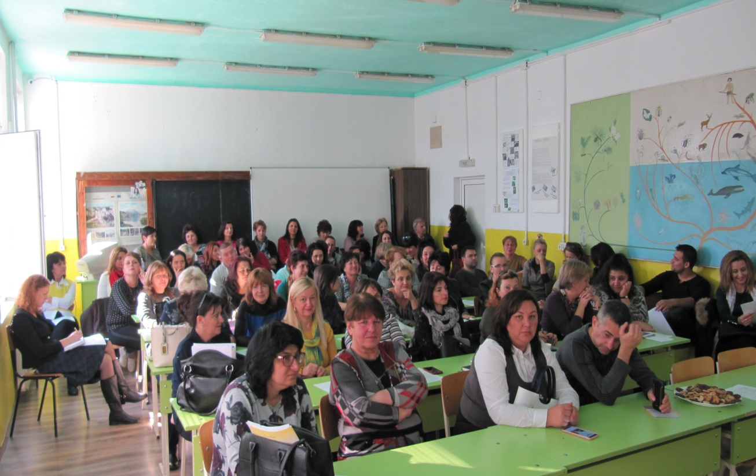
Good practices from Bulgaria – prevention of Domestic Violence
3 awareness campaigns with 77 teachers and 133 students were conducted.

Slide 10
Good practices from Bulgaria – women and girls with disabilities victims of violence
In the period 2015-2018, the Bulgarian Gender Research Foundation and
Alliance implemented 2 projects aiming to ensure effective protection and
access to justice for women and girls with disabilities victims of domestic
violence and other forms of gender-based violence.
"Pilot action to tackle violence against women and girls with disabilities in Bulgaria through research, awareness raising and strategic case management“;
"Enhanced cooperation with key actors - institutions and NGOs to strengthen support and policies for effective protection and access to justice for women and girls with disabilities, victims of violence in Bulgaria“.
It is a new topic for Bulgaria and the 2 projects developed a base for legislative and policy changes in favor of women and girls with disabilities-victims of violence based on research and expertise.

Slide 11
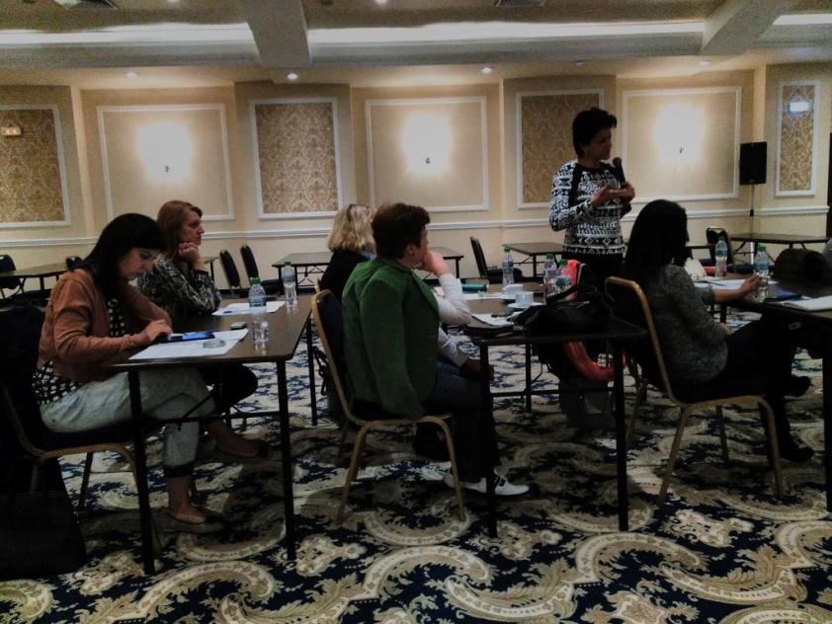
Good practices from Bulgaria – women and girls with disabilities victims of violence
The lack of holistic institutional approach toward women and girls with disabilities, victims of violence is one of the recognized problem in the national context and is an incentive for us to work on that issue. The project results showed that only 8% out of a total of 253 women with disabilities had access to justice supported by women's organizations – service providers.
According to data from Alliance members - women with disabilities, victims of GBV are 5% (253 victims) of the total number of victims of 5053 women for the indicated period of 3 years (2015-2018).

Slide 12
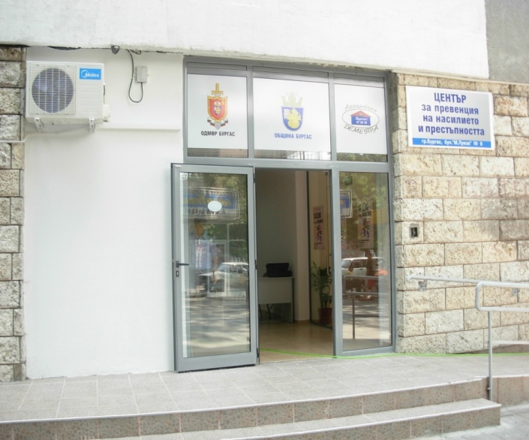

Good Practices from Bulgaria - Prevention of Violence and Crime
Center for prevention of violence and crime established in 2009, under a
trilateral agreement between Burgas Municipality, District directorate of the
Ministry of Interior and Association “Demetra”. Since its opening, the Center
provided help to 2023 victims of GBV, 3330 counseling
sessions, 514 requests for protection orders.
The special program for perpetrators has been
attended by 48 people. The Center employs a
multidisciplinary team of lawyers, therapists
and social workers.
The accommodation process requires
an order or referral from the Social Assistance
Directorate and maximum stay period 3-6 months.

Slide 13
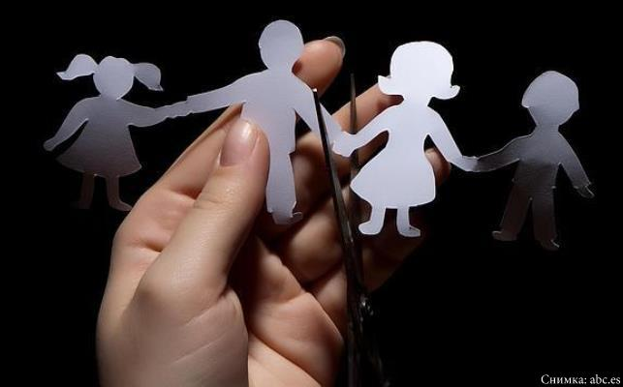
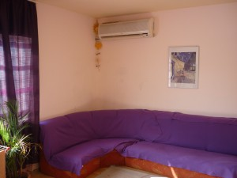
Good Practices from Bulgaria - Crisis center for adults and children
Crisis center for adults and children - victims of abuse and human trafficking is established by Association Demetra in 2008 and until now 130 women and 82 children have been accommodated

Slide 14

Good Practices from Bulgaria - Crisis Center for children - victims of abuse
The Crisis Center for children - victims of abuse in Sredets was established in
2014 by Demetra Association in a building, provided by the Municipality.
The capacity is 10 places, intended for children of ages 7 to 18, victims of abuse and/or internal or international human trafficking for the purposes of sexual or labor exploitation.
The accommodation process requires an order from the Social Assistance
Directorate and has a maximum
stay period of 3 to 6 months.
41 children been accommodated
up to the now.

Slide 15
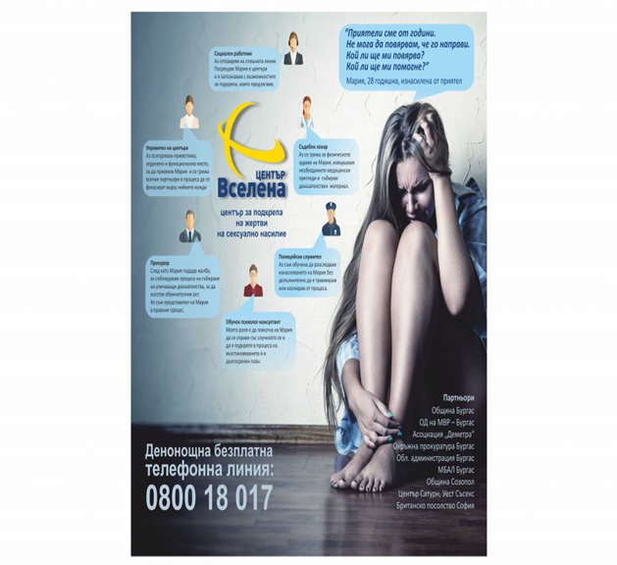
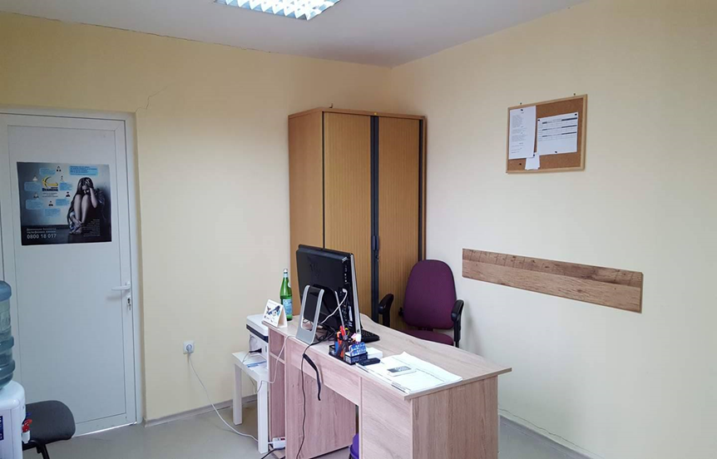
Good Practices from Bulgaria - Sexual Assault Referral Centre “Vselena”
Sexual Assault Referral Centre “Vselena” Burgas has been functioning since 2016.
It was established in partnership with Demetra, the Municipalities of Burgas and Sozopol; Regional Prosecutor’s Office; The Regional Directorate of the Ministry of Interior; The District council Burgas and General Hospital Burgas.
The initiative for establishment of such center came from the British Embassy in Sofia, using a similar Sexual assault referral center in Brighton, UK as a model. Center “Vselena” is the first of its kind initiative in Bulgaria.

