Slide 1



Egypt National Observatory for Women (ENOW)
Magued Osman
CEO, The Egyptian Center for Public Opinion Research “Baseera”

Slide 2
Vision Goals Targets Indicators
Egypt National Strategy for Women Empowerment 2030
Towards a nation free from discrimination and inequality
Participatory
&
Evidence-based

Slide 3
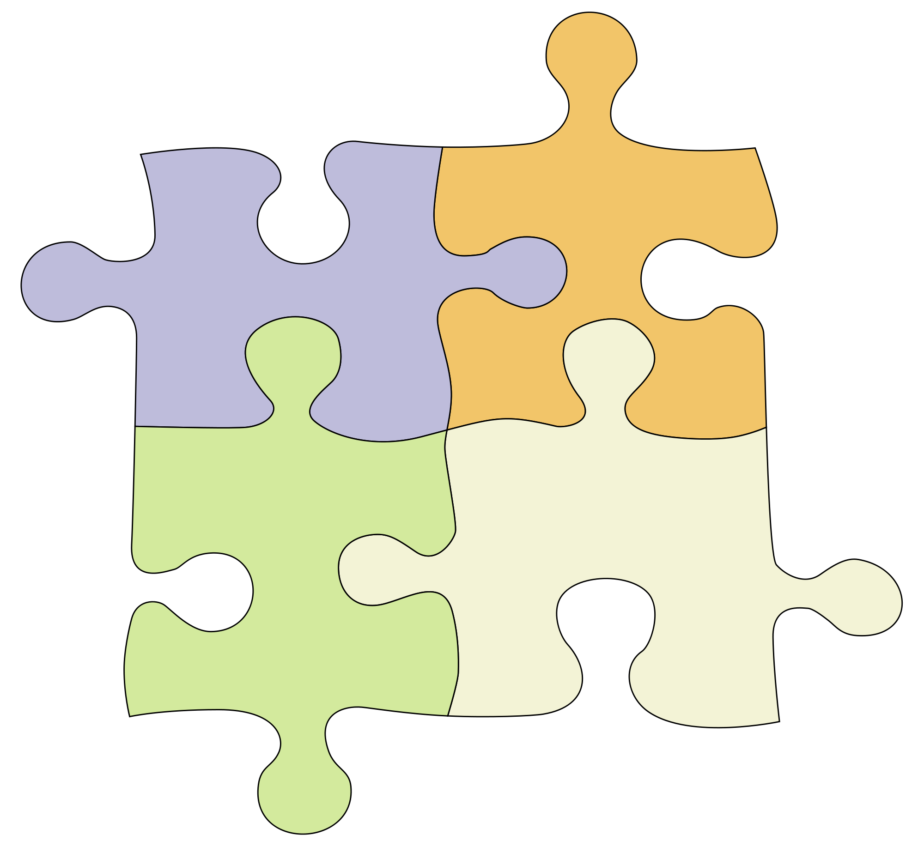
Changing culture
Economic empowerment
Political empowerment
Social empowerment
Protection
Legislations

Slide 4
For each of the four pillars, the strategy addresses:
The current situation;
The general goal and detailed objectives;
Interventions and programs that will support the achievement of the goal and detailed objectives; and;
Indices for measuring progress towards achieving the desired results in 2030.

Slide 5
Critical Factors for the Strategy’s Success (from the consultations)
Availability of a comprehensive and updated information database.
Efficient mechanisms for monitoring and evaluation.
Developing accountability mechanisms & tools for strategy implementation.
Egypt National Observatory for Women

Slide 6
Egypt National Observatory for Women (ENOW)
An evidence-based decision support system to monitor and analyse the state of affairs of women in Egypt and also a mean for ensuring evidence-based, results-based and rights-based gender-policy design and implementation.
Civil society | Parliament | Government
Political parties | Media | Development cooperation partners
Stakeholders:
Information
for All

Slide 7
M&E Indicators
Sustainable Development Goals (SDGs)
The indicators to be used in monitoring the implementation of Egypt national strategy for women empowerment (NSWE):
Other indicators that are important for guiding the implementation of the strategy
Displaying indicators on different administrative levels,
Displaying trend of the indicators
Displaying a documentation for each indicator including definition, calculation methodology, sources of data and the importance of the indicator
Calculating the achievement rate

Slide 8
Updates
The Observatory was launched in October 2017
www.enow.gov.eg
Four updates have been made since the launching of the observatory.
Developing a simulator for Egypt rank in the GGG index.
Preparing a set of analytical reports related to women status in Egypt.

Slide 9
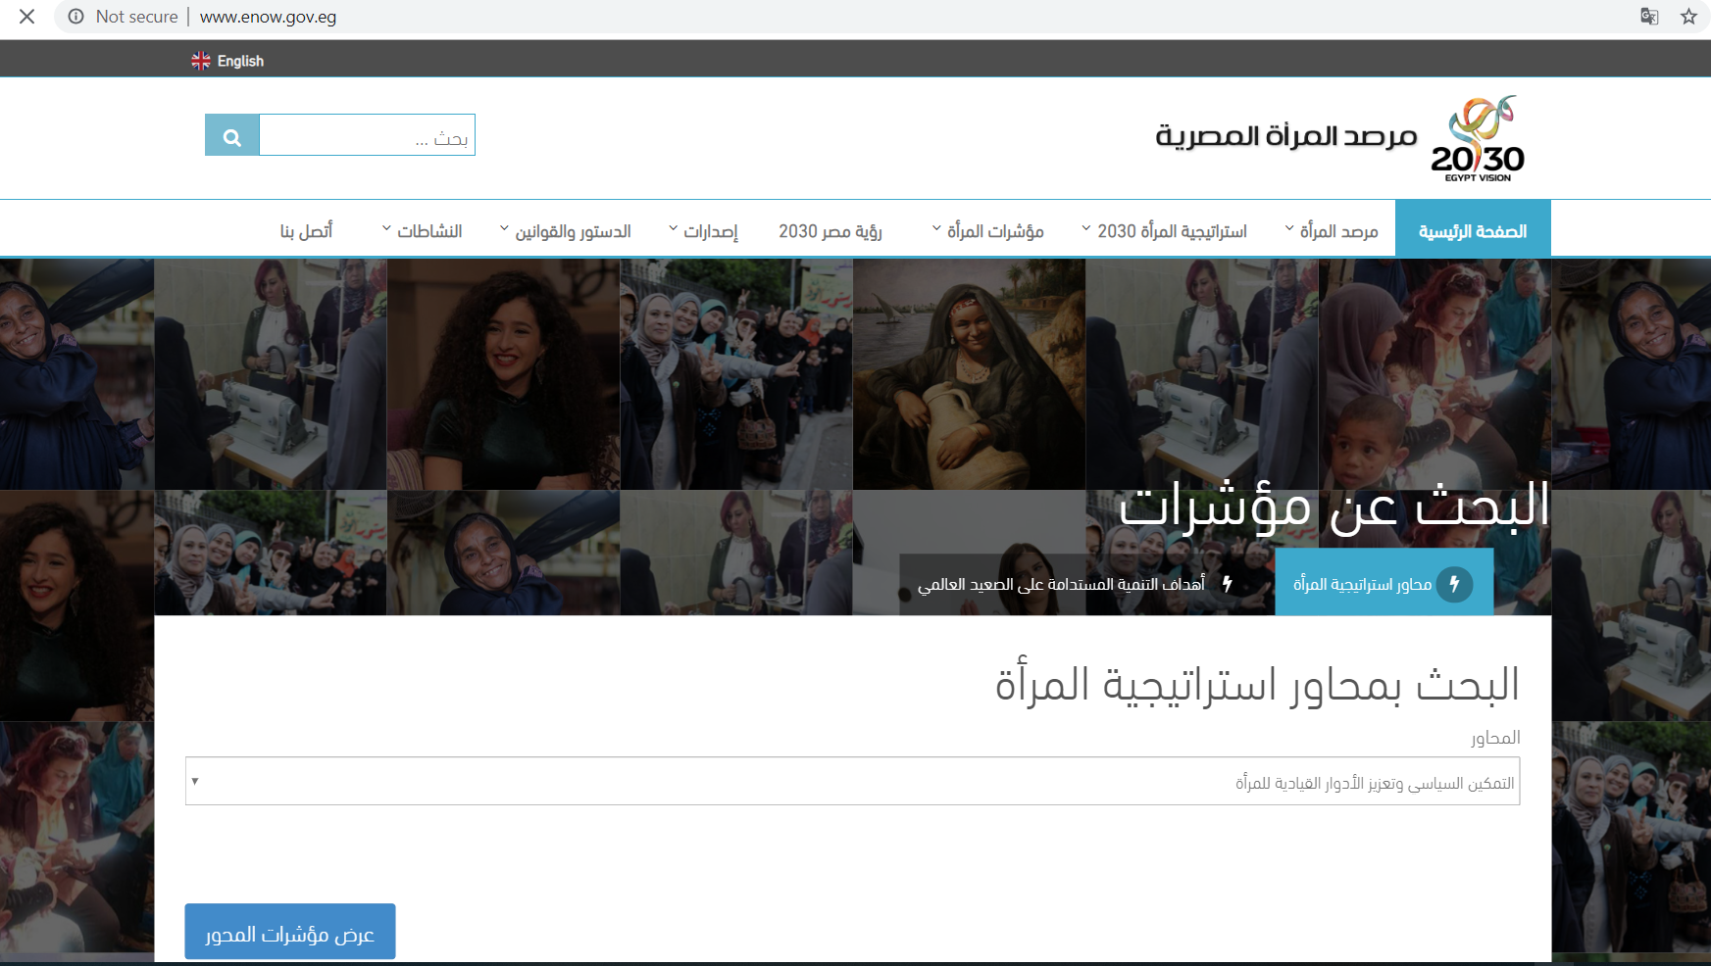

Slide 10


Slide 11
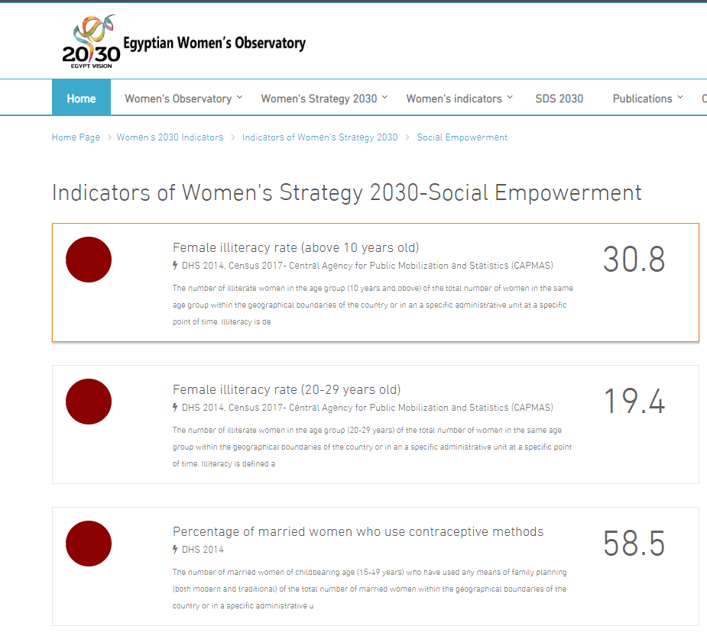

Slide 12
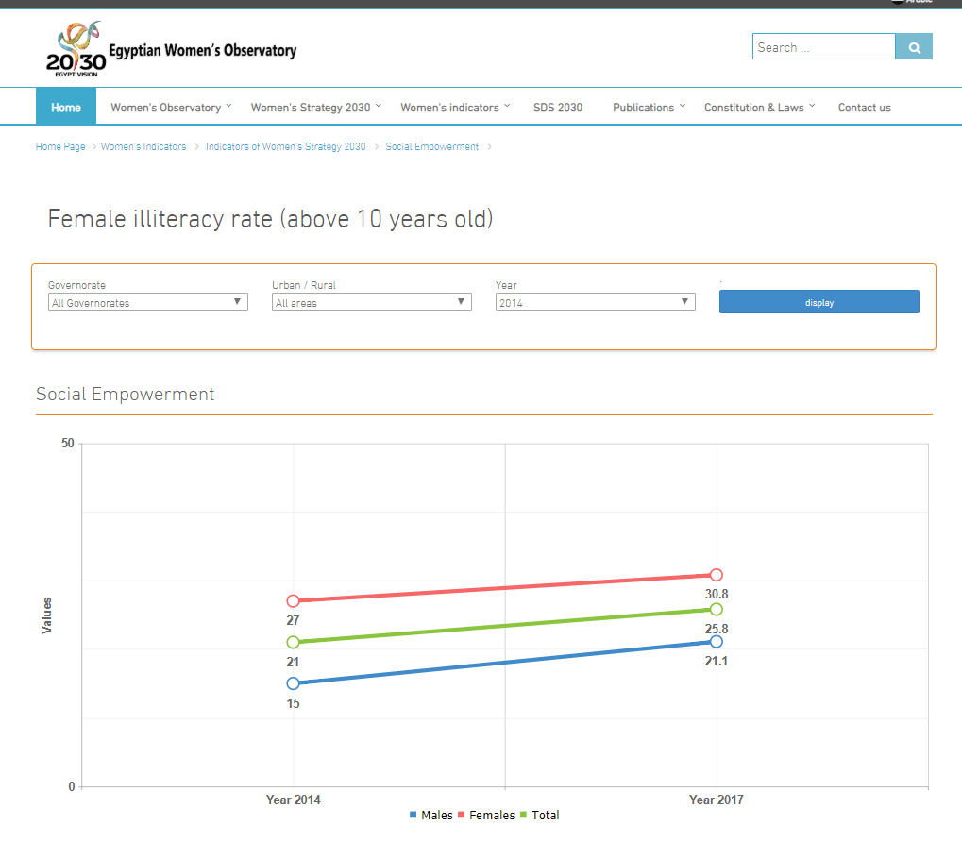

Slide 13
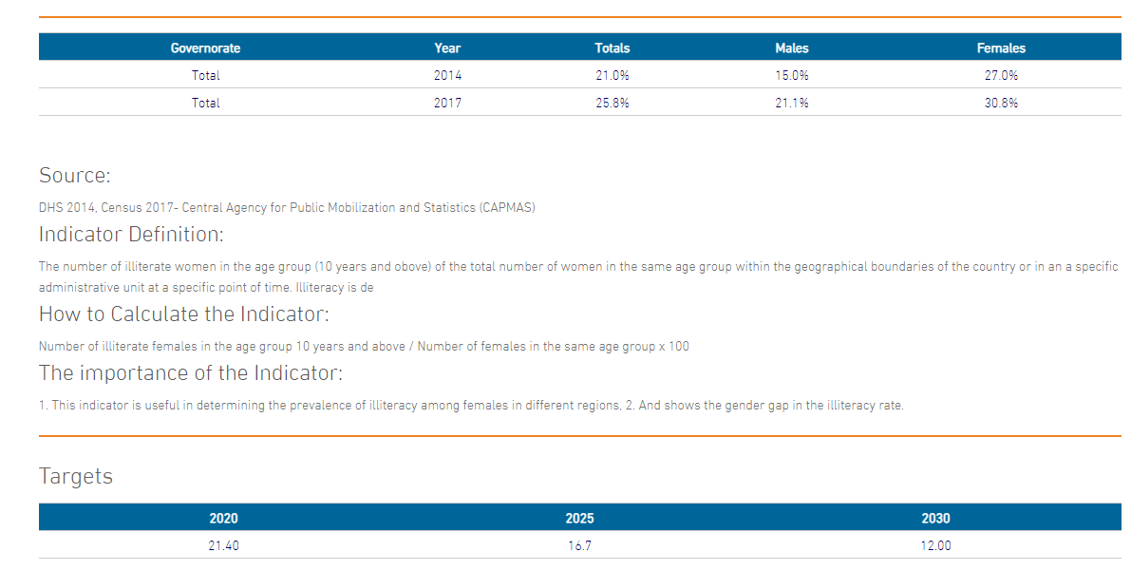

Slide 14
Main findings
Education
Egyptian women have achieved notable success in closing the educational gap. Most education statistics tend to favour women. Females: 54 % of university students, 56% university graduates, 48% of graduate students who were granted a Master degree and 39% of graduate students who were granted Ph.D. degree.
Digital literacy is higher among males however, no gap in digital literacy among youth below 25.

Slide 15
Employment
Unemployment rate is higher among females, however, it starts to decrease for the first time in recent years:
24.2% in 2015
23.6% in 2016
23.1% in 2017
Wide discrepancy in female unemployment rates among governorates (ranging from 9% to 45%).
7% increase in the number of female working (2014 – 2017)

Slide 16
Access to ENOW
119 thousand files downloads or views,
183 thousand hits,
100 thousand responses on Nes2alak.
Way forward
Sustainability.
Bridging more info gaps.

Slide 17
Thank you
magued.osman@baseera.com.eg

