Slide 1
Women’s empowerment and the link to sustainable Development
Egypt Voluntary presentation on the review theme of CSW60
13 March 2019

Slide 2
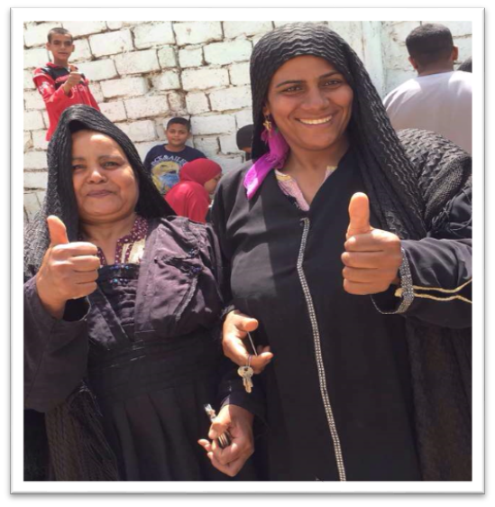
Strengthening Normative, Legal And Policy Frameworks
Egyptian Constitution 2014
For the 1st time, 20 Articles dedicated to addressing women's issues
Ensure equal opportunities for women
Transfer the nationality to their children.
Allocate a quarter of the seats of local councils for women
Social, economic and political rights
Social security services
Prevent discrimination
Protection against all forms of violence,
Women's empowerment
Commitment to care at various stages of the lives
commitment to the international conventions on human rights, which all includes the rights for women

Slide 3
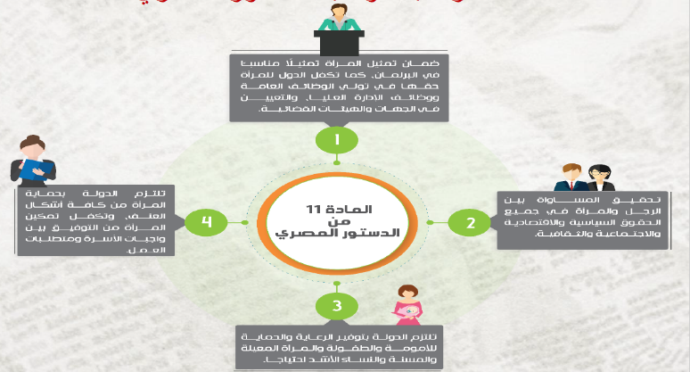
Strengthening Normative, Legal And Policy Frameworks
Egyptian Constitution 2014
Protection of women against all forms of violence, and ensures women empowerment to reconcile the duties of a woman toward her family and her work requirements.
The state ensures protection and care for motherhood and childhood, and for female heads of household, and elderly women, and women most in need
Article 11
2014 Constitution
The state commits to taking the necessary measures to ensure appropriate representation of women in the houses of parliament
It grants women the right to hold public posts and high management posts in the state, and to appointment in judicial bodies and entities without discrimination
Achieving equality between women and men in all civil, political, economic, social, and cultural rights

Slide 4

Strengthening Normative, Legal And Policy Frameworks
Women’s Year 2017
2017 was declared by the president to be the women’s year

Slide 5


Strengthening Normative, Legal And Policy Frameworks
Strategic Framework
Egypt’s Vision 2030
National Strategy for the empowerment of Egyptian Women 2030
National Strategy to combat VAW
National Strategy to combat FGM
National Strategy to combat Child Marraige

Slide 6


Strengthening Normative, Legal And Policy Frameworks
Strategic Framework
National Strategy for the Empowerment of Egyptian Women 2030
Egypt is the First country globally to align and launch its Strategy 2030 to both the SDG Global Agenda
It is aligned to a pillar of Egypt’s SDS 2030.
In March 2017, The Egyptian President announced and endorsed the National strategy for the Empowerment of Egyptian Women to be the national policy and guiding document for the Government.
The Establishment of The National Egyptian Women observatory.

Slide 7
Strengthening Normative, Legal And Policy Frameworks
Strategic Framework
National Strategy for the Empowerment of Egyptian Women 2030
Methodology of Strategy Preparation
  Evidence-based
  Scientific approach
  Consultation with the key stakeholders
  Expanding the space for participation of target groups.

Slide 8
Strengthening Normative, Legal And Policy Frameworks
Strategic Framework
National Strategy for the Empowerment of Egyptian Women 2030
The strategy used a Participatory approach
where 175,000 women
180 civil society
500,000 women demands
Phase One:
Reference Survey’s and studies
Phase Two:
Consultative
meetings
Phase Three:
Community participation
and public outreach

Slide 9
Strengthening Normative, Legal And Policy Frameworks
Strategic Framework
National Strategy for the Empowerment of Egyptian Women 2030
The Strategy’s Pillars:
1st
Political Empowerment and Leadership
2nd
Economic Empowerment
3rd
Social Empowerment
4th
Protection
2 Mainstreamed Pillars: Legislation & Culture

Slide 10
Strengthening Normative, Legal And Policy Frameworks
Legal framework
Amendment of the law criminalizing FGM (2016) to become a felony with harsher penalties
A presidential decree for the protection of Motherhood for women in Prison to (keep her child until reaching 4 yrs old, & visitation rights after this age)
Delaying the execution penalty for the mother until her child reach the age of two

Slide 11
Strengthening Normative, Legal And Policy Frameworks
Legal framework
Civil Service Law granting working mothers 4 months MATERNITY LEAVE instead of 3 months;
A law organizing the institutionalizing the National Council for Women as an independent National Women Machinery (2018);
Amendment of the Inheritance law (2018) to impose stricter penalties for those that deny a family member their lawful inheritance rights.

Slide 12
Strengthening Normative, Legal And Policy Frameworks
Legal framework
Investment law article No. 2 in the investment law explicitly stated EQUAL investment opportunity between men and women (2017);
Issuance of a new law No. 10 of 2018 for the Rights Of People With Disabilities
Issuance of law No. 11 of 2019 of the National Council of People with Disabilities

Slide 13
Financing Gender Equality And
The Empowerment Of Women And Girls
Efforts Towards: Social Empowerment & Social Protection policies
Egyptian President Dedicates amount from the national budget for Childcare Services
Egyptian President dedicates an amount from the national budget to support Women heads of Households and poor families
Microfinance projects for the economic empowerment of women
250 million
EGP
50 million
EGP
250 million
EGP

Slide 14
Financing Gender Equality And
The Empowerment Of Women And Girls
38 million women benefited from bread and flour subsidiary
34 million women benefited from food ration cards
10 million women benefited from health care support
8 million benefited women from family and reproductive health services
2 million and 100 thousand women benefited from SMEs loans
89% women benefiting from social protection programs (2.25 million households – 10 million individuals
5 million refugees were economically empowered

Slide 15

Inclusive Growth, Macro-economic Stability & Social Justice
Political Commitment
Ensuring social rights, equal opportunity, fair distribution of development outcomes & reducing income gaps.
Medium & long term development plans for the whole country with social inclusion as the central element.
2014
Constitution
SDS 2030
Sector Specific Strategies
Pro-poor policies & Programs
Social Justice Committee
From universal to targeted subsidies
Focus on Upper Egypt
Social Protection; Targeting and transparency.
Education; universality & equity
Health; Equity & accountability
Food subsidy; Food security, supply chain & efficiency

Slide 16
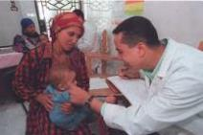



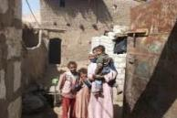

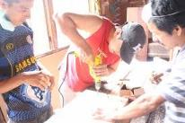
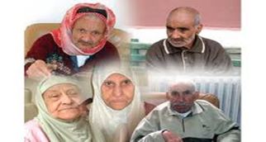
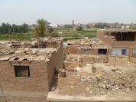
Financing Gender Equality And
The Empowerment Of Women And Girls
Social Protection policies safety & integrated safety net
Food
Ration
Cards
Health
Care
School Feeding
Cash
Transfer
Decent Housing
Emergency
Insurance &
Social
Pension
Village/Slum Development
Employment
& FI
Source: Ministry of Social Solidarity, Development of Social protection In Egypt , February 2019

Slide 17
Financing Gender Equality And
The Empowerment Of Women And Girls
Social Protection policies safety & integrated safety net
80% of upgrading of unsafe areas
96.8% drinking water coverage
99.7% electricity coverage
66% sewer system coverage

Slide 18


Financing Gender Equality And
The Empowerment Of Women And Girls

Slide 19

Financing Gender Equality And
The Empowerment Of Women And Girls
Financial Inclusion
The Government of Egypt has recently taken concrete strategic steps to enhance the financial inclusion for women such as:
(1) A presidential decree has been issued in Feb 2017 to establish a National Council for Payments, with the President of the Republic being the head of the Council.
(2) Celebrating the First ever year (2017) of women in Egypt and activating the Economic empowerment pillar in the National Women strategy 2030,The National council for Women signed a Memorandum of understanding with the Central bank of Egypt (CBE); which places Egypt as the first Country to have its CBE sign an agreement with a National Women machinery worldwide.

Slide 20
Financing Gender Equality And
The Empowerment Of Women And Girls
Financial Inclusion
Two credit lines exclusively targeting women to finance women entrepreneurs
3 million beneficiaries of microfinance in Egypt, 70% of them are women
880 trained women in all governorates of Egypt on financial inclusion topics
Raising the awareness of 50,000 women on ground on banking products and financial services during 2018
National Campaign on the awareness of financial inclusion concepts through PSAs
production of E-catalogs to help market products Egyptian women in areas with less access to services

Slide 21
Financing Gender Equality And
The Empowerment Of Women And Girls
Financial Inclusion
New regulations for the mobile payments
Financial inclusion strategy
Digital payment of governmental agencies has been launched and implemented
Banking initiative to secure more finances for the SMEs
Establishment of the financial inclusion unit in the CBE
A new definition for women holding SMEs

Slide 22
Gender Equality Seal
Financing Gender Equality And
The Empowerment Of Women And Girls
Gender Equality Seal :
Egypt is the 1st Arab to develop a certification program for government and private sector based on the success of the gender equality seal
The Seal provides Egyptian companies guidance on how to address challenges for women, such as access to work, wage inequities, sexual harassment, work-life balance and access to leadership positions.
10 Private sector companies have undergone a thorough process of assessment
In 2019 , an Egyptian company have been granted the Seal
The Egyptian private sectors Companies have started to implement Women Empowerment principles

Slide 23


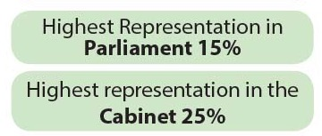
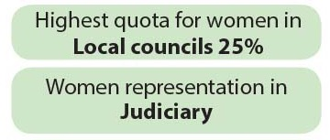

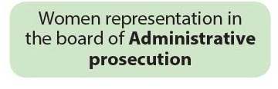
Women’s Leadership And Their Full & Equal Participation In Decision-making
Efforts Towards Political Participation & Leadership

Slide 24





Women’s Leadership And Their Full & Equal Participation In Decision-making
Efforts Towards Political Participation & Leadership
Women Governor & deputy governors

Slide 25
Women’s Leadership And Their Full & Equal Participation In Decision-making
Efforts Towards Political Participation & Leadership
For the first time representation of the younger generation leadership, the disabled as well as rural women in the reshuffling of the board of the National Council for Women (NCW) in the year 2016
Awareness raising campaign for women’s voters & women candidates
Political participation targeting 2 million women in 2017

Slide 26
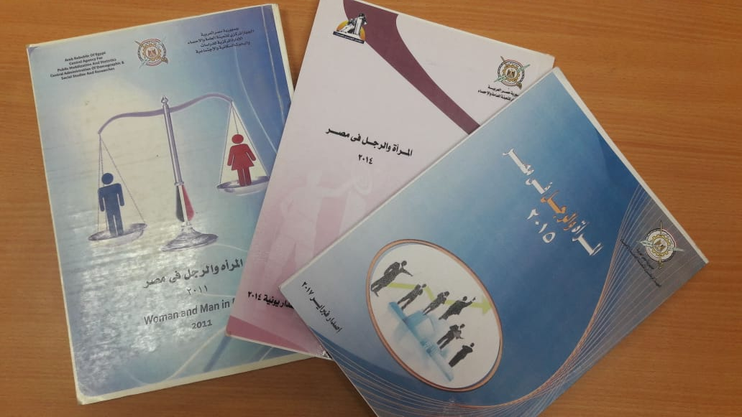
Strengthening Gender-responsive Data Collection,
Follow-up And Review Processes
In cooperation with the Central Agency for Public Mobilization and statistics (CAPMAS), statistics were developed to gather desegregated data on the National level according to the NCW indicators which are all collected into :
The National Egyptian Women observatory.
  Egypt established a National Women Observatory to monitor the implementation of the women strategy outcomes, outputs and indicators.
Reports on the Status of Women and Men in Egypt

Slide 27

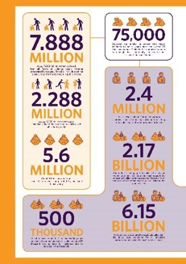
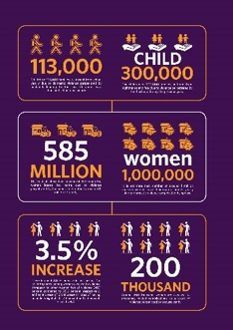
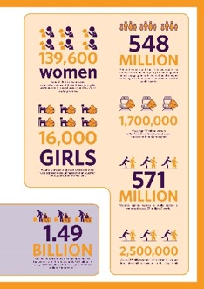
Strengthening Gender-responsive Data Collection,
Follow-up And Review Processes
Egypt Economic Cost of Gender Based Violence Survey
Egypt is the first leading Arab country to conduct an economic cost of violence against women study.

Slide 28



Institutional Framework
Enhancing National Institutional Arrangements
National Machineries & Mechanisms
National Council Of Disability Affairs
NCW
27 branches
Report to the President
NCCM
Report to Minister of Health

Slide 29

Enhancing National Institutional Arrangements
The National Council for Women
NCW, the highest specialized national machinery for the advancement of women in Egypt.
Establishment + Institution + Mandate
Established by Presidential Decree 90, in 2000.
Law sets its structure and mandates in 2018.
2014 Constitution:
Independent national machinery from the states
17 specialized committees in NCW (Foreign Affairs, Education and Scientific Research, Media, Culture, Environment, Health, Legislation, Political Participation, Disabilities, Youth, Governorates, NGOs … )
Article: 93: International agreements and conventions
Article: 214: National Councils, Independent Bodies

Slide 30
Enhancing National Institutional Arrangements
The National Council for Women
NCW, the highest specialized national machinery for the advancement of women in Egypt.
Entrusted with:
planning for the advancement of women,
following up on the plans’ implementation,
proposing policies for women’s development and empowerment,
enabling them to play their essential role in society,
integrating their efforts into national comprehensive development programs

Slide 31
Enhancing National Institutional Arrangements
Equal Opportunity units in all ministries
Family court established to safeguard women & children
Sector established in the Ministry of Justice “Women & Child Rights”
Unit in the HR sector at Ministry of Interior to combat VAW
Establishment of additional legal aid offices in family courts to provide free legal advice and assistance to women,
Egyptian National Women Observatory
Enhancing coherence and coordination of national mechanisms for promoting gender equality and the empowerment of women and girls, with relevant government agencies

Slide 32
Enhancing National Institutional Arrangements
VAW Efforts :
Egypt launched three national strategies; the National Strategy to Combat Violence against Women, the National Strategy to Combat Female Genital Mutilation (FGM), and the National Strategy to Combat Early Marriage
The complaints offices of NCW through the main branch and the 27 branches in the governorates provide legal and social services and the receive complaints through a hotline.
Establishment of 18 anti-harassment units in national universities. the upgrading shelters for women victims of violence under the supervision of the Ministry of Social Solidarity
440 general hospitals integrated Gender Based Violence (GBV) comprehensive package of health services and capacitated service providers to provide services for victims

Slide 33
Enhancing National Institutional Arrangements
VAW Efforts :
Establishment of Violence against Women unit within the Ministry of Justice
Hotlines linked to the Violence against Women Department of the Ministry of Interior
A Department of Combating Violence against Women in MOI
Training of law enforcement
The Government of Egypt has been working on a comprehensive law for Violence against women that is intended to be passed to the Egyptian Parliament
Manual on Violence against Women (VAW) in Islam was launched by Al Azhar to train religious leaders

Slide 34
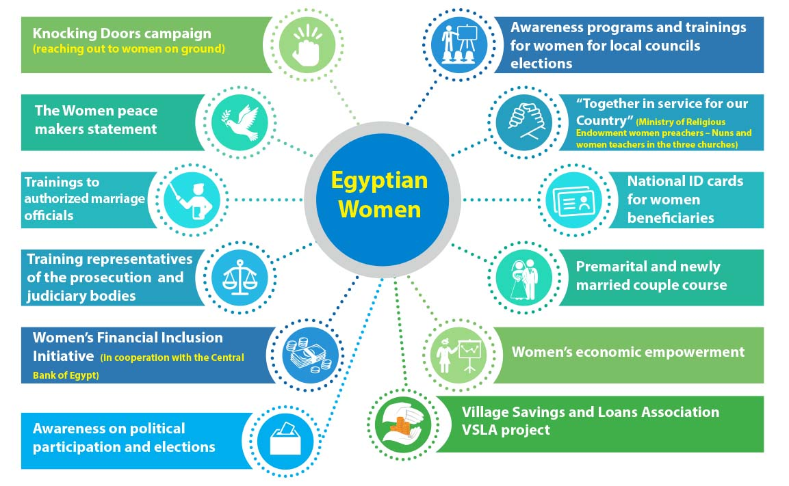

7. Good Practices

Slide 35
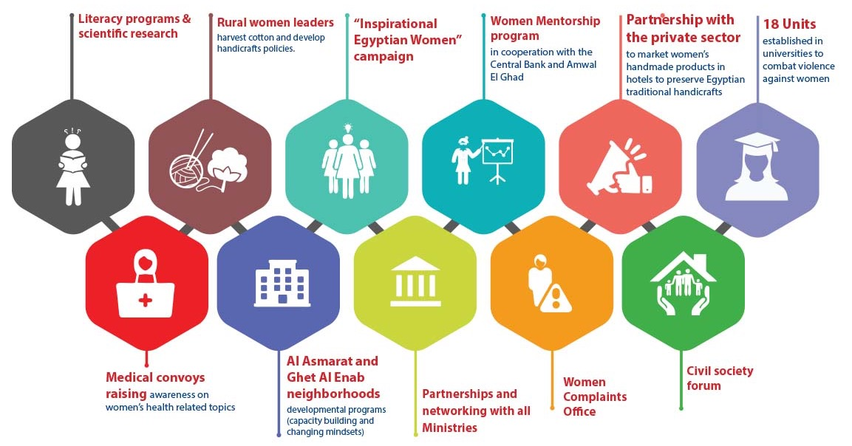
7. Good Practices
7. Good Practices

Slide 36



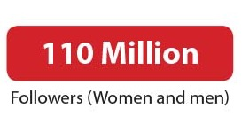

7. Best / Good Practices
7. Good Practices
Efforts Towards Behavioral Change

Slide 37

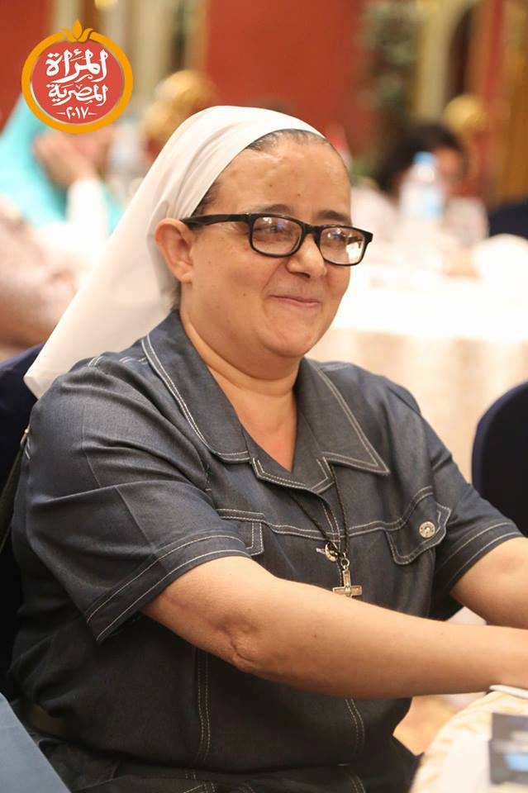
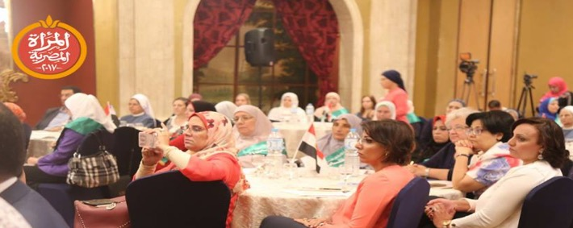
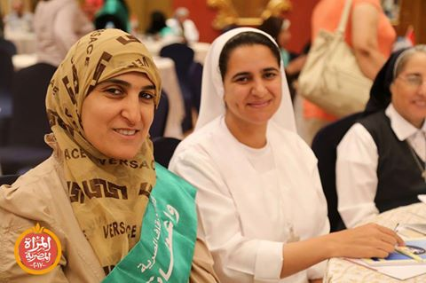
Together In Service for Our Country
A Program in collaboration of the Ministry of Religious Endowment and Preachers, Nuns and women teachers in the three churches in Egypt. Women Religious leaders
7. Good Practices
Enhancing coherence and coordination of national mechanisms for promoting gender equality and the empowerment of women and girls, with relevant government agencies

Slide 38





7. Good Practices
Efforts Towards Behavioral Change
Engaging Men and Boys
Reaching 12 millions with 24 thousands volunteers

Slide 39



Inter Governmental Organizations

Slide 40

















Our international partners

Slide 41
Our Embassies' Partners
The embassy of china
The embassy of Denmark
The embassy of Finland
The embassy of France
The embassy of Italy
The embassy of Japan
The embassy of Korea
The Embassy of Spain
The embassy of Sweden
Embassy of Netherlands
Embassy of united kingdom

