Slide 1
Big data and the modernization of national statistical systems: Experiences of Colombia
New York, United States
March 16th, 2018

Slide 2
National Statistic System (NSS)

Slide 3
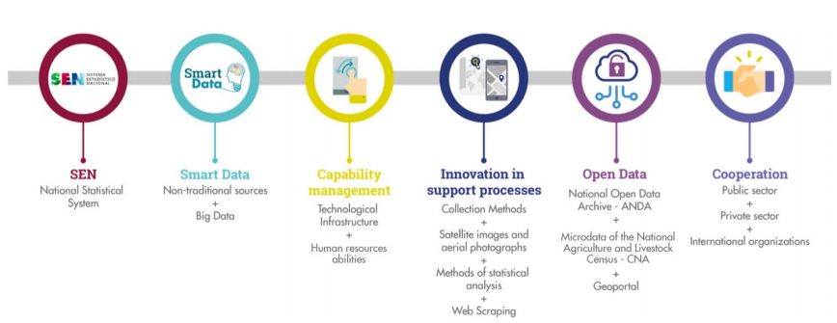
Since 2014 DANE began its process of modernization and innovation aimed at impacting the generation, production and dissemination of statistics in Colombia.

Slide 4
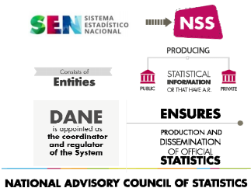
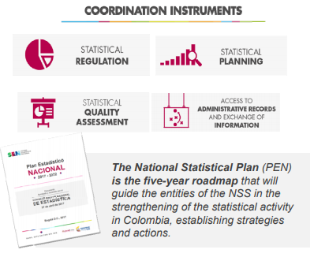
National Statistic System (NSS)
The NSS allows us to improve the availability, quality, consistency and comparability of statistics and to reduce the duplication of efforts

Slide 5
BIG DATA: MAIN PLAYER

Slide 6
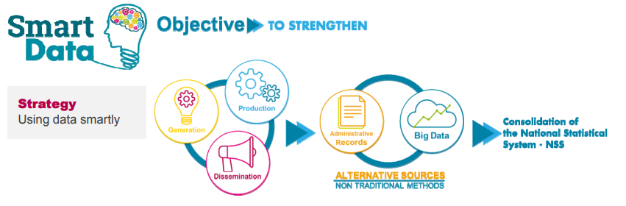
We are working on the incorporation of non-traditional and Big
Data sources into the statistical process: Smart Data, It is not only about how big but, how smart is its use.

Slide 7
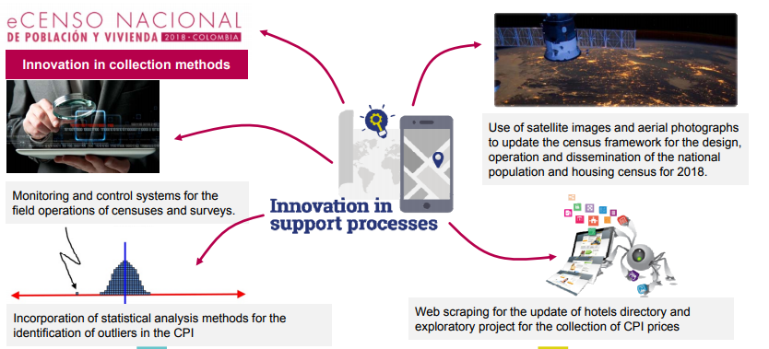
Innovation in Support Process

Slide 8
Projects using Big Data
Project | Aim | Method | Year
Big Data as instrument for updating the Business Statistic Directory | Improving the range and update data of identification and location from hotels’ enterprises. | Web Scraping | 2015-Currently
Consumer Price Index | Optimizing collecting process and his range from centralized information of prices in huge areas. | Scanner Data | 2015-Currently
Big Data for the calculation of the ratio of urban land consumption rate and population growth rate, by using remote sensing images | Generate a methodology to compute DSGs indicator 11.3.1 | Web Scraping | 2015-Currently
Consumer Price Index | Proposing another method of collecting information using diverse sources. | Web Scraping | 2016-Currently
Integrated Information System on Gender Violence (IISGV) | Disposing, integrating, harmonizing and disseminating statistical information on gender violence. | Administrative Records | 2016-Currently

Slide 9
Integrated Information System on Gender violence

Slide 10
Normative Framework
Article 12 of Law 1765 of 2015
Integrated Information System on Gender Violence
Articicle 9 of Law 1257 of 2008
Information on Gender Violence
Article 31 of law 1719 of 2014
Unified Information System on Gender Violence
Decree 4796 of 2011 by which is regulated Article 9 of Law 1257 of 2008.
Article 4 on the system of information.
Numeral k of article 3 of Decree 164 of 2010.
Promote a unified registration system case of violence against the woman

Slide 11
DANE
IISGV
Violence Records
Standardized Concepts
Sources
RUAF
RIPS
Construction Gender Violence Index
PILA
SIVIGILA
Other sources
National Code of Best Practice for Official Statistics.
Integrated System based on Administrative Records
Diagnosis and Evaluation
Today
Arrival Point

Slide 12

To achieve…
Identifying and showing the gender violence dimension
Identifying and monitoring risk factors associated with each sort of gender violence
Characterizing gender violence.
Identifying institutional response to the victims .

