Slide 1



VOLUNTARY NATIONAL PRESENTATION
KENYA’S PROGRESS IN IMPLEMENTING AGREED CONCLUSION OF THE 47TH CSW
Presented by:
HON RACHEL SHEBESH
Chief Administrative Secretary,
Ministry of Public Service, Youth and Gender Affairs

Slide 2
Presentation Outline
Introduction
Context
Enabling Legal and Policy on ICT
Good Practices in ICT for Development in Kenya
Case Study- Huduma Kenya Programme
Challenges and Opportunities
Way Forward

Slide 3
Context
ICT plays a key role in raising productivity, , driving innovation, efficiency, job creation, manufacturing and delivering solution to services necessary for National Development.
Expansion of ICT and social media has enhanced women’s participation in development conversations and shared experiences, hence a good learning platform to promote development
It is also critical to governance and social development as well as promotion of gender equality.
Gender parity in the use of ICT has remained low in favour of male users due to barriers caused by awareness, access costs, digital literacy, poverty and cultural barriers among others.
In mobile telephony and mobile money efforts by Government of Kenya has resulted in access and use at levels almost equal amongst women and men.
Penetration rate of fixed telephone has shown a narrowing gender disparity.

Slide 4
Enabling Legal and Policy Framework
Kenya’s efforts to promote access to ICT as a catalytic tool for development with potential to empower women and girls and transform gender relations in society, by providing an enabling legal and policy framework as follows:
Constitution of Kenya - promotes freedom of the media and access to information and Vision 2030 recognises the critical role that ICT plays in raising productivity, wealth creation and social integration.
Revised National ICT Policy 2016 ensures inclusiveness, equity, non-discrimination and partnerships seeks to improve access, resource and optimal management of ICT technologies.
National Broadband Strategy promotes internet connectivity as well as lowering costs of doing business and cross border trade. National Optic fibre backbone infrastructure insulates users from threats, fraud and theft of telephones.
Kenya Information Communication Amendment Act (KICA) 2013 established by Media Council as regulatory platform for arbitration of cases and complaints against the media particularly around language and gender stereotyping.

Slide 5
Innovations in ICT for Development in Kenya

Slide 6
Innovations in Using ICT
E-fertilizer Service: This is an electronic-based fertilizer distribution system by MOALF in conjunction with Safaricom that avails the farm input to farmers. Issue electronic vouchers directly to farmers through their mobile phones to purchase the inputs from agro-dealers.
MHEALTH is a mobile learning platform developed by AMREF Health Africa to conduct training of community-based health workers in Kenya. 45 mHealth services among them Daktari a mobile hotline for medical inquiries
AMPATH, a government service that includes SMS messaging to remind HIV patients to take their medicines.
M-Farm is a mobile platform for farmers: with the touch of a button, they can find prevailing prices for their produce
Ushahidi (Swahili for testimony) is a ground-breaking interactive mapping tool, now used across the world to crowd-source information in elections and emergencies.

Slide 7
Innovations in Using ICT
M-PESA the mobile money platform that has brought financial access to millions who were left out of the traditional banking sector: these days, nine in every ten Kenyans access financial services through it.
National Hospital Insurance Fund e-payment: partnership with Safaricom to allow self-employed and informally employed to pay health insurance premiums through M-pesa money platform. This service has seen more women in rural areas and informal settlements within urban areas enrolled into the healthcare insurance.
GBV Hack: GBV Hack technology is used in mapping violence, gathering GBV data, using data gathered to advocate for change and providing survivors with access to essential information and support.

Slide 8
GOOD PRACTICES IN ICT FOR DEVELOPMENT

Slide 9
Good Practice-Digital Learning Programme (DLP)
Initiated by the Government of Kenya in 2013.
The government initiated the program out of the conviction that technology has the power to bring about systemic change in basic and higher education by transforming teaching and learning through integrating technology in the learning environment.
This programme involves distribution of digital learning devices (tablets) to students and training of teachers to deliver digital based learning.
In 2017, the Government installed 702,403 devices in 14,336 schools.
Over 95,000 teachers have been trained to deliver digital based learning.
To ensure sustainability, the Government has built capacity of local universities locally to manufacture and assemble 1,500,000 devices annually .

Slide 10
Good Practice-‘Huduma Kenya’ Services
The Huduma Kenya programme is a Kenya Vision 2030 flagship project outlined in the Medium Term Plan for the period 2013 – 2017.
The Government has embarked on a Digital Government programme whose objective is to make Kenyans’ aspirations and dreams a reality by leveraging on technology to provide adequate access to information and transform the quality, efficiency and effectiveness of public services.
The Kenya Vision 2030 identifies Huduma Kenya Integrated Service Delivery Model as a global standard for Public Service innovation in service delivery
The programme objective is to transform the quality and efficiency in the delivery of public services by leveraging on technology to among others introduce integrated service delivery platforms such as one stop shop Huduma Centers.

Slide 11
Good Practice-‘Huduma Kenya’ Services
One stop shop citizen service centers to provide National government services from one single location (e.g. IDs, passports, NHIF/NSSF, birth/deaths, co. ltd)
Huduma Centers
Online portal to provide integrated services offered by various national government ministries, departments and agencies
Huduma Web Portal
Mobile phone platform to offer m-government services to citizens from the convenience of their mobile phones
Huduma Mobile Platform
Call center to provide customer service using a single dialing prefix that citizens can use to enquire about services offered by different government agencies
Huduma Call Center
Unified and integrated multi channel payment gateway to facilitate ease of payment for government services through debit cards, m-pesa, paypal etc
Huduma Payment Gateway

Slide 12
Huduma Kenya - Background
Huduma Kenya Programme is one of the Country’s Vision 2030 flagship project.
Launched by H.E the President in 2013 during the opening of the first Huduma Centre in Nairobi
Objective is to transform public service delivery by setting high quality standards of service delivery that meet citizen expectations
Governance Framework includes the Huduma Service Delivery Summit Chaired by H.E, the President, Huduma Technical Committee and the Huduma Secretariat
The implementation of the programme is coordinated by Ministry of Public Service, Youth and Gender Affairs jointly with the Ministry of Interior and National Government Coordination

Slide 13
Huduma Kenya - Current Status
  There are 52 centres established since the inception of the programme and are fully operational. The Centers serve on average 42,000 people per day, and has served more 15,000,000.
  There are 73 services deployed to the different Huduma Services, each of the Centres provide 20-55 services from Government agencies.
  The Huduma Centers provide a range of 45 different Government Services offered by 28 Government Agencies.
  Huduma Mashinani outreaches in 141 pilot Sub Counties have reached 700,000 people in the rural areas reducing cost of services.

Slide 14
Huduma Kenya –Benefits and innovations
Integration and seamless collaboration of the 45 services deployed from 28 Ministries, Departments and Agencies government agencies present a single window to the citizen
Re-engineering of services has resulted in improved efficiency and working practices
Integration of back-end data and systems has led to standardisation of services delivered at Huduma Centres.
Business analytics provide a monitoring framework for continuous service standards against set benchmarks
Robust back-end operations ensure customers can access services with simplicity
Ticket and queue systems promotes transparency and equity in service delivery for all
Electronic Payment Management System facilitate transparent payment of fees/charges.

Slide 15
Transforming Public Service Delivery
GOVERNMENT SERVICES DEPLOYED AT HUDUMA CENTRES
1. | Duplicate Identity Card | 13. | HELB services
2. | Issuance of Birth Certificates | 14. | Kenya Film
3. | Franking of Stamp Duty Documents | 15. | National Cohesion and Integration
4. | Registration of Self Help Groups and CBOs | 16. | Health services
5. | Registration of Welfare Societies | 17. | Electricity services
6. | Name Search and Reservation | 18. | Voter Registration (IEBC)
7. | Registration of Business Name | 19. | AGPO certificate
8. | Issuance of Police Abstract | 20. | Ombudsman
9. | Issuance of Certificate of Good Conduct | 21. | EACC services
10. | NSSF services | 22. | Pensions
11. | NHIF services | 23. | County services
12. | Issuance of Driver’s license AVERAGE OPERATIONALISATION SCORE - 67%

Slide 16
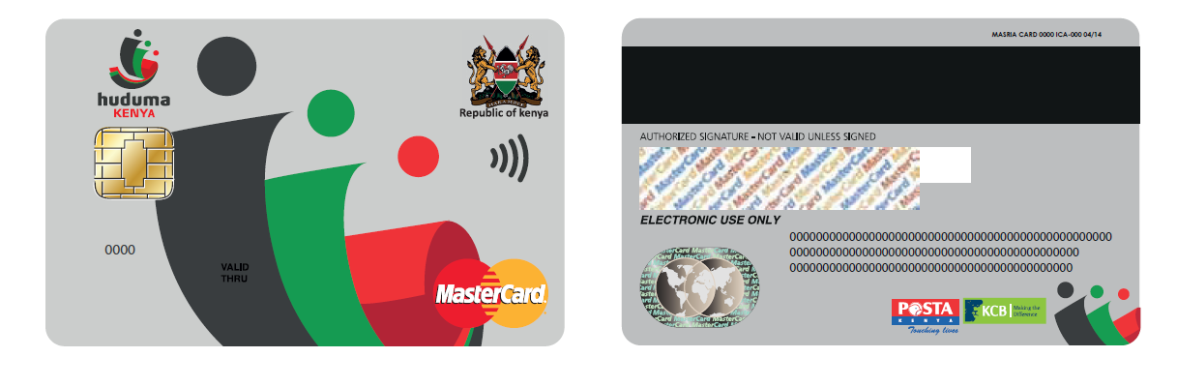
Huduma Smart Card
    The card will enable Kenyans to access electronic services and make payments for public and private services 24 Hours a day 7 days a week
    This card will also automatically register Citizens for NHIF, NSSF and get KRA PIN at one registration point
    The Card will enable the Government to meet its targets on Universal Health Coverage, and support vulnerable citizens to access services and funds.

Slide 17
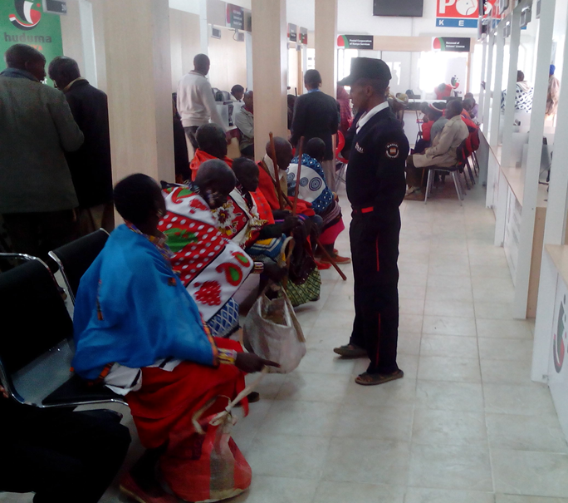
KAJIADO HUDUMA CENTRE

Slide 18

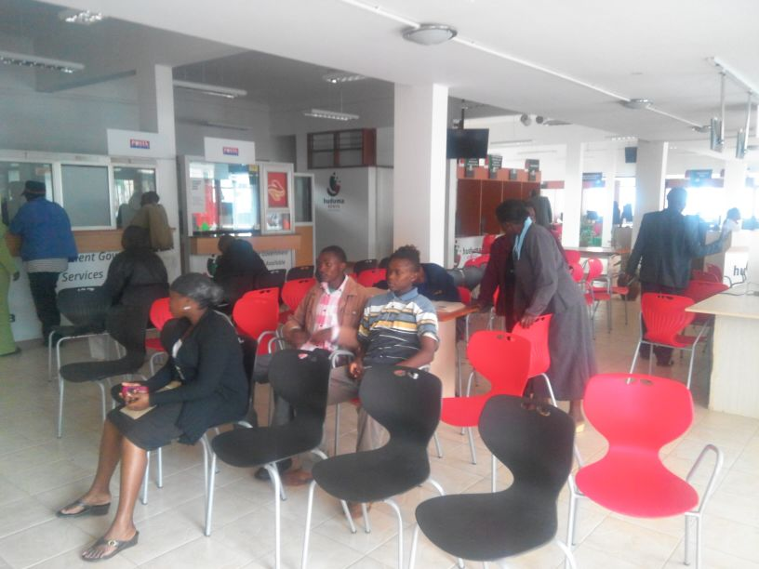
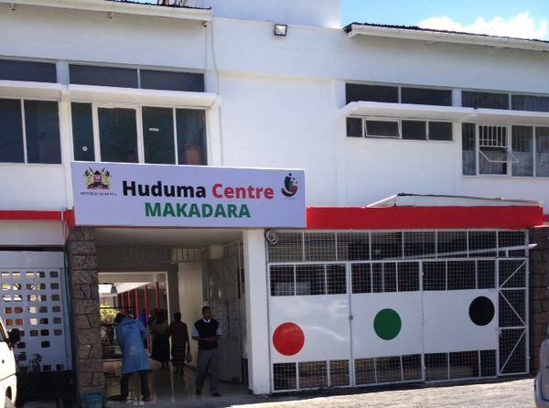
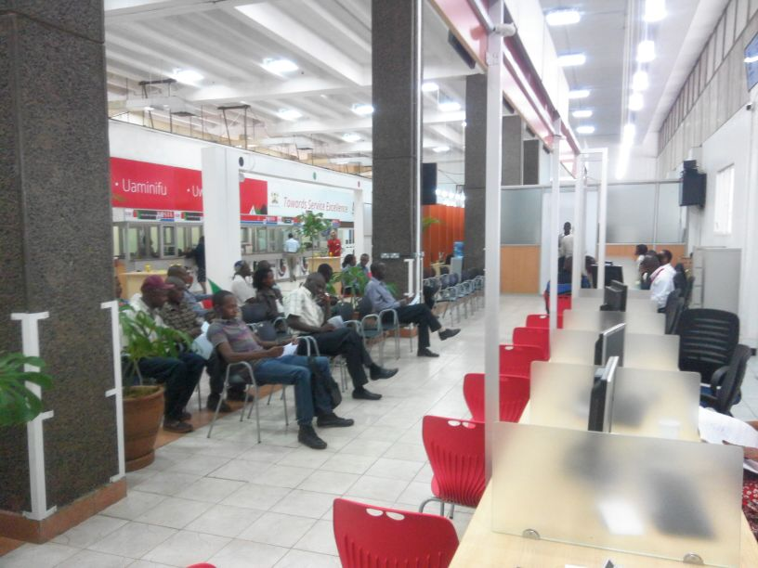
HUDUMA CENTRE -MAKADARA

Slide 19
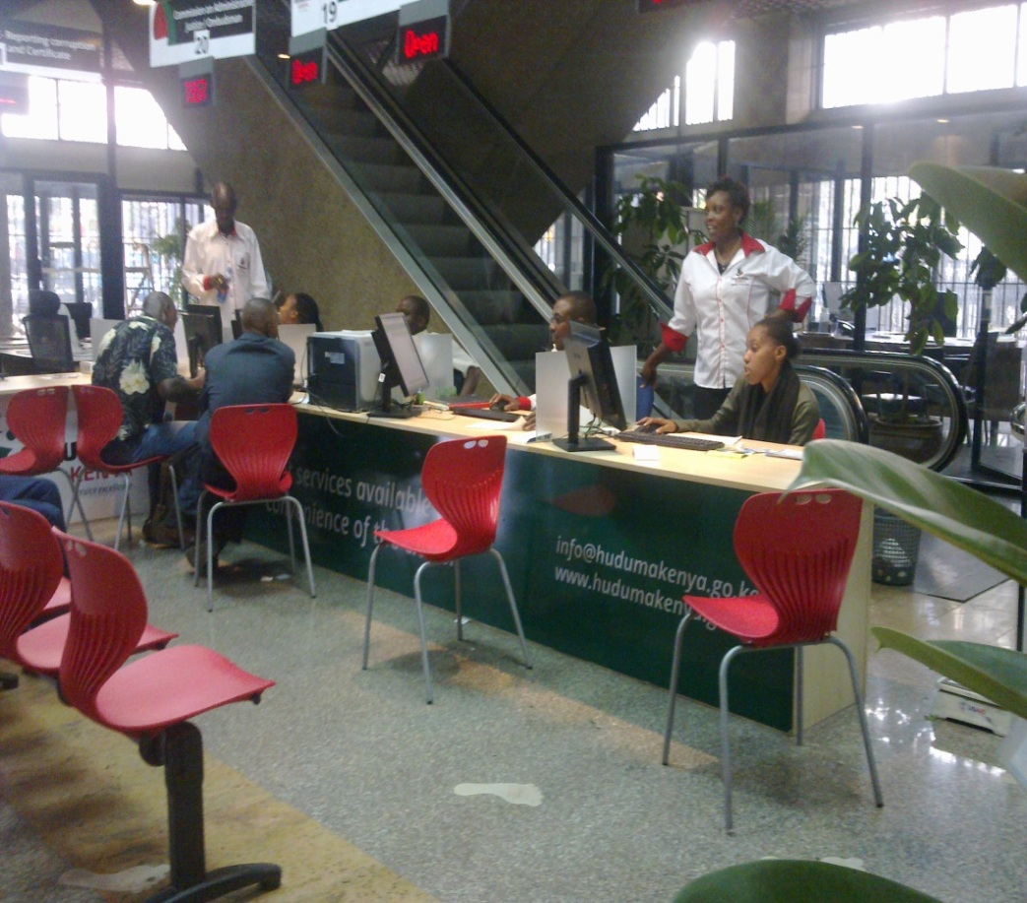

HUDUMA CENTRE –GPO

Slide 20

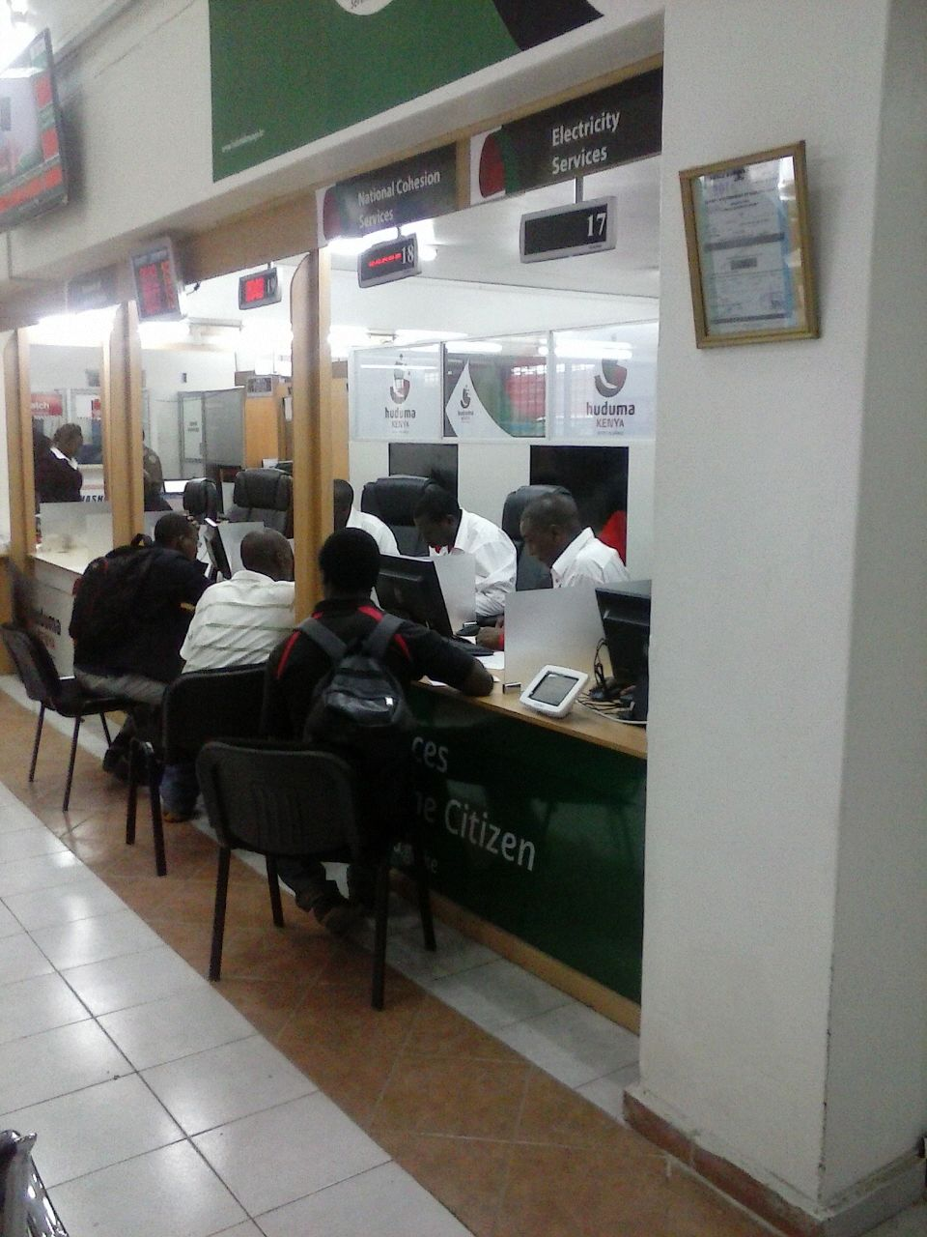
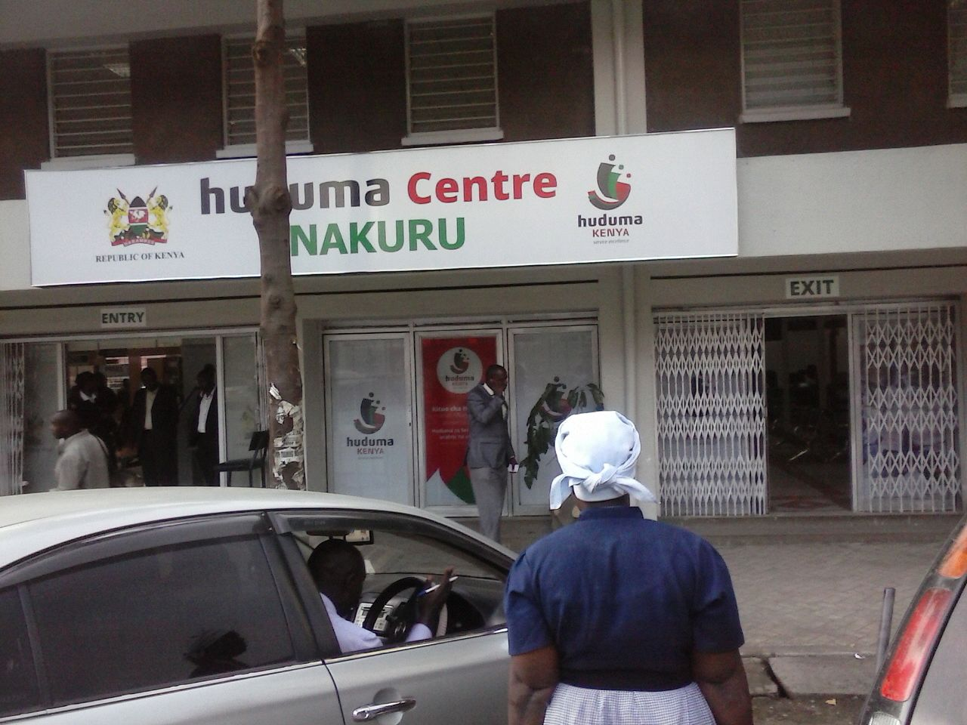
HUDUMA CENTRE- KISUMU AND NAKURU

Slide 21
Challenges and Opportunities
Challenges
Rapidly changing technological advances
ICT services in unserved and underserved areas remain a problem to women in the rural areas.
High cost and unreliability of Telecommunication disrupts the flow of services which might reverse gains.
Limited ICT awareness that hinders cultural and attitudinal change continue to disadvantage women and girls especially in the rural areas.
A wide internal digital divide between rural and urban areas.
Opportunities
Public-private partnership: There is a growing Public-Private Partnerships (PPPs) and Kenya’s largest contributor to innovation is the private sector.- revolutionized m-commerce , M-pesa.
Local innovations: A number of ICT hubs in Kenya have been established to promote the development and use of ICT technologies.
Deployment of ICT Infrastructure Services in Counties: The Communications Authority will support licensing of County-based service providers to offer last mile access solutions.

Slide 22
Ahsante Sana!
Thank You!

Slide 23


MINISTRY OF PUBLIC SERVICE YOUTH AND GENDER AFFAIRS
GOVERNMENT OF KENYA

