Slide 1
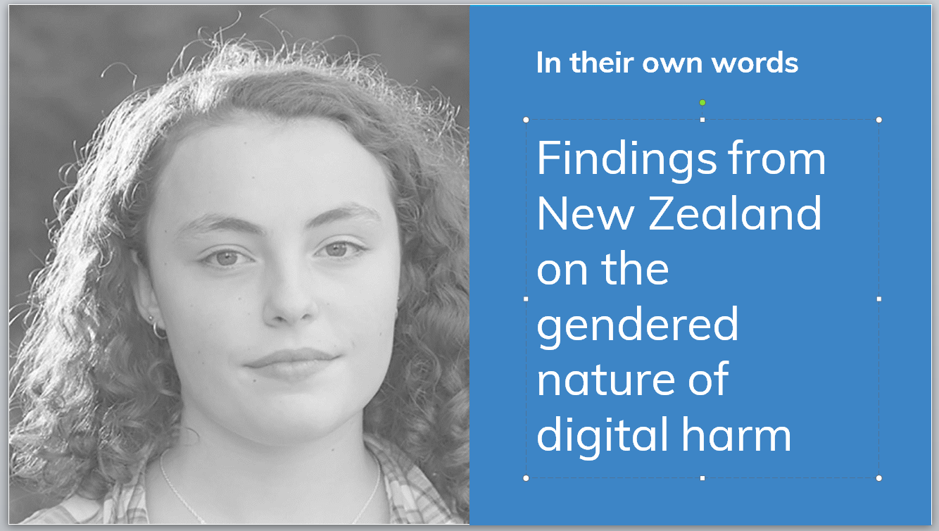

Slide 2
I think girls are probably way more worried about their image on stuff like that. You see them editing photos and stuff heaps on their profile pictures whereas most guys don’t really care.
- single sex boys’ school group

Slide 3
That’s the big thing with cyber safety is the only thing is that’s discussed is: don’t accept messages from old men. That’s what they tell you.
-co-ed school girls’ group

Slide 4
Because everyone uses social media very often, so often, it’s a part of everyone’s daily lives, it sort of has become like a normal thing. There’s no separate cyberbullying or bullying, it’s straight up bullying.
-co-ed school girls’ group

Slide 5
It’s not even a boy or a girl thing, it’s more like each person. Each person deals with [their emotions] differently.
- single sex girls’ school group

Slide 6
But the thing is you’ve kind of got to think we’re young, we’re making dumb mistakes and our parents’ generation or like our bosses’ generation, they haven’t had social media that long so they haven’t had that risk. They could have... done the same things or worse but there’s no record of that, so it’s kind of like they can take the high road.
- single sex girls’ school group

Slide 7
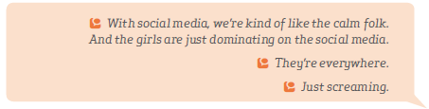
- co-ed school boys’ group

Slide 8
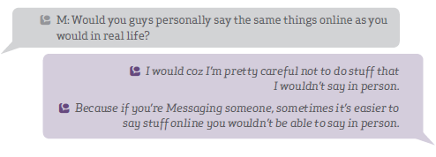
-co-ed school girls’ group

Slide 9
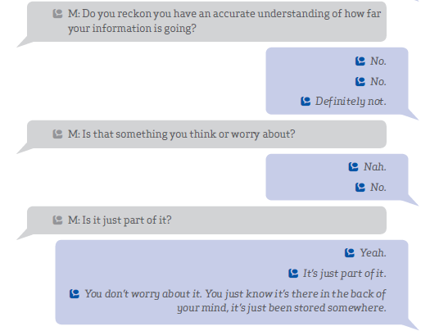
- single sex boys’ school group

Slide 10
You’ve got to think you’re not going to be too offensive to the point where it’s like if a potential employer was looking at this, would they want to see that? You’ve always got to be kind of conscious of that.
- co-ed school boys’ group

Slide 11
There’s also like perceived fear of punishment as the victim which can be really hard as well and stops people from reaching out.
- co-ed school boys’ group

Slide 12
Everyone’s more confident online. It’s like you have the chance to re-read it, make it perfect and then just post it and be like, yeah there’s no consequences now. Because no one is going to come up to you and confront you, why did you say that on my profile?
-single-sex girls’ school group

Slide 13
The rule for posting anything online is: would my mother cry if she read this? No? Okay.
-co-ed school girls’ group

Slide 14
I know a few stories of girls’ nudes going around and them not knowing about it until everyone’s seen it.
-co-ed school girls’ group

Slide 15
Are people consenting to me posting these photos? This person consenting to receiving this photo of me? That is the biggest problem with interactions online is people don’t understand that boundary of where, it’s like not understanding this person might not want you to do this. But it’s like because it’s online it’s okay.
-co-ed school girls’ group

