Slide 1


NIGERIA’S PRESENTATION ON THE CSW62 REVIEW THEME:
Participation in and Access of Women to the Media, and Information and Communication Technologies and their impact on and use as an instrument for the Advancement and Empowerment of Women
Senator Aisha Jummai Alhassan (Mrs.):
Nigeria Minister for Women Affairs and Social Development
14TH MARCH, 2018, NEW-YORK

Slide 2

Actions Using Media, Information & Communication Technology from (2003-2018) over 15 year period has impacted Gender Equality through:
POLICY & LEGISLATION: From Women Policy to National Gender Policy and Sectoral Gender Policies (Agriculture, Emergency Management, Police, Media); GBV - VAPP 2015, State Laws & Local Edicts + other Policy Reforms
PROGRAMMES : Advocacy, Capacity Building, Livelihoods Support, Sectoral Interventions & Linkages, Flagship Projects
RESEARCH: Increased Disaggregation of Data, Evidence-based Advocacy, Macro Level Planning, National Demographic Household Survey, National Bureau of Statistics
INNOVATIONS: Value Addition in Agricultural Processing, Lady Mechanic, Smart Woman Nigeria, GEMTECH Awards, Technology for Health, Agriculture, Artisans, IDPs, WWDisabilities, Female Prisoners

Slide 3
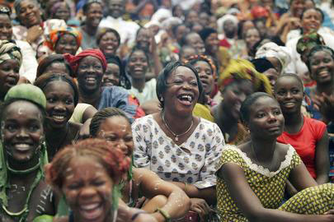
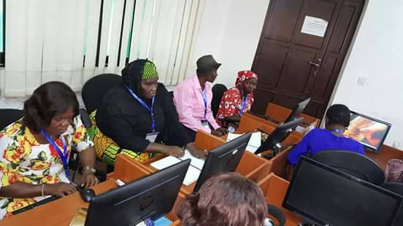
Photos of women participating in Financial Empowerment & ICT Programmes
Information Communication Technology
Financial Empowerment

Slide 4
Context of Implementation of CSW 42 Outcomes
Population Growth from 132m in 2003 to 193m in 2018 with 46.7% Females (NBS)
Women’s Access to Justice Guaranteed in 1999 Constitutional Provision
Net Enrolment Rate at Primary School Level now 56% for Girls
Over 5.5m Girls Out of School (UNESCO 2014)
40% Women had never attended School
(NPC 2009)
Media Social Justice Redress Platform- Berekete
Culture of Silence on GBV Broken
2nd NAP on UNSCR 1325 to address needs of over 1.5m Women & Girls affected by Conflict (including NE)
Review of Body of Laws of 2004 by Technical Expert Committee (2007)
Legal Aid Act Reviewed in 2011 & Expanded to cover crimes against human body & sexual offences like rape, assault
Freedom of Information Act May 2011
NAWOJ & Other Media Networks in Place e.g.
WPS – Media, Nollywood etc.
Citizen’s Mediation Centres Set up with British Council & DfID Support

Slide 5
Selected Achievements in the Context of CSW 62- Review Theme:
Economic Empower-ment
Women Fund for Economic Empowerment (WOFEE)
ICT Led Actions
Smart Women Initiatives
Technology Solutions to Livelihoods
Government Enterprise & Empowerment Programme (GEEP)
National Women Empowerment Fund (NAWEF)
E-Wallet Agric Scheme
Abiye-Safe Motherhood Prog
Eight Digital Hubs ( Lagos & AAdamawa Commissioned)
Sectoral Gender Policies
14 yr VAPP Bill Campaign by FMWASD & LACVAW
Gender Focal Person in Media Houses, MDAs & weekly Gender Programme on Topical issues
Dedicated HR Radio with daily Citizen’s Redress Platform
• Nig Won ITU/UN Women
•Kano, Lagos &Edo Lady
GEMTECH Award 2014
36 States Women Empowerment Projects
• • Tony Elumelu Foundation Youth
Technology Innovation Fund
National Gender Policy
Media Advocacy for HR Protection,
Policy & Legal Reforms
Pilot Young Women Artisanship Training
Value Chain Addition Agro-Processing
Lady Cobbler Shoe Centre
Motor Mechanic Workshops
Support for WWDisabilities & Prisoners
Digital Capture of CCT Beneficiaries
Business Development Fund for Women (BUDFOW)
HeforShe Nigeria Campaign flagged of by Acting President
Specialized Livelihood

Slide 6

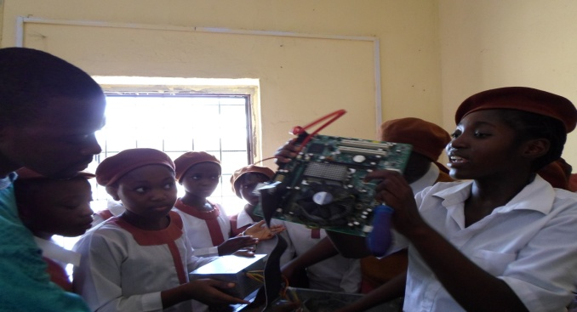

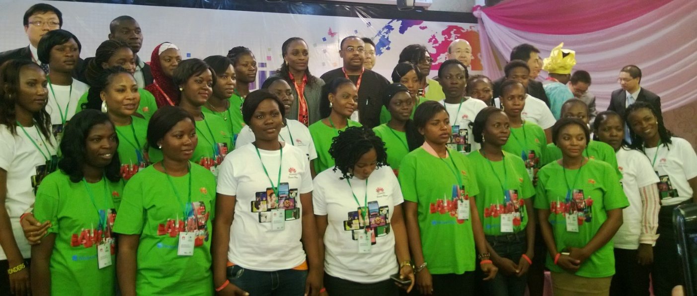
SmartWoman Nigeria Initiatives
ICT programme targeted at secondary school girls develop early interest in ICT related careers
Provides young unemployed female graduates with job ready skills to improve their chances of employment in the ICT sector

Slide 7
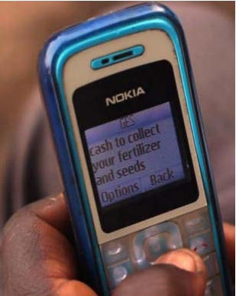
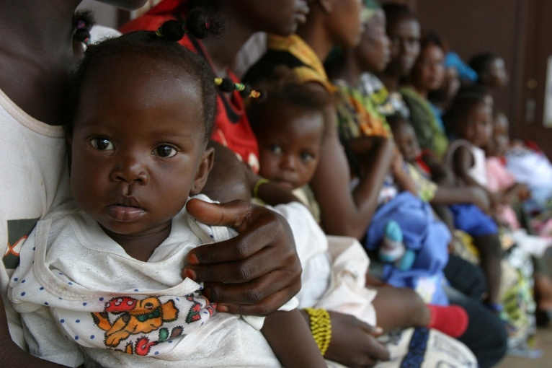
E- Wallet Agricultural Scheme:
has enabled women to gain direct access to agricultural input such as seeds, fertilizer, agrochemicals, cutting out the middle man hence increasing their profit margin
Abiye(Safe Motherhood) Project:
In 2010, 2000 pre-paid mobile phones were distributed free to pregnant rural women in Ondo State. This provided support and enhanced direct communication between a pregnant woman and the Community Health Extension Worker (health ranger) dedicated to her care.
Between 2010 and 2012, there has been 47% reduction of maternal mortality cases in Ondo state, an increase of 58% of registered patients and an increase of 96% of the number of live births.

Slide 8
Reach & Impact of Government’s 5 Pillar National Social Investment Programme (NSIP)
Conditional Cash Transfer (CCT) : targets provision of 1 million poor and vulnerable households in rural locations, with N 5,000 monthly cash transfers
Result: 622,649 Beneficiary H/Holds; 439,859 Captured in NSR with 293,973 women from 9567 Rural Communities
Home-Grown School Feeding(HGSF): provide 5.5 million school children, including girls with one nutritious meal/day using food locally grown by farmers
Results: 6,044,625 pupils are fed daily in 20 States by 61,352 cooks in 33,981 primary schools, mopping up the over 10.5 million out of school children.
Science, Technology, Engineering & Mathematics (STEM): A national bursary initiative to provide financial support to students especially young girls from rural areas studying Education, Engineering, Science, Technology & Mathematics
Results: Eight innovation hubs across the country to extend technology to rural communities - North East Makeathon & Lagos Climate Change Hubs.

Slide 9
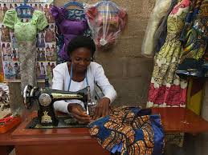
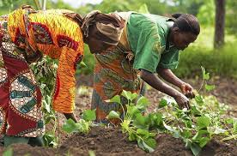
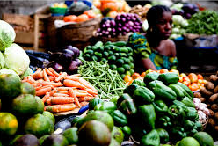
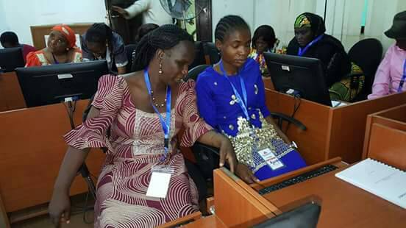
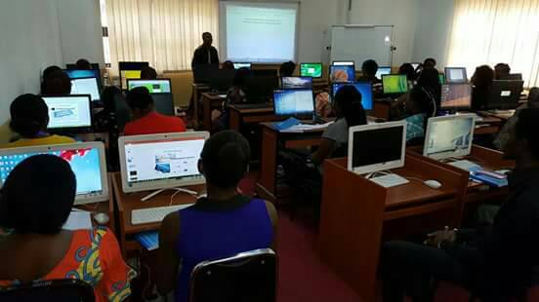
National Women Empowerment Fund (NAWEF): Promoting Financial inclusion and supporting rural women’s entrepreneurial skills
Women Artisans
Women Farmers / Agric Workers
Market Women
50 visually Impaired women trained in ICT by the National Centre for Women Development
ICT Training for Female Entrepreneurs

Slide 10
Reach & Impact of Government’s 5 Pillar National Social Investment Programme (NSIP)- Cont’d
Job Creation and Youth Employment Programme (N-Power): Supports young Nigerians to acquire and develop life-long skills and become solution providers in rural communities while contributing as players in the domestic and global markets
Results: 200,000 N-Power graduates have been successfully deployed to serve local communities & 300,000 graduate volunteers pre-selected
Government Enterprise and Empowerment Programme (GEEP), also known as ‘Market Moni’ with NAWEF as Dedicated Women Component: Provides micro lending to 1.66 million businesses at the base of the financial pyramid. Beneficiaries typically traders & often women cooperatives, market women, enterprising youth & farmers largely residing in rural areas with $164 million earmarked for GEEP and $1.56 million for NAWEF
Results: 259,451 GEEP Loans disbursed with additional 478,388 eligible beneficiaries under processing; 4,979 NAWEF beneficiaries in 6 Pilot States;

Slide 11
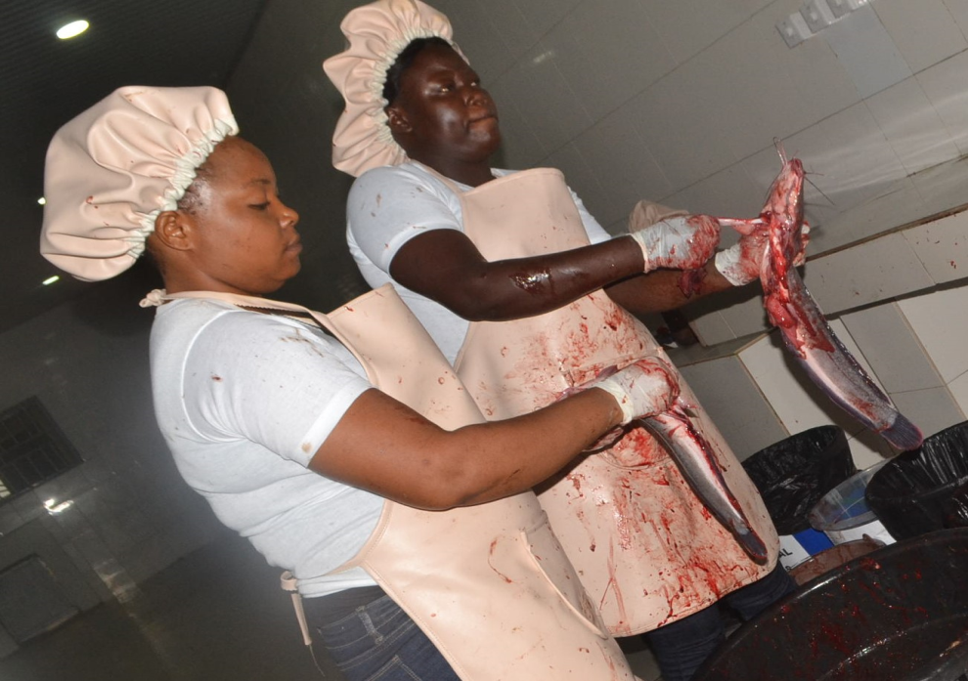
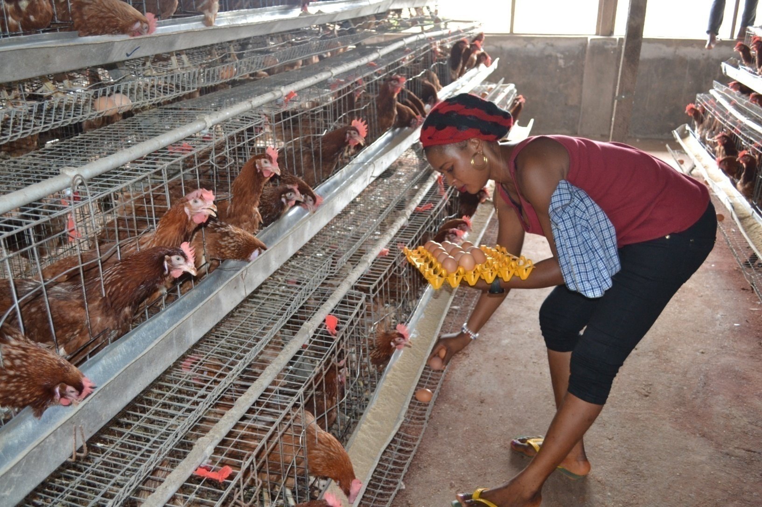
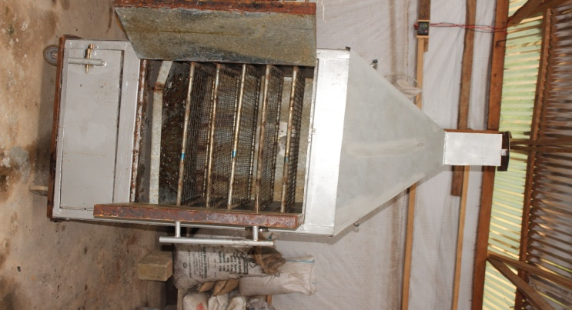
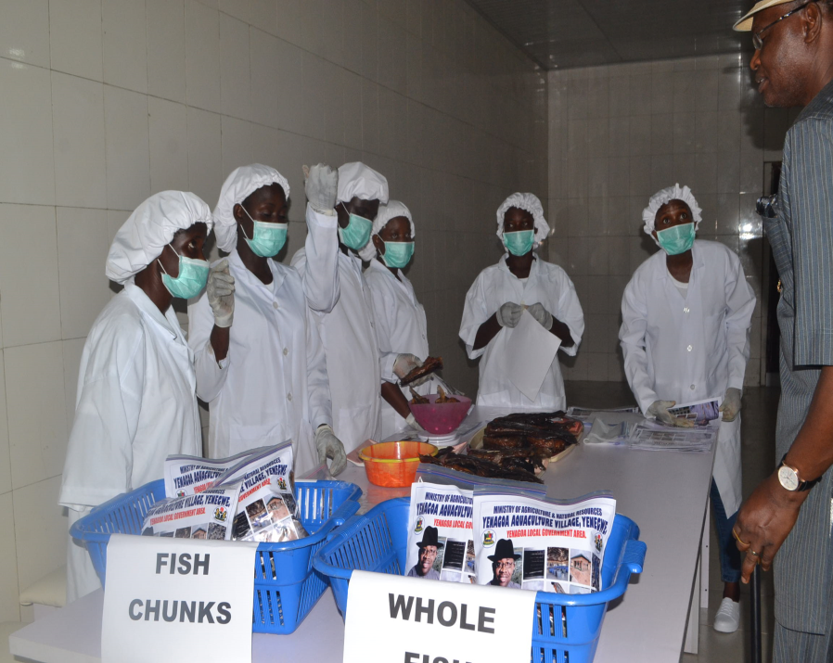
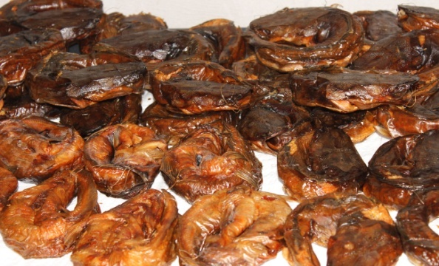
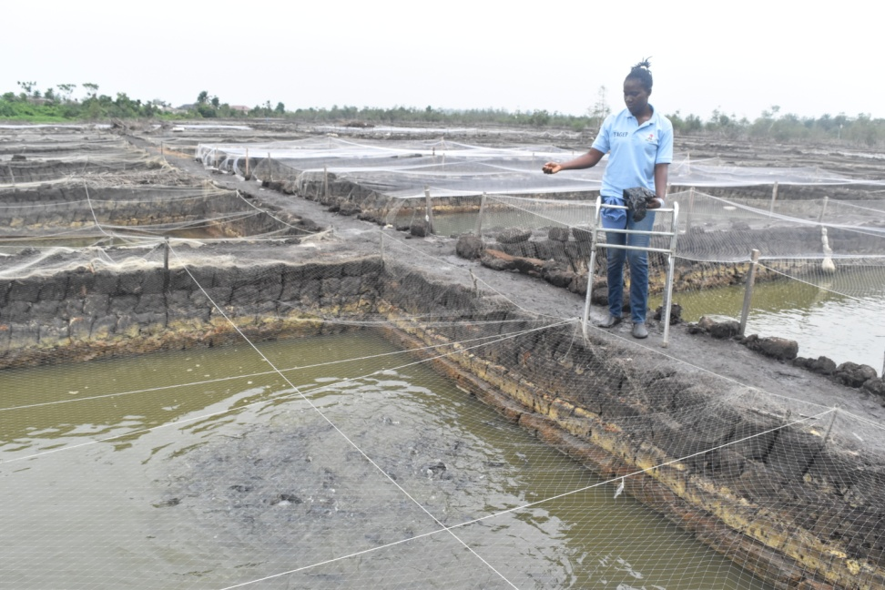
Value Chain Addition in Agro- Processing: Women in Bayelsa State trained on the use of Kiln Technology for improved preservation, packaging and distribution of fish ; Delta State Youth Agricultural Empowered Scheme : 15,000 Women & Girls beneficiaries
Women gutting the fish in preparation for drying
Fish Drying Kiln
Poultry Farming
Fish Farming
Dried Fish
Ready for Market Packaged Dried Fish

Slide 12
Key Lessons Learned and Emerging Issues
Appropriate Policy Framework required across sectors
Enforcement of Legislation is essential to improved Rights Protection
for Women & Girls especially in rural areas
Innovation, Infrastructure and Technology are key tools for transforming rural economies and empowering women and girls
Media is a vital tool for educating the public and promoting cultural & attitudinal change
Empowerment of women and girls including their participation in governance and decision making is key to poverty reduction
Availability of gender sensitive date is a pre-requisite to policy reform & media advocacy
Partnership and Coordination of women empowerment initiatives is required to minimize duplication of efforts & ensure judicious use of resources
Integrating WPS concerns into Human Security Architecture is fundamental to sustainable peace processes.

Slide 13
Challenges and Opportunities
(i) Internal Strife still threatens women’s livelihoods;
(ii) Notwithstanding gains, Labor force participation of women still at 63.5% in low-wage labor;
(iii) Child and Maternal Mortality rates still high
Social Norms that constrain:
-Physical mobility – Paucity of safe spaces
-Sharing of Household responsibilities
-Access to Social networks, formal and informal institutions
-Access to Productive assets, finance, information and skills
Inadequate gender-inclusiveness in Formal Institutions
-Policy and Regulations
-Programming
- Service Delivery and basic infrastructure
Non-competitive markets that prevent
- Market access
- Positive return on investment for livelihoods
- Technology infusion
Information Asymmetries that insufficiently addresses
- Efficient decision making
- Price realization
- Leveraging opportunities
NSIP & other Intiatives provide opportunity for spcial transformation & poverty reduction

Slide 14
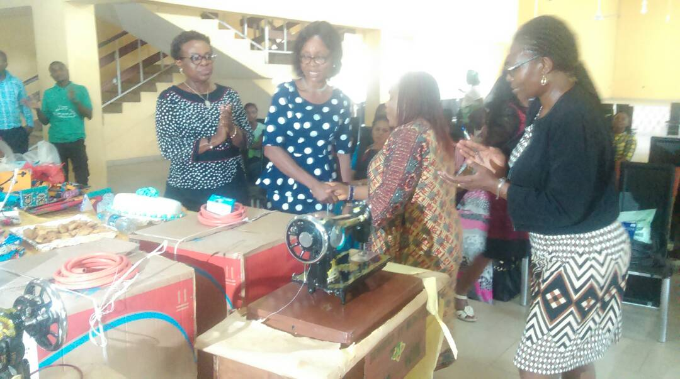
Livelihood Support Skills

Slide 15
THANK YOU
&
GOD BLESS

