Slide 1

The participation of women in the media, information and communication technologies, and women's access to them: Good practices identified in Costa Rica
Costa Rica
March 2018

Slide 2
National Regulatory Framework
It is based on the Conventions, Declarations, and International Agreements on the participation of women in their diversity and in the rural and urban areas.
National Policy for Equality and Equity, it approaches the subject through 3 of its 6 objectives, related with:
Paid work and income generation: women entrepreneurs, information systems and technical support.
Education and cultural change: information, communication and education strategies.
Protection of rights against violence: unified systems of statistics on violence and the Comprehensive Plan of Services for Attention to Women Victims of Violence (PISAV).
National Policies in Science and Technology, they address issues such as:
Attraction of women to the field of science and technology.
Training and permanence of women in Science and Technology careers.
Promotion of research and employment of women in Science and Technology.
Social appropriation of science with a gender perspective.
Society and economy based on knowledge.
Access and use of telecommunications services.

Slide 3
National Regulatory Framework
It is based on the Conventions, Declarations, and International Agreements on the participation of women in their diversity and in the rural and urban areas.
Policy for the Care and Prevention of Violence Against Women
Axis 4.1 Social communication for change. Under the understanding that violence against women is sustained and perpetuated through sociocultural patterns that are expressed in ideologies, discourses, images, stereotyped ideas, among others, that justify learned and naturalized social practices.
The Communication for Social Change (CCS) is defined as a process of public and private dialogue that seeks to facilitate the active participation and decision-making of the population through access to timely and quality information and through the creation of spaces for dialogue and confrontation of ideas for the achievement of consensus and agreements.

Slide 4
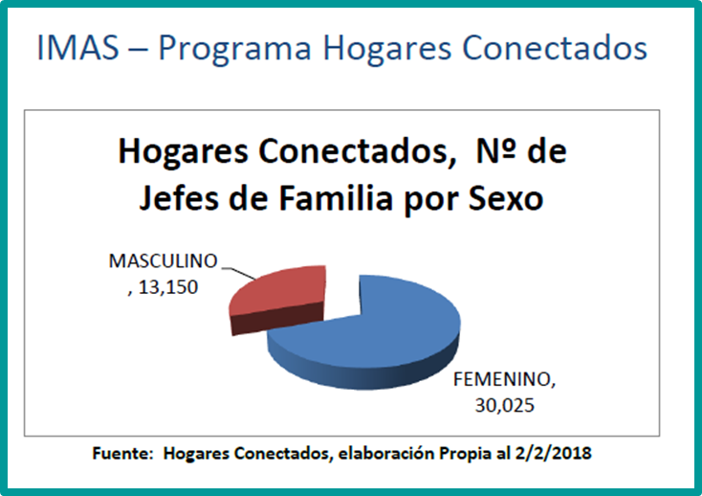
Eliminate infrastructure barriers related to information and communication technologies.
587/5000
The Superintendency of Telecommunications (SUTEL) through the National Telecommunications Fund (FONATEL) has developed 4 programs (financing with money from telephone companies, internet and cable TV).
Connected homes (14,000 families).
Equipment Program for Public Services Provider Centers.
Program of Access to Telecommunications Services in Communities Not Connected or Sub-connected. Connected Communities Program (75 priority districts and 24 indigenous territories).
Connected Public Spaces Program.
30,4%
69,6%

Slide 5
Gender aspects for coverage and representation in the media
Local stations in rural territories, with a focus on women's rights in their diversity.
Spaces to express and civil society participation that works in alternative communication processes to strengthen the information, articulation and political advocacy capacities of women.
Specific spaces for addressing issues related to the advancement of women's rights in state media and public universities.

Slide 6
Facilitate the access of women and girls to information and communication technologies through formal and non-formal education, and increase the number of female students in STEM courses at all educational levels
Formal education:
Technological Institute of Costa Rica (TEC) has a Plan of Attraction, Insertion and Permanence of women in the field of engineering. For the 2017 enrollment a percentage of 65% of men and 35% of women.
The College of Architects and Engineers (CFIA) has a Joint Gender Commission.
Universidad Fidélitas: its program called Women in Engineering seeks to promote the enrollment of women in engineering careers.
Omar Dengo Foundation: has developed a series of initiatives to motivate more girls and young people to careers in science and technology, especially robotics.
Ministry of Public Education:
TEACH (HER): A UNESCO´s initiative to reduce the education gap through public-private partnerships. Costa Rica has developed a pilot plan for Central America (INAMU, MICITT, MEP, MREE, USA EMBASSY) where 1,465 students had been beneficiated by this initiative, as well as teachers from 7 educational centers and National Advisors.
Schools for Change (INAMU-MEP): promotion of girls in science and technology. Chapter of the curriculum.

Slide 7
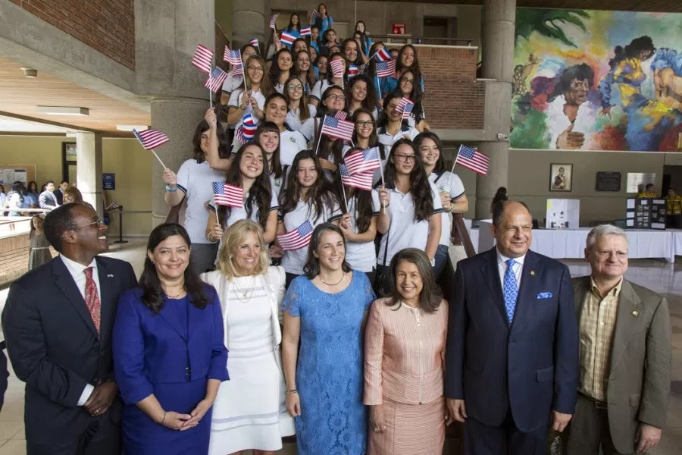

Slide 8
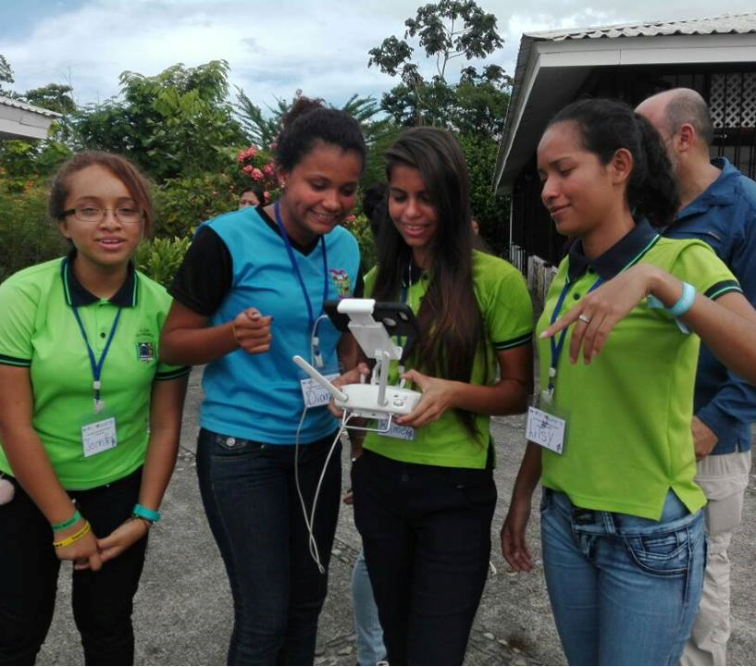
INAMU participates directly in the following initiatives to empower women and girls in STEM careers
From the Academia: XI Ibero-American Congress on Science, Technology and Gender that motivates the inclusion of gender in science and technology, and thus contribute to search for fairer and more equitable societies.
Public-Private Partnerships: Meetings of Women in Science and Technology. Between 2016 and 2017, 900 young people from different areas of the country have been beneficiated. By 2018 it is planned to be: 650 young people.

Slide 9
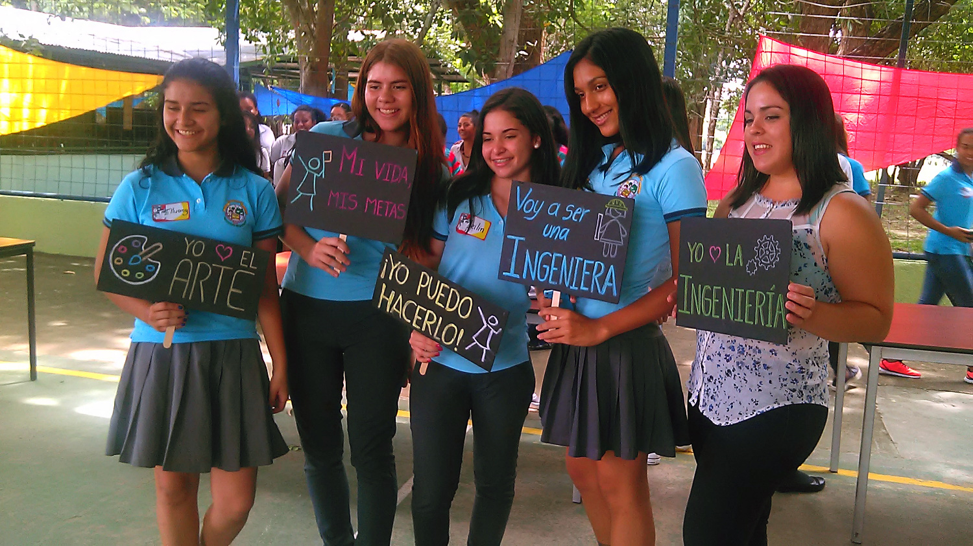

Slide 10
Initiatives in Non-Formal Education
Project 500 Women Scientists in CR: The objective is to visualize the work of women scientists in the country, their trajectory, contributions and proposals.
Cooperativa Sulá Batsú: seeks to empower and create female leaders through the strengthening of ICT skills and digital technologies.
Red MenTe Project: NGO that promotes science and technology for women.
We | Women Connecting: works for gender equality through the formation of meeting spaces, coaching and mentoring.
Public-private inter-institutional work for the celebration of the International Day of women and girls in science (750 young people in 2017, 100 of the urban areas and 650 of rural areas).
INTEL: It has several initiatives to promote STEM careers for women, but also policies towards the interior of the company in the promotion of parity opportunities in hiring.

Slide 11
Initiatives in Non-Formal Education
Civic Centers for Peace: Participants between 4 to 18 years old. Is a physical space use to implement strategies for the prevention of violence, the strengthening of citizen coexistence capacities and the creation of development opportunities for people, through education, technology, art, sports and the recreation. There are 7 centers, one in each province of the country.
Club House (INTEL - Local governments - Private companies - State): provide young people with safe and innovative alternatives for learning and coexistence after school. The program offers them the possibility to explore software and professional resources in the areas of graphic design, digital animation, 3D modeling, music, programming, video editing and robotics; as well as, educational prototypes developed by the MIT Media Lab. All without any cost for the participant.

Slide 12
Create programs for vocational training, vocational training, on-the-job training and capacity-building, or expand existing ones, for women and girls
The National Apprenticeship Institute (INA): Strategy for the insertion and permanence of more women in non-traditional careers "Rompiendo Moldes” (Breaking Molds). The general objective is "Incorporate in the formal labor market, women graduated from programs of the five sectors that have the lower female participation rates.

Slide 13
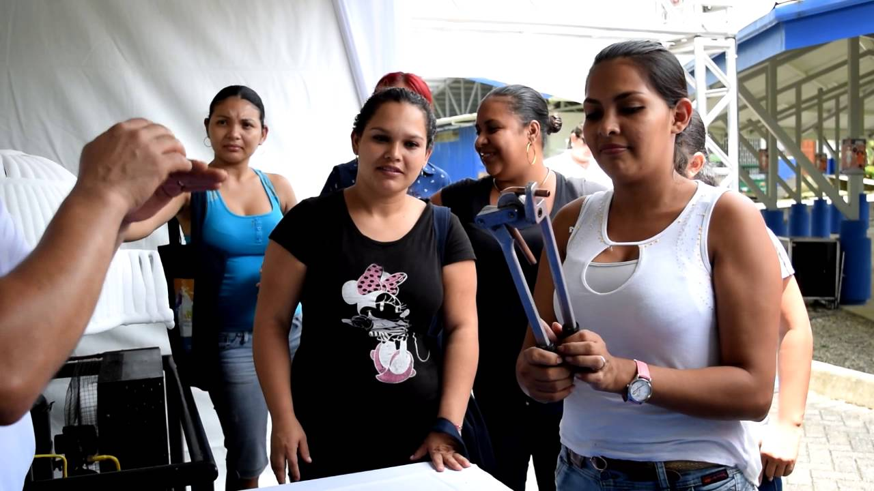
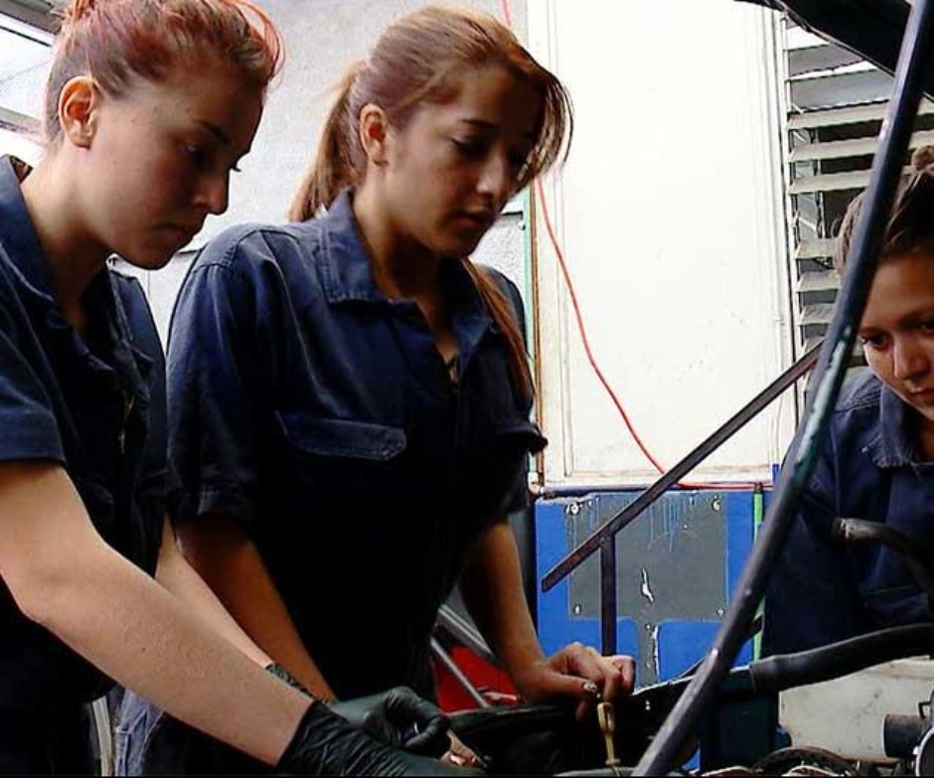
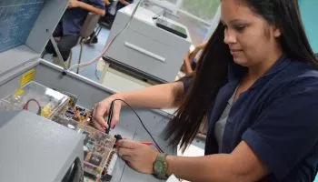

Slide 14
Equal access for women to economic activities based on information and communication technologies, such as small businesses
Entrepreneurship: strengthening of women's economic autonomy, entrepreneurial skills and the increase of marketing spaces through the use of information technologies.
The National Women's Institute and Facebook signed an alliance for the implementation of the program "She Makes History" in Costa Rica, a program that made available to public officials and the private sector technological tools and digital marketing that has Facebook to enhance business of women entrepreneurs and businesswomen. It counted with the participation of 11 public institutions, 4 private companies and 3 civil society organizations.
Financial inclusion of women: The Office of the Superintendent of Financial Institutions, in cooperation with the financial institutions, has developed a set of guidelines to promote the financial inclusion of women, in 4 areas: data and disaggregated information, financial education, awareness of financial operators, and differentiated products.

Slide 15
Fight violence against women through the media and information technology
GEMA Central American Gender and Communication Observatory: a space for meetings and dialogue between citizens, the media, cultural industries, advertising companies and communication professionals. Main objective: to contribute to the construction of journalist and advertising ethics, based on the universal values of Human Rights, by making the media aware of the struggle for diversity and equality without any type of discrimination based on gender, nationality, age, profession, sexual orientation, origin, religious beliefs, etc.

Slide 16
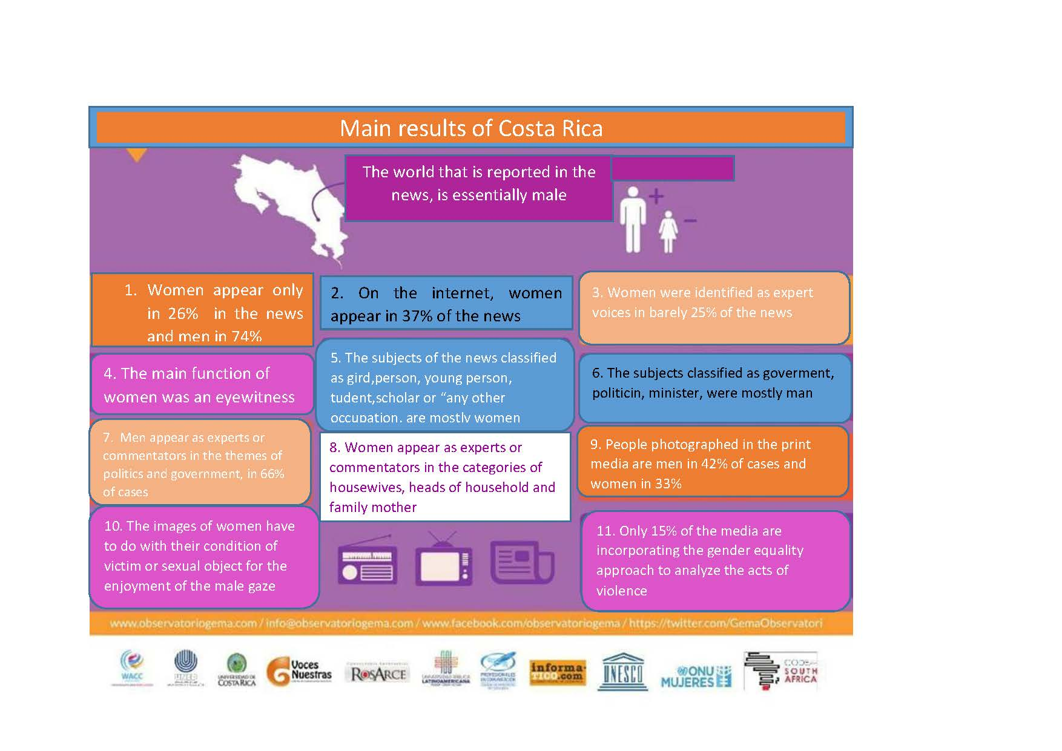

Slide 17

Joint campaign with the private sector, INAMU and Soccer Federation: THIRD SCORE
The efforts of Televisora de Costa Rica, INAMU and the National Soccer Federation to make visible violence against women was recognized globally.
The campaign won several awards in in important festivals in the world.

Slide 18
Positively recognize and widely publicize good practices to break down stereotypes, negative portrayals and exploitation of women in all forms
Gender Equality Seal: The National Institute of Women in partnership with UNDP. Recognizes the importance of incorporating the business sector in the achievement of gender equality in the workplace, through the identification of gaps and corrective measures.
Certification in Management System for Gender Equality: 1 certified company and 66 organizations (53 private and 13 public) have signed the Letter of Intent.
Recognition of Good Practices for Gender Equality in Employment in order to motivate public and private organizations to take measures that promote equal opportunities and treatment between women and men and to close the gender gaps in the workplace. One category of recognition is the inclusive communication and non-sexist language. On 2017, 15 recognitions were granted.

Slide 19
Challenges
There still are exclusion and discrimination against women, that keeps them outside of the factors enhancing the country's development, such as science, technology, telecommunications and innovation. The sectors of greatest dynamism with respect to employment in these fields, have a low representation of women in the public and private sectors.
Social de-construction of gender based on a sexual division of labor and traditional roles that create stereotypes that promote discrimination and inequality by limiting the access of more women to careers related to STEM areas, and placing them in the branches of economic activity and employment low pay and higher unemployment, regardless of their qualifications.
The perspective of women is absent or mediated by the masculine experience, and it requires substantive changes in the culture and society, in particular in the field of science and technology, and media.
Entry of women into paid activities, under conditions of equality with men, and increase the participation of women in the field of STEM research. Currently in Costa Rica this participation ranges between 32% and 45%.

Slide 20
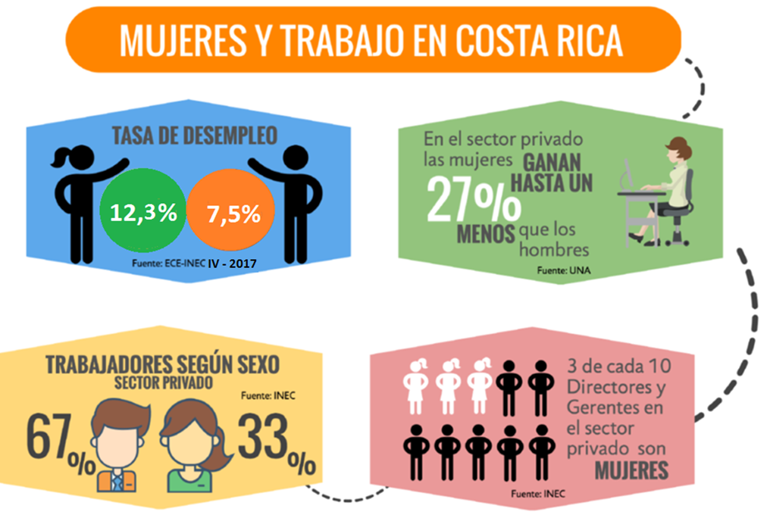

Slide 21
Challenges
The relationship of women with scientific and technological production, has not been part of the research agenda in Costa Rica. The closer initiatives made have focused on the analysis of access to information technologies, without considering their use and exploitation.
Programs, job profiles, educational curricula and research initiatives in the STEM area should be free from gender bias.
Increase the collection of disaggregated data by sex and the preparation and statistical analysis with a gender focus. Develop databases where the profile of scientific communities is maintained.
Promote leadership for the appropriation of technological knowledge.
Work on the social construction of female and male identity to avoid gender bias and the sexual division of labor.

Slide 22
Thank you!

