Slide 1

The Republic of Sudan
Ministry of Security and social Development
General Directorate for Women
Women’s participation in
Media, Information Technology & Communication Mediums
As Effective Means for Women’s Empowerment and Progress in Sudan
14 March 2017

Slide 2
Background:
Information technology and telecommunications are responsible for huge changes in infrastructure and development in all aspects of life all over the world.
This is quite crucial in a country like Sudan with vast lands and different terrains assisting basically in development efforts and in strengthening unity within its diverse society.
Sudan is also predominantly susceptible to climate change, Drought, flood, communal conflicts, huge foreign debts and influx of refugees which brings about huge financial burden and greater demand for quality services.

Slide 3
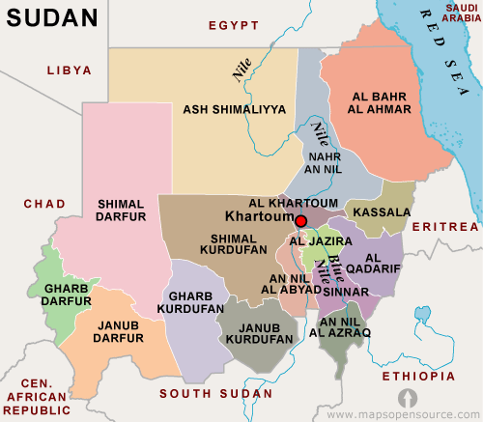
General overview:
The current estimated population of Sudan is about 41,985,512 people
(21,273,853 male - 20,710, 660 female).
30.8% are living in the urban areas and 69.2% in rural areas, with a population growth of 2.86%.
Young population with the median age 19 years.
The total life expectancy for male and female at birth estimated around 62.6 yrs (male 61 yrs – female 64.2 yrs)(CBS Figures).

Slide 4
Strategic plans and policies:
Strategic plan adopted by the Ministry of Information technology and communications (2007 -2031).
Three main objectives:
1. improving the scope and service quality to cope with the requirements of the millennium development goals, 2030 Agenda and other regional settings.
2. Bridging the learning opportunity - gap between males and females,
3. Introduction of IT and computer learning as an essential component of general education in the country.

Slide 5
Strategic plans and policies:
It must be noted that, the establishment of specialized ministries headed by highly qualified women in Education, Higher Education, IT and communication, and Information ministries as well as Sudan News agency, marks the participation by women in these crucial bodies.
A national data center was launched in 2010 as a nucleus to the National Information Centre (NIC) which was established since 2001. This connects all government entities and has branches in all ministries at the federal and state levels. The NIC since its establishment plays a consultative role and as well works in several tracks in terms of infrastructure, applications, standards and information promotion.
A Sudan e – Government portal was also established since 2016 and acts as a main interface to the Government of Sudan providing information and electronic services.

Slide 6
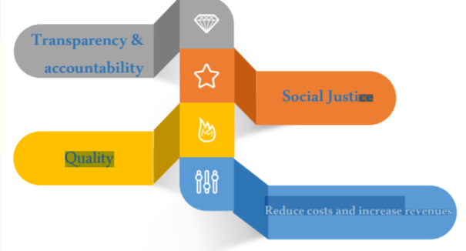
Principles of e- Government of Sudan:

Slide 7
Legislations governing IT and communications in Sudan:
National Telecommunications Cooperation Act 2001(under revision).
Electronic Transactions Act 2007.
E – Crimes Law 2007 (under revision).
Careers in Computer systems Act 2015.
Right of access to information Law 2014.

Slide 8
Progress in Educational Sector:
To meet SDGs requirements in education literacy campaigns in coordination with the UNESCO were held in three states; North Kordofan, White Nile and Gadaref, at districts where there are no schools in order to help rural women acquire basic necessary learning skills.
General education statistics for 2014 shows continued progress in pre-school learning levels with a 42% physical accommodation capacity. Male-female educational equality index indicator at primary level has risen to 0.98% in 2014 compared to 0.94% in 2010.
Literacy levels among both sexes stood at 61% in 2007 (71% for males and 52% for females). In 2014 literacy level among females of 15 – 24 years old has risen to 59.8% compared to 45.2% in 2010(Ministry of Education figures).

Slide 9
Progress in Educational Sector:
Male-female educational equality index indicator at secondary school level has risen to 1.10% in 2014 compared to 1.08% in 2010 (Ministry of Education figures).
It is noted that the number of admitted female students exceeds the number of male students, which is a clear indication of a trend change in community interest as regards female college education as well as a significant hike in female students’ academic scores.

Slide 10
Community Development & Research Centers:
These are more than 134 community development centers in total in Sudan, which were initiated by the technical training authority of the Ministry of Higher Education and Scientific Research. The centers are attached to government universities at various states of Sudan and are earmarked to enroll women in rural and urban areas of various age segments and learning backgrounds.
Higher education and scientific research institutions are around 83 institutions of which 30 are government-funded institutions while 53 are private-funded. These institutions cover all states of the Sudan and provide educational opportunities for women.

Slide 11
Women empowerment in the Media:
There are 36 broadcasting service corporations of which 7 are specialized in women and family affairs including all social, cultural and artistic aspects. Around 38.9% of air cast hours was devoted to women and family issues(Ministry of Information figures).
Magazines devoted to women issues constitute 20% of total number of specialized magazines.

Slide 12
Women empowerment in the Media:
Women constitute 40% of a total 260 casters working in Sudan Broadcasting Service Corporation.
Statistics revealed that there are 118 females holding various positions such as caster, program specialist, program director, team manager, training official, technicians, senior casters, as well as news desk managers, political analysts and field correspondents within the capital and for the regional states as scheduled.
Women accessing the Internet increased to 41%, owing to the recent IT revolution, where the percentage of women owning mobile telephone devices has risen to 71%, over the past years.

Slide 13
Ministry of Information in Sudan figures
Female journalists in Sudan:
Traditionally, journalism has been a male-dominated profession in Sudan; however, the influx of female graduates from the universities across the country has increased the job opportunities for female journalists over the past years. Conversely, gender inequalities still exist, leaving women behind when it comes to working conditions.
Number of female professional journalists | 699
Number of experience-qualified female journalists | 1029
Number of bar-qualified female journalists | 614

Slide 14
Bridging the male-female recruiting gap in the Media:
There was no wide recruiting gap before, but there existed a lack of media channels infrastructure, as there was only one broadcasting corporation and one TV channel. But now with the various number of media corporations the number of female employees has increased to represent 40% of total labor force of press corps, and also 40% of labor force in the Sudanese Broadcasting Corporation.
Sudanese women have greatly benefited from training and capacity building programs organized by various government and non-government institutions in various educational and computer literacy fields, as well as from vocational training programs and participation opportunities in local, regional and international media forums

Slide 15
Modern Technology & its effect on Sudanese Women Progress:
With the introduction of the e-government system in government institutions, intensive IT courses have been arranged for government staff members at all levels, within Sudan and abroad.
IT and computer studies have also been incorporated as essential subjects within the general education curriculum and are delivered by specialist trainers. Further, the introduction of IT literacy programs has been of great help to government female staff members.

Slide 16
Modern Technology & its effect on Sudanese Women Progress:
There is considerable evidence that IT literacy Programs promote participation of rural women in social life.
Proper implantation and maximum utilization of social media channels as means of awareness help empower women & raise their living standards and enhance their communal participation through a secure and reliable channel of communication.
At certain levels women have taken a daring step to access international markets and get engaged in electronic commerce dealings through the Internet.
Use of Internet and social media means has also come as a life jacket for rural women who are subject to certain traditional restrictions, as it opens a window for them upon the outside world.
Expert researches have revealed that females, in rural areas, are more interested in using social media channels than their male counterparts.

Slide 17
Use of Information and Communication Technology to facilitate Training & primary health service provision for rural women in Sudan (Gezira State):
The implementation of family medicine faces many challenges in Africa in general and in Sudan specifically.
These challenges include: poverty, focus on hospital care, poor training capacity, drainage of doctors towards rich or more developed countries, and an upsurge of refugees with high demand on services in some localities and states.
This has been evident in Sudan, and in the Gezira State in particular a significant gap was identified in this context, reflecting a considerably low ratio of primary health doctors to resident population.

Slide 18
As a solution, the Government of Sudan according to national strategies, plans and policies used Information and communication technology (ICT) to implement specific projects in the health sector (e - health).This was done through:
Provision of health care in a distance (tele - medicine),
Facilitation of medical education (e-learning), and
Management of patients’ information (electronic medical records, EMRs).

Slide 19
The Gezira Family Medicine Project (GFMP) as a Model:
The Gezira Family Medicine Project (GFMP) in the Gezira state was based on the fact that better health services outcomes are related to the quality of primary health care available. If present it assists in lowering mortality rates, especially in the rural areas where rural women suffer increased maternal mortality rates.
The main objective of the project was to train graduate doctors in family medicine by means of 2 years (in – service) Master Degree Programme, and to provide accessible and affordable primary care based health services in rural areas with ICT being fully integrated in it.

Slide 20
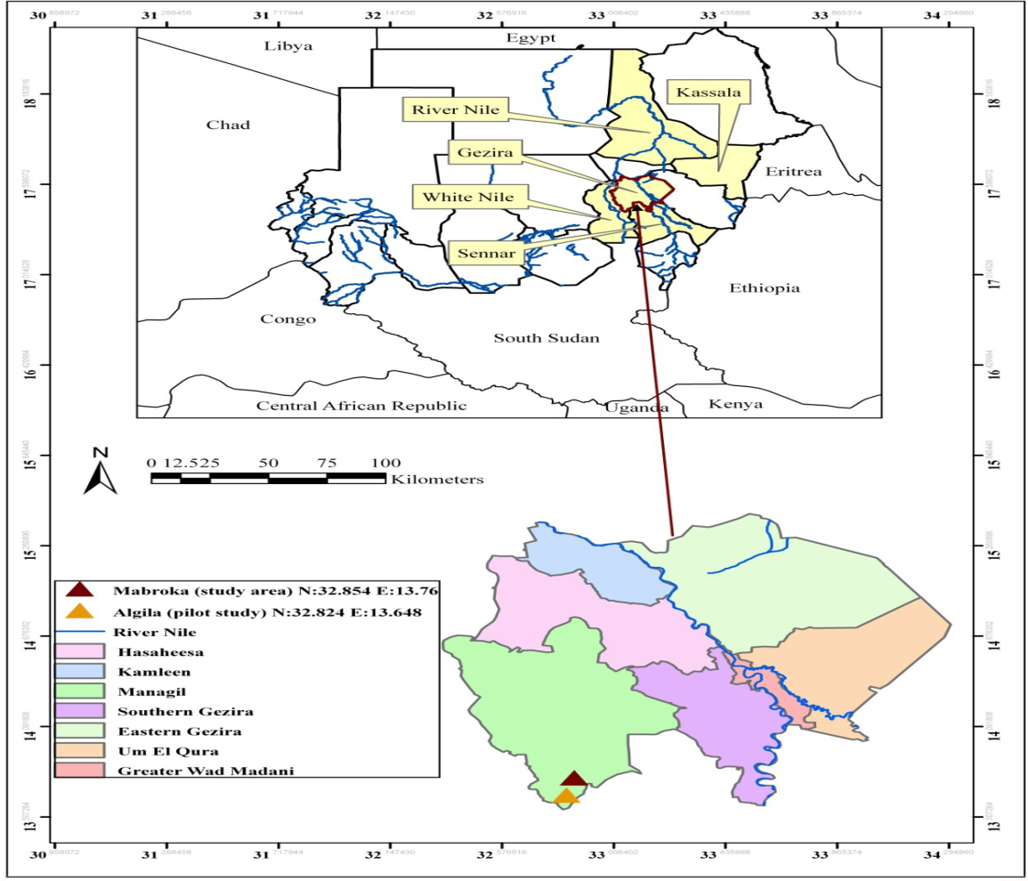
Location of the GFMP:
The GFMP was located in the Gezira state which is one of the 18 states in Sudan with a population of almost 4 million, with a rural population (80%) scattered over 7 localities and 3000 villages.
The curriculum used in the project was community oriented, providing health services in 158 centers around the Gezira state of which 84 has never been served by a doctor (Gezira University figures).
Gezira localities

Slide 21
Who are the main players in GFMP?
The project is a product of collaboration between several partners at both Federal and the State level:
University of Gezira, faculty of Medicine: provides academic training component including curriculum development.
Ministry of Health of Gezira state: responsible for providing health centers with required staff, including doctors, equipment, and buildings, paying chosen candidates tuition fees, in addition to extra laboratory technicians and nurses.
Sudan Medical Specialization Board: giving approval for any successful graduate from the 2 year Master Programme to eventually continue for 2 more years to obtain a full MD degree in family medicine at the national level.
Local communities in Gezira state: provided housing for the doctors especially in rural areas.
National Health Insurance Fund: provided health insurance services at all health centers launched in the GFMP.
National Health Insurance Fund
Local communities in Gezira state
University of Gezira, faculty of Medicine
GFMP
Sudan Medical Specialization Board
Ministry of Health of Gezira state:

Slide 22
How was ICT used in the GFMP :
Family doctors were connected with hospital specialties using online interactions to break geographical barriers (using CPU, display devices, VC cameras,, telecommunications, telemedicine software).
For distance or e- learning the software Cisco WebEx® was used.
Candidates were connected electronically to a virtual classroom with full interaction of life voice, picture, chatting.
For registration of patients an electronic filing system was developed by GFMP management (Family Clinic®). This system also includes a diagnostic system, and statistical reports can also be generated from it which helps in creation of a reliable data base for patients. Registration of patients was usually done at every tele - medicine session.

Slide 23
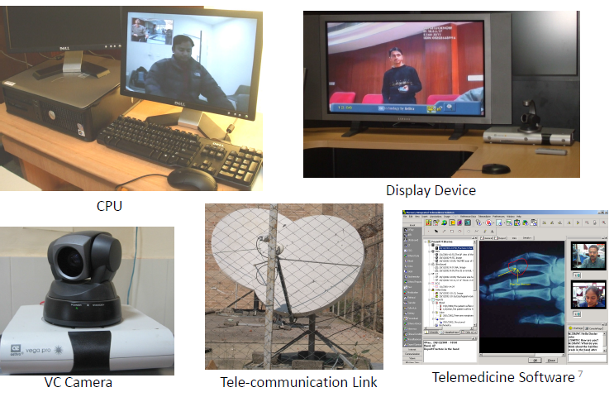
Tele - medicine tools used in GFMP:

Slide 24
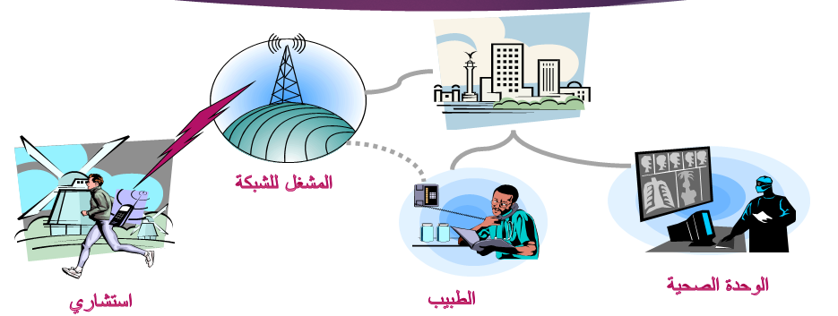
How Tele - medicine works for the GFMP :
Hospital in the City
Network Operator
State Level
Health Center
Consultant
Doctor/Trainee
Localities Level

Slide 25
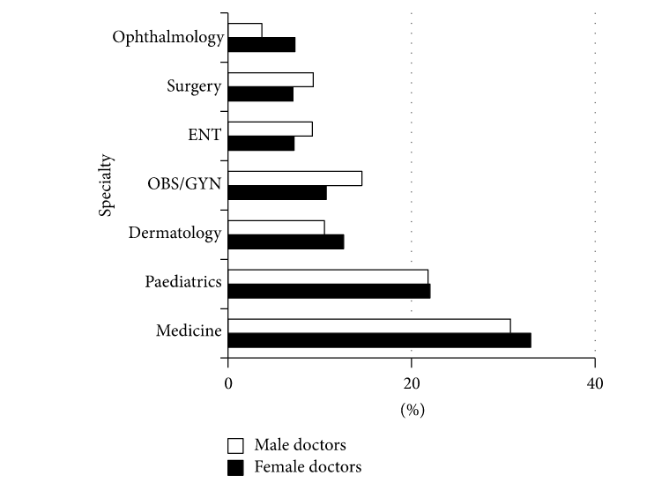
Figure 1: k.g. mohamed, s.hunskaar, S.H. Abdelrahman, and E. M. Malik, International Journal of family medicine, Telemedicine and E-Learning in a Primary Care Setting in Sudan: The Experience of the Gezira Family Medicine Project volume 2015(2015).
Type of specialty that both male and female doctors (medical officers enrolled in the project) have chosen to work in during the online sessions held with consultants aiming for patient diagnosis.

Slide 26
Results of the GFMP:
In the period from April 2011 to December 2012 (which is the first year of the project), about 3808 telemedicine online consultations were recorded and over 165000 new patients’ EMRs(electronic medical reports) were established (125 candidates enrolled in the program).
Results confirmed the suitability of ICT use in postgraduate training in family medicine and in health care service provision. This assisted in medical intervention and lowering of maternal mortality rates in rural areas covered by the project, further decreasing overcrowding in hospitals and possible financial burdens for patients.
Figures show a decrease in maternal mortality rates from 469 in 2005 in every 100, 000 child birth to 129 in every 100,000 child birth in 2015.
The Ministry of Health in Gezira state recruited about 417 midwives to assist in these efforts as well as hiring of consultants and conduction of capacity building programmes to manage the project.

Slide 27
Challenges facing women in Media and Information Technology fields:
Negative and restrictive traditions and social customs.
Lack of proper media portrayal and discussion of women issues (audio, video, press).
Spread of poverty and communal conflicts, as well as remote geographical areas also restrict women’s access to modern IT and communication technologies and training.
Need to strengthen measures to secure and maintain women’s right in compulsory and free primary education.

Slide 28
Challenges facing women in Media and Technology fields:
High illiteracy rates among rural women specially in remote areas and lack of interest to learn computer skills in spite of all incentives provided.
Need to introduce technology packages in agricultural field.
Need to strengthen coordination between institutional and networking actors on national and international levels to empower women.
Need to strengthen community mobilization and provide services for itinerant life styles (pastoralism etc.).
Need to expand network coverage to remote areas.

Slide 29
Opportunities for Rural Women in Sudan:
Political commitments towards women issues.
Decentralization leading to better decision making.
External funding opportunities.
Partnerships with international institutes and universities.
Recent gender sensiive reform initiatives in various sectors specially in IT and communication strategic plan.

Slide 30
Thank You

