Slide 1
Gender and Media Policies and Actions in the Wallonia- Brussels Federation Belgium
Alexandra Adriaenssens, Director, Equal Opportunities Directorate, FW-B
Martine Simonis, General Secretary, Association of Professional Journalists
Commission on the Status of Women (CSW) – UN –March 14th 2018

Slide 2
Agreed Conclusions 2003/44
Women’s participation and access to new information and communication technologies: content, production, use
vs. Negative effects on gender equality and perpetuation of inequalities
Vs. NT > Tool for empowering women and promoting gender equality
Broaden women's access to benefits of information and NT
Increase women’s access and participation in the media
Role of women in decision-making
Sexualization, pornography, violence against women
Sexist stereotypes

Slide 3
2006-2013 : Policies lead in FW-B
2006 : study on young people’s integration of sexist stereotypes conveyed by the media
2008 : raising awareness among young people and media players about stereotypes
2010 : Action plan for equality and diversity in Audiovisual Media in FW-B
Collaborations : CSA, UNIA, IEFH, AJP, etc.
Barometers (2011, 2012, 2013) : representation of women and men (+ other minorities) in television programs broadcasted in FW-B
Biannual since 2016 / integral part of the missions of the CSA
Spectrum of good practices: blockages, solutions, work tracks

Slide 4
2010 -2018 : FW-B and AJP
Conventions « Gender and diversity in journalistic content and editorial staffing »
Studies and Research: presence and representation of women in the media
2 axes :
Media content: information – where are women?
Global Media Monitoring Project (2010 and 2015)
Equality and diversity barometer in the daily press (2011 and 2014)
Journalism : women in media
Diversity in the journalistic workforce (2013)
Women’s journalism (2018/2019)
Recurring and convergent findings
Awareness and training of journalists and journalism students on gender issues
Findings into action: Expertalia, a tool for journalists

Slide 5



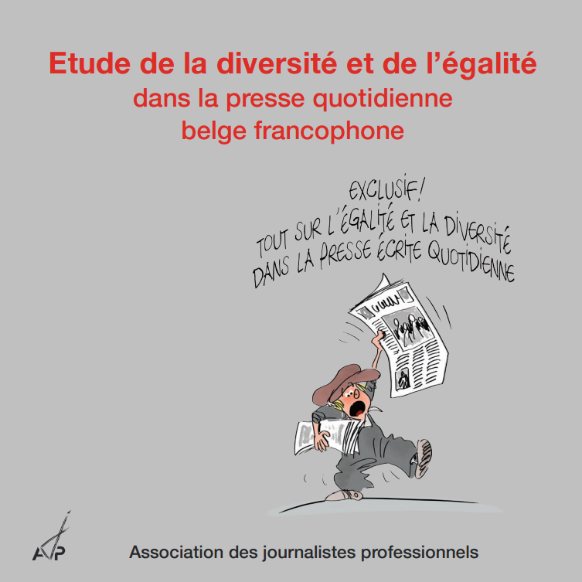
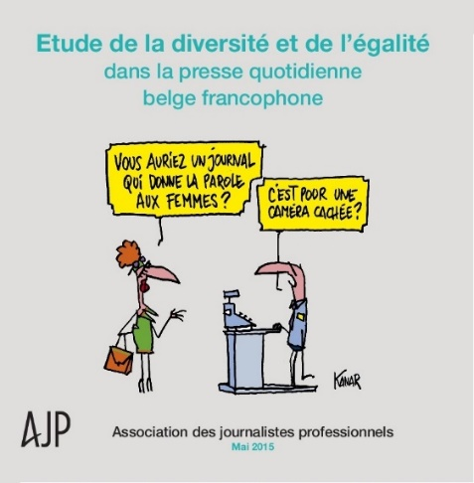
Research and Studies
Media Content
Journalism
2010
2015
2013
2011
2013-2014

Slide 6
Media analysis: Recurring and converging findings
Underrepresentation of women
Especially invisibles in « sports », « politics », « economics/finances »
Women mostly occupy supporting roles
Nearly 9 experts out of 10 interviewed are men
Women are nonetheless equally represented until the age of 20… then they disappear

Slide 7
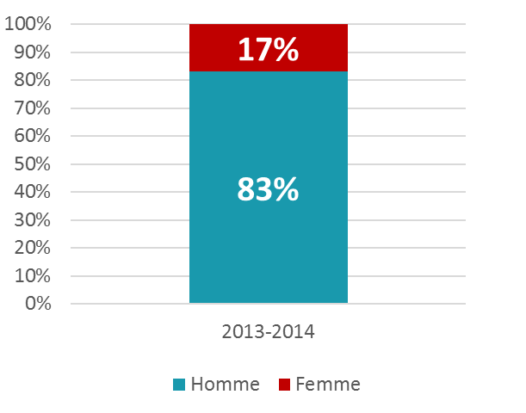
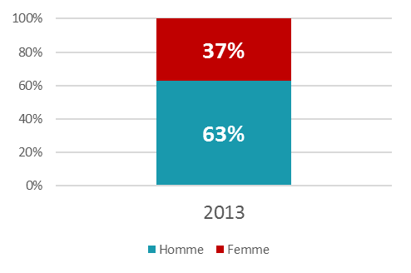
Women’s representation in the media
In the daily press
In audiovisual media
Figures from AJP and CSA (Belgium)
2014 www.ajp.be/diversite

Slide 8
Women’s representation in the media (2)

Slide 9
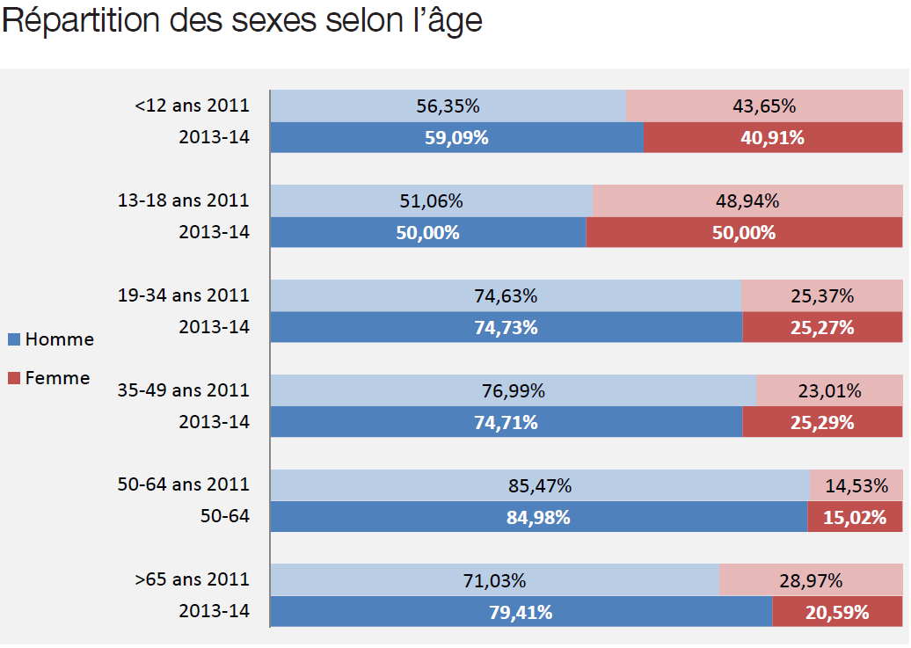
Gender distribution by age

Slide 10

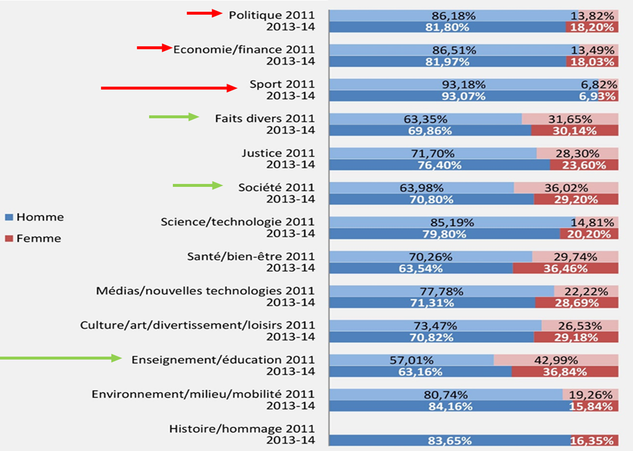

Slide 11
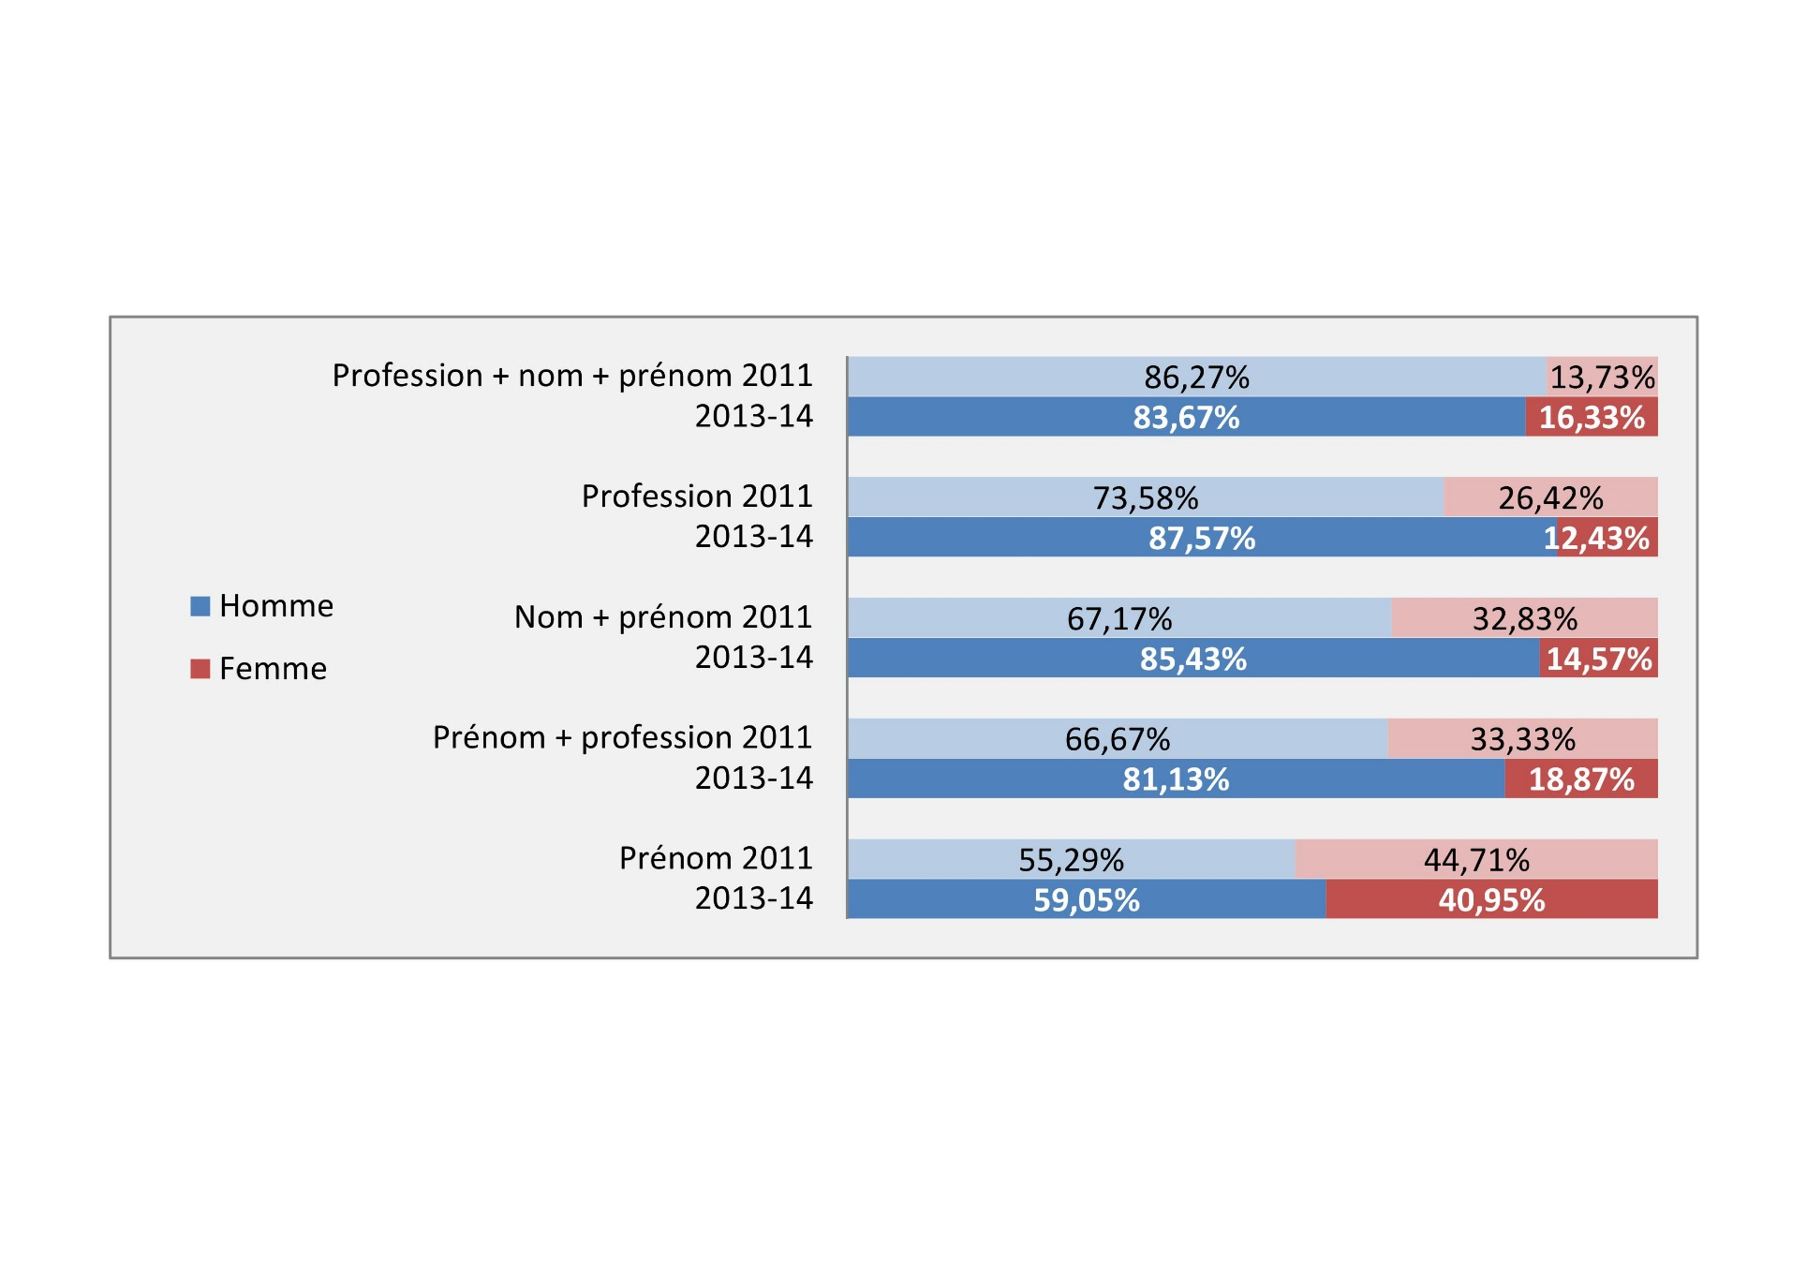
Gender distribution by identification

Slide 12
From observation to action
Follow and et document content analysis= awareness of professionals.
New AJP barometer written press: fin 2018.
Students in journalism= privileged target audience
Journalists and media directorates : permanent training
Media : promote quantified indicators (barometers) by show, types of programs with set quantified targets
Public service media: equality plans with quantified indicators + action plans = gender equality policy

Slide 13
Journalistic profession: Where are the women?
Distribution of women and men by age group (in%) in Belgium
Figures from the 2013 Belgian study on the profile of journalists
(UGent/ULB)

Slide 14
Hierarchy : 2 to 3 times more men
Percentage of men and women for each hierarchical position

Slide 15
Career and seniority
15 years on average for women, 19 for men
41% of women have seniority ≤ 10 years, for 22% of men
Respondents are less likely to have children(63% against 80% of men)
Difficult for women to lead a parental life whilst working as a journalist
The job is time-consuming and involves more radical life choices (private and professional) for women
The rigid working conditions prevent a balanced private/professional lifestyle

Slide 16
Journalistic profession: to investigate and promote
Provide a clear and scientific diagnosis of obstacles/problems/… that women encounter in their career
→ New study in progress (AJP/ULB)
Advocate a short-term action plan with quantified indicators for media companies
Sensitize female students and young women journalists on the inequalities of the job market and offer them adequate answers
Support actions of « mentoring » and « permanent trainings»
Pay attention to the new challenges of digitalization and more specifically cyber-harassment of women journalists

Slide 17


From observation to action
Expertalia : a tool for journalists
www.expertalia.be

Slide 18
The origin of Expertalia
Respond to the deficits and shortcomings observed in women presence and people from a variety of backgrounds (identical findings)
Chosen axis : expertise
Offer journalists a tool to facilitate the diversification of sources that favors equality and diversity
Provide a pragmatic answer to the usual saying “ there are no expert women…” or “ there are no experts with various backgrounds”
Identify and present expert women and experts from diverse origins
Inspirations : www.expertendatabank.be; www.expertisa.lu ; « expert women » (BBC)

Slide 19
From observation to action
Expertalia is an initiative of the Association of Professional Journalists for journalists → Legitimacy
Draws on recent media analyzes, based on an indisputable methodology → Rationality
Avoid value judgments, aiming for quality, diversified sources, angles, …→ professionalism
Aim : make media and journalists allies in the fight for equality and parity

Slide 20
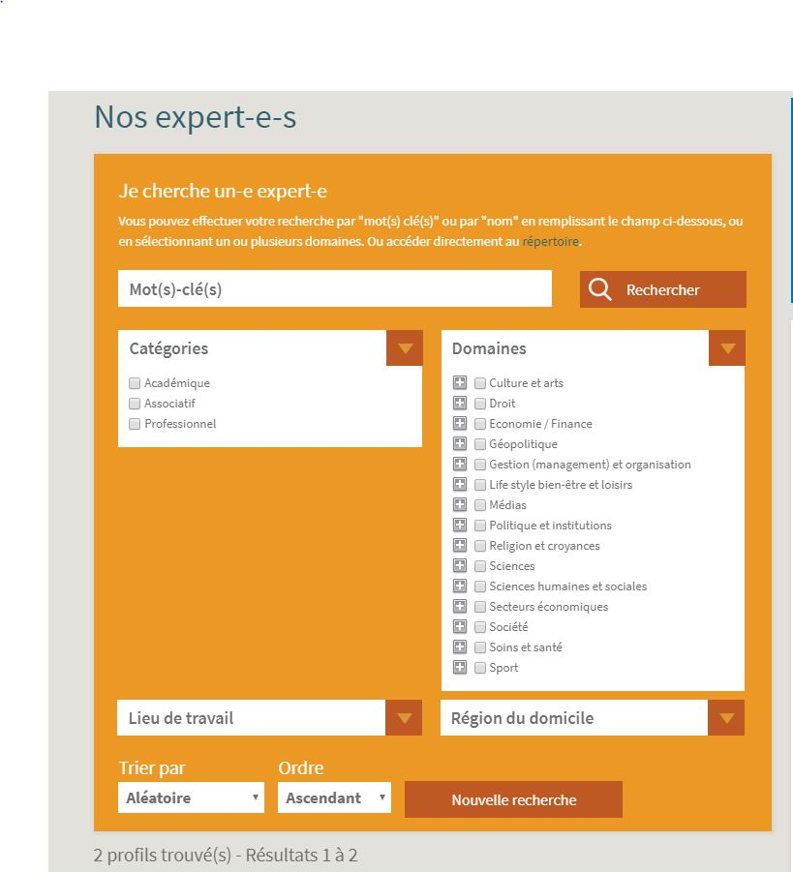
Expertalia, instruction manual
Currently 370 experts
250 Belgian journalists use Expertalia
Group of experts: academic, professional, associative
Detailed information per expert
Contact details
Photo/video
Publications

Slide 21
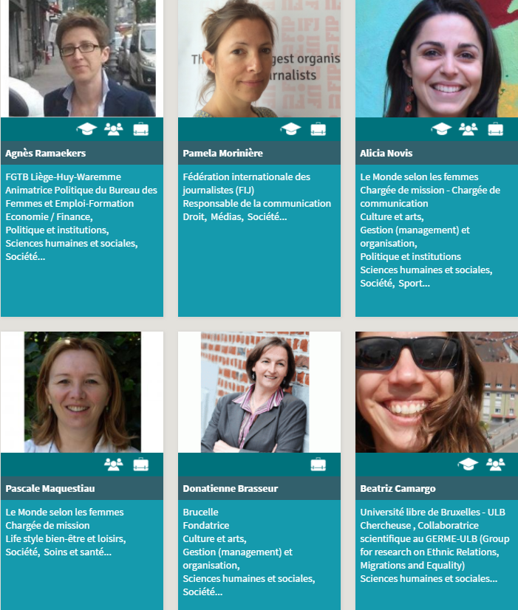
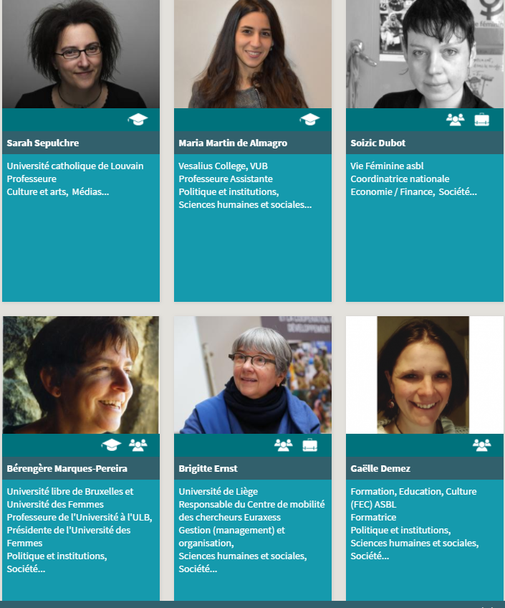
Example– keyword « Gender »

Slide 22
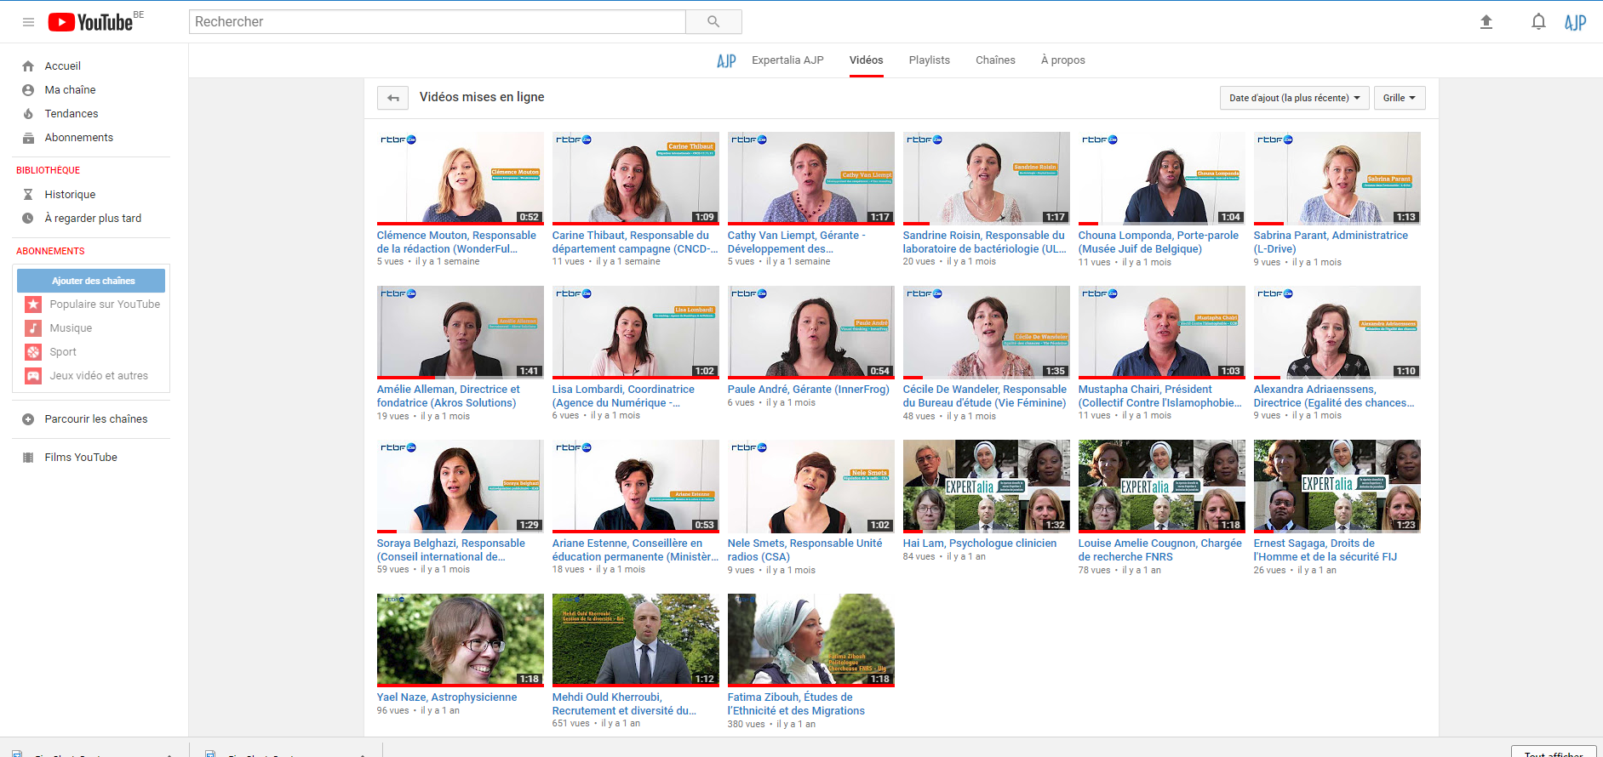
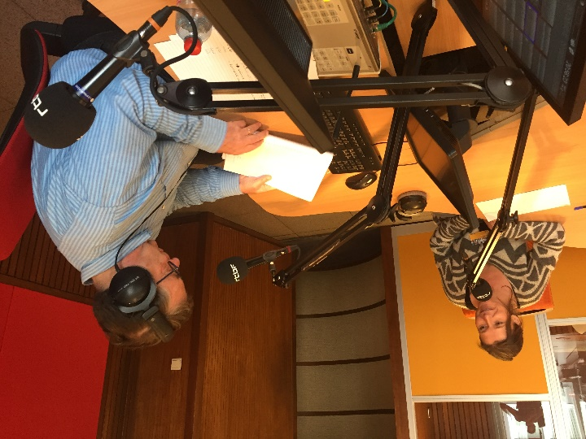
Partnership Expertalia / RTBF
Partnership with RTBF :
Expert media coaching+ production of videos
https://www.youtube.com/channel/UC6wVBuvHQZsE-LBigAedlbQ

Slide 23

Partnership Expertalia Agence Entreprise innovation (AEI)
Promotion of women entrepreneurs : information, profile, interview, media coaching, videos

Slide 24
Perspectives: to investigate and promote
Raising awareness of self-regulatory bodies : Ethics always pays little attention to equality issues!
Sensitize regulators and legislators
Studies on pay gaps in the journalistic profession
Studies on the presence of women : it is time to have update figures!
Investigate violence against women in the workplace

Slide 25
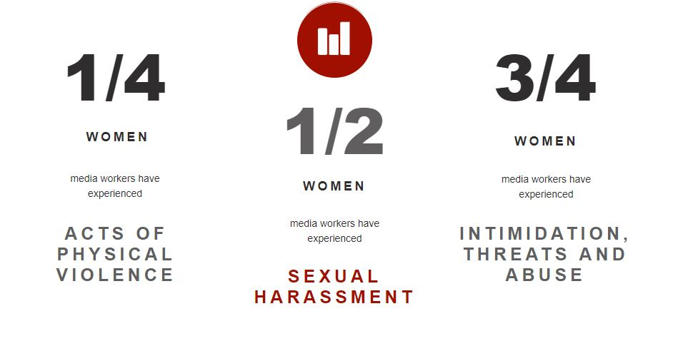
Perspectives: to investigate and promote
Fighting gender-based violence in the workplace – International Federation of Journalists (IFJ) campaign

Slide 26
Thank you for your attention
Association of Professional Journalists:
Find out about our studies and actions on
www.ajp.be/diversite
Wallonia-Brussels Federation of Belgium
Directorate of equal opportunities
www.egalite.cfwb.be – egalite@cfwb.be

