Slide 1
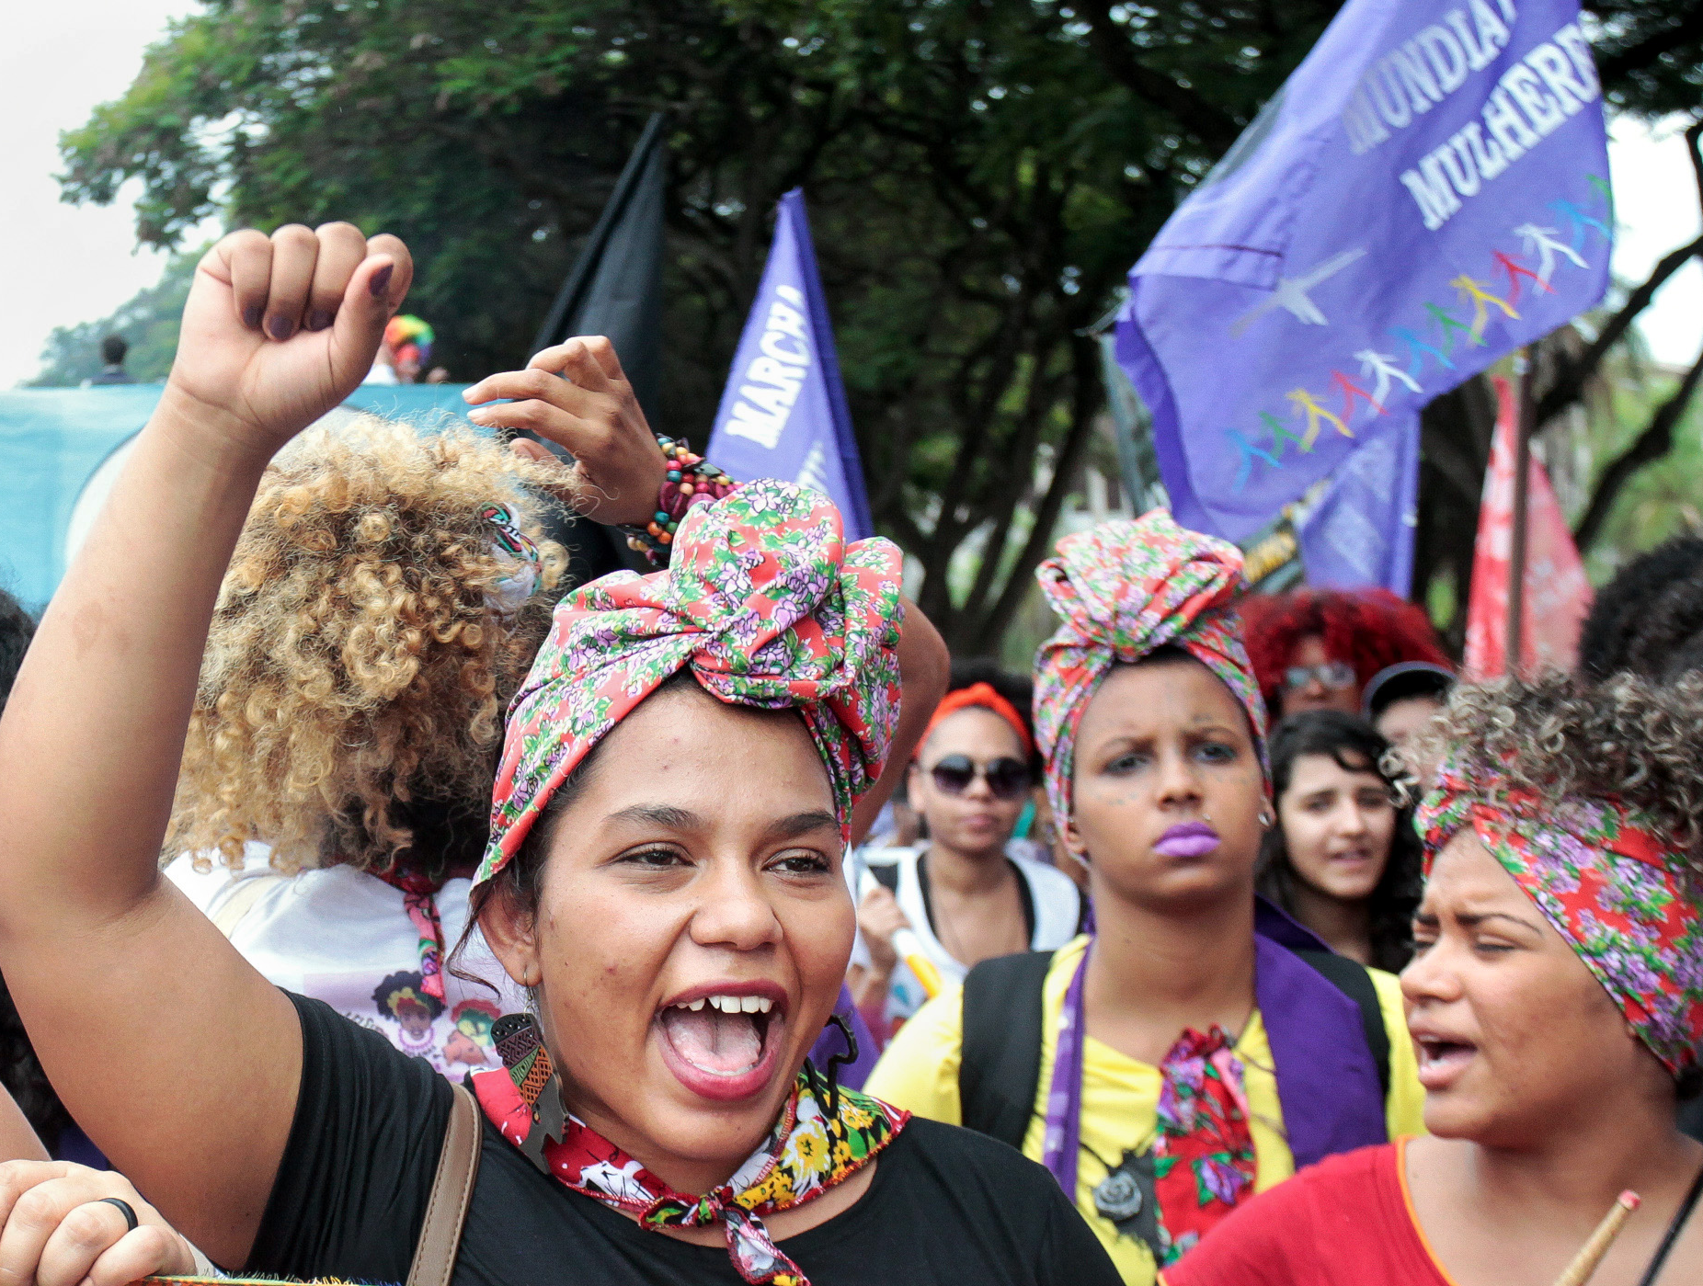

ACT GLOBAL Civil Society PLATFORM EVAW
Pre-proposal conference
24 June 2024
08.30-10.00AM
Photo | UN Women/Bruno Spada

Slide 2
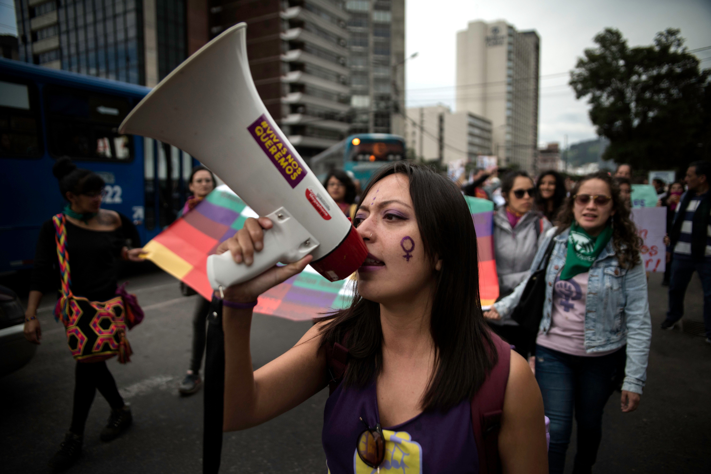
Agenda
1. UN Women Presentation (20-25 mins)
Background on the ACT Global Civil Society Platform call for proposals and expected results
Selection and eligibility Criteria
Mandatory documents to submit
Tips to write a quality proposal
2. Q&A session (1 hour)
3. Next Steps (5 mins)

Slide 3

HOUSEKEEPING

Slide 4






Brief OVERVIEW of the Call for Proposals
WHAT?
👉 As part of the ACT Programme, UN Women is looking to identify a Responsible Party to establish and lead a new ACT Global CSO Platform on EVAW.
APPLY AT:
WHEN TO APPLY?
Deadline: 08 July 2024, 11:59 pm (New York time)
act@unwomen.org
WHO? ​
👉Global, regional Women’s Rights Organization (WRO) or consortium of organizations with diverse areas of expertise.
HOW LONG?
👉 Partner agreement duration:
Approx. 1st of September 2024 to 30th of June 2026
HOW MUCH?
👉 Max. of 830,000 USD
Only one application per organization / consortium will be accepted.​

Slide 5
Background on the ACT Global Civil Society Platform on EVAW

Slide 6

Brief OVERVIEW OF ACT programme
Joint Commitment between European Commission and UN Women to Action Coalition on GBV.
22 million Euro financial commitment by the EC
Focus on Africa and Latin America & global component
This call for proposals for the set-up and co-hosting a new ACT Global CSO Platform is part of the global component of the ACT Programme.
Objective 1
Objective 2
Strengthen coalition building, networking, leadership and resilience of global and regional feminist women’s rights movements.
Strengthen advocacy, campaigning and influence policymaking on EVAW through multi-stakeholder partnerships and coalitions.
For more information on the ACT Programme visit: https://www.unwomen.org/en/what-we-do/ending-violence-against-women/act

Slide 7

Key OBJECTIVES OF THE ACT Global CSO PLATFORM ON EVAW
To facilitate networking, strategizing and coalition building between WROs across regions.
To strengthen global advocacy on EVAWG through consensus building around a shared advocacy agenda.
To elevate and amplify the voices and advocacy priorities of grassroots WROs and survivors.
To strengthen solidarity and collective care in pushing forward against the pushback.
To facilitate intersectional and intersectoral alliances to foster partnerships between WROs and CSOs across diverse sectors.

Slide 8
Membership
Membership will be open to all women’s rights and feminist organizations working towards EVAWG committed to a shared advocacy agenda.
Potential members should either (i) work in EVAWG advocacy; (ii) work at the intersection of EVAWG and other intersectional issues such as LGBTQI, disability rights etc., (iii) work at the intersection of EVAWG and other sectoral issues such as digital rights and climate justice.
Once in place, the ACT CSO Platform, with support from UN Women, will invite WROs to join the platform and will manage membership engagement and coordination.

Slide 9
ROLE OF UN WOMEN
UN Women will serve as a strategic partner to the ACT CSO platform and as a co-convener. This includes:
Facilitating high-level political engagement
Building bridges and facilitating collaboration with other multistakeholder platforms
Facilitating engagement and collaboration with the EDVAW Platform of Independent Expert Mechanisms on Violence against Women
Build bridges between CSOs and other sectoral actors
Supporting the development of strategic communication and resource mobilization for the Platform
Convening CSOs during key strategic moments

Slide 10
ROLE OF PROGRAMME PARTNER/CONSORTIA & RESULTS EXPECTED
Create space for solidarity and sharing experience and knowledge:
    Create a space for feminist networking, strategizing and co-creating
    Fostering cross-regional learning
    Supporting collective care and solidarity action in response to pushback
    Facilitating skill sharing and capacity strengthening including through intersectional and intersectoral alliances
Coordinate EVAWG advocacy and develop strategic partnerships and alliances:
Developing and implementing shared advocacy agenda and an action plan with strategic actions at key advocacy moments
    Coalition building, forging strategic partnerships and alliances with other organizations and relevant stakeholders to advance and amplify joint advocacy agenda
Develop and implement communication strategy in partnership with UN Women.
    Co-creating and implementing a comprehensive strategic communications plan to amplify advocacy priorities and to mobilize support, engage relevant stakeholder and influence decision makers
SEE PAGES 5-8 OF THE TORs IN THE CFP FOR A FULL DESCRIPTION OF FUNCTIONS AND FOR INDICATORS OF SUCCESS.

Slide 11
Selection and eligibility Criteria

Slide 12
ELIGIBILITY CRITERIA – Please See mandatory requirements/pre-qualification criteria in Annex B-1
1. Must be a global or regional women’s rights/feminist organizations or consortium with expertise, experience and capacity as outlined in the required competencies
2. If applying as a consortium, the proposal must specify which organization is the lead organization and which organizations are sub-partners. The lead organization must meet the mandatory requirements/pre-qualification criteria in Annex B-1 of the call for proposal
3. Legal status and registration (5 years), exceptional circumstances 3 years
Applicants also need to provide the legal registration documents of sub-partners
4. Demonstrated operational, financial, and technical experience for a project of this size/scope
N.B. If the organization or consortia is backed by a fiscal sponsor, the fiscal sponsor cannot outsource all the work and must meet the mandatory requirements including the technical requirements.

Slide 13
Required competencies refer to page 8 of the TOR’s
Must be a global or regional women’s rights and feminist organization or a consortium with proven expertise, experience and capacity to:
  Convene women’s rights organizations across regions globally
  At least 5 years of experience in the field of ending violence against women and girls. In exceptional circumstances three years of experience may be accepted
  At least 3 years of experience in engaging in global advocacy and policy analysis on EVAWG
  At least 3 years of experience in movement building and coordination, including the ability to manage different stakeholders and create consensus-building
  Capacity to bring together women’s rights and feminist organizations and co-create strategies and tactics to advance a collective advocacy agenda
  Experience in strategic communications. This includes developing advocacy campaigns and awareness raising
  Experience with and capacity to carry out grant management, if grantmaking is included in the proposal
  Experience in Partnership Development, including experience engaging with different stakeholders

Slide 14

INELEGIBILITY CRITERIA
The following are NOT eligible under this call for proposals:
Organizations that do not meet the mandatory requirements/pre-qualification criteria as outlined in Annex B-1
Organizations that do not have the required experience and capacities as outlined in the required competencies section of the terms of reference within the Call for Proposals
Organizations who work primarily at the country level will not be considered
Government agencies or institutions, UN agencies or UN Country Teams, Private individuals and Private sector entities. Universities registered as a Civil Society organization are eligible but private and government Universities cannot apply
Organizations that do not have the legal basis as an organization or that cannot provide legal registration documents
Notes:
Organizations or consortia that do not meet the mandatory requirements/pre-qualification criteria outlined in Annex B1 that we just reviewed in previous slides will not advance to the next stage which is the evaluation of technical and financial evaluation.
Important to note that organizations working at the country level will not be eligible for funding under ACT – the current resources are from an EU fund which is not eligible for funding country level organizations.

Slide 15
Mandatory documents to submit as part of proposal

Slide 16

The following documents need to be submitted as part of the application
Submit completed Annex B-1 (must be completed by the lead organization)
Evidence of being a women’s rights, women-led and/or constituent-led organization
Evidence of specialized knowledge and expertise (with dates and duration) on:
  At least five years of experience in the field of ending violence against women and girls
  At least 3 years of experience in engaging in global advocacy and policy analysis on EVAWG
  At least 3 years of experience in movement building and coordination, including the ability to manage different stakeholders and create consensus-building
Legal registration (lead and consortium members if any)
Two reference letters demonstrating a track record of your experience/expertise
Submit all the mandatory documents under Annex B-4 (see next slide)
Audited statements referred to under Annex B-4 should cover years 2021, 2022 & 2023
Notes:
In terms of the mandatory documents to include as part of your application, please make sure to provide the following documents – your application will not be considered further without these documents:

Slide 17
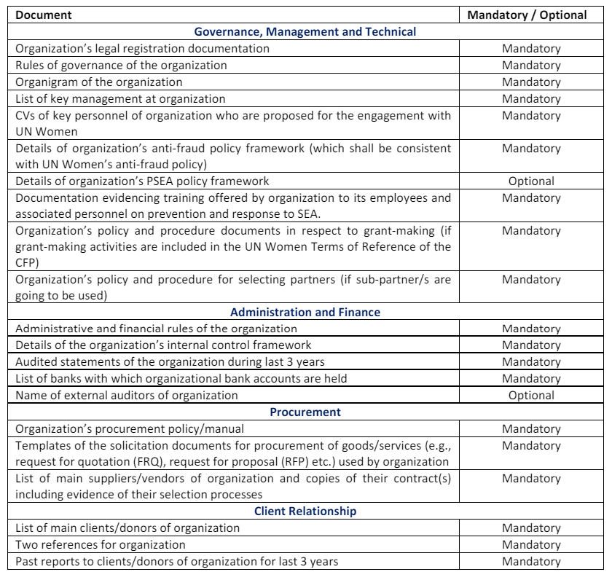
Annex B-4
Notes:
For consortia, parties should undertake a self-assessment (on technical and financial fronts) before nominating the lead organization.

Slide 18
KEY COMPONENTS TO BE INCLUDED
Organizational Background and Capacity to implement activities to achieve planned results (max 1.5 pages)
2. Expected Results and Indicators (max 1.5 pages)
3. Description of Technical Approach and Activities (max 2.5 pages)
4. Implementation Plan (max 1.5 pages) including Monitoring and Evaluation plan (max 1 page)
5. Risks to Successful Implementation (max 1 page)

Slide 19
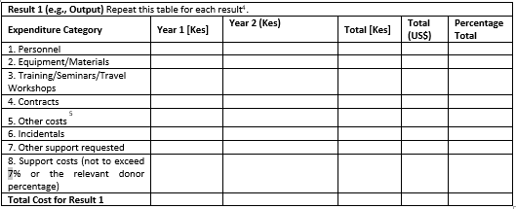
Component 6: Results Based Budget
Maximum for personnel related costs on a proposal - 20% of programming costs;
Between 3-5% for audits (to be retained by UN Women for Responsible Party audits) (may change as per the annual audit cost);
3% for monitoring and evaluation; and
Up to 7% (as per EU requirements) – support costs including (utilities, rent and other operational costs not directly connected to project.).
Notes:
Compliance and clarity in budgeting: Develop a detailed budget with the maximum limit of 830,000 USD, justifying each budget item and ensuring it reflects the scope and objectives of the platform
Support Costs mean those indirect costs that are incurred to operate the Partner as a whole or a segment thereof and that cannot be easily connected or traced to implementation of the Work

Slide 20
EVALUATION OF PROPOSALS
Pre-qualification
(Pass/Fail)
Technical Evaluation (70 points)
Financial Evaluation (30 points)
Notes:
Important to reiterate that only the proponents that meet the mandatory requirements will advance to the technical evaluation.
Those that do not meet the pre-qualification /mandatory criteria will not be considered.
The technical evaluation will consider the proposal in relation to requirements and results set out in the terms of reference. A maximum of 70 points may be determined at this stage and a minimum technical score of 50 points is required to advance to the financial evaluation.
The financial evaluation will evaluate the results-based budget submitted with the proposal and the lowest evaluated cost will be awarded 30 points. Other financial proposals will receive pro-rated points based on the relationship of the proponent’s prices to that of the lowest evaluated costs.

Slide 21
Tips FOR the preparation of a quality proposal

Slide 22
Tips FOR A quality proposal
Align proposal to the expected results: Scope of proposal must be aligned to expected results & cover work and functions outlined in the CFP. Pay special attention to the key indicators of success.
Leave No One Behind: Outline how intersectional alliances will be established and ensure meaningful engagement of WRO’s, survivor groups, CSO’s representing women and girls in all their diversity in order to leave no one behind.
Consensus building: Describe how diverse perspectives will be considered and balanced. Facilitate consensus building on contentious issues in the development of the shared advocacy agenda.
Strategic and results-oriented advocacy plan: Include key strategic advocacy moments & strategies to mobilize support & accelerate action on EVAW globally, regionally and at country level.
Country level engagement: Highlight strategies for ensuring strong connections and engagement with women’s rights movements at the national level.
Notes:
1. Align proposal to the expected results: Scope of proposal must be aligned with the expected results and cover the scope of work and functions outlined in the terms of reference in the CFP. Include clear and specific problem statement or challenges to be addressed and clear and specific outline of what the proposal will accomplish in relation to UN Women’s TORs including the specific results/outputs. Pay special attention to the key indicators of success outlined in pages 5-7 and remember to include all the different components outlined in the TORs that we saw in slide 18 such as the expected results and indicators, implementation plan, sustainability plan, M&E plan, results-based budget etc.
2. Pay special attention to inclusion, diversity and intersectionality: Proposal should outline how intersectional alliances will be established and meaningful engagement of women’s rights organizations, survivor groups, civil society organizations representing women and girls in all their diversity (LGBTQ, indigenous and afro-descendent women, young women, women with disabilities in order to leave no one behind to ensure that policy advocacy is grounded in the lived experiences of women and girls.
3. Consensus building: The proposal should outline how it will work to ensure that the platform respects and is inclusive of organizations with diverse perspectives and facilitates consensus building on contentious issues in the development of the shared advocacy agenda.
4. Strategic and results-oriented advocacy plan: The proposal should outline key strategic advocacy moments and strategies to successfully mobilize support and accelerate action on EVAW efforts globally, regionally and at country level. Not just awareness raising events, but a range of strategies should be considered.
4. Country level engagement: Although this initiative is focused on global and regional advocacy and coalition building the proposal should highlight strategies for ensuring strong connections and engagement with women’s rights movements at the national level to ensure that global advocacy is informed by grassroots women as well as to generate impact at the country level.

Slide 23
Questions and answers

Slide 24
NEXT STEPS
Publication of presentation & summary of Q&A in this session | Will be uploaded to the website shortly after the conference
Deadline for any further questions | July 1, 2024
Deadline for publication of all final responses | Final consolidated responses: to be published on July 3, 2024 Kindly note that we have been periodically updating responses to individual questions on the website here.
Deadline for CFP | July 8, 2024
act@unwomen.org

Slide 25
ASANTE/ THANK YOU/MERCI/ GRACIAS

